Slide 1
VCE PSYCHOLOGY
Reconstructing Memory
Study design dot point
The reconstruction of memories as evidence for the fallibility of memory, with reference to Loftus’ research into the effect of leading questions on eye-witness testimonies

Slide 2
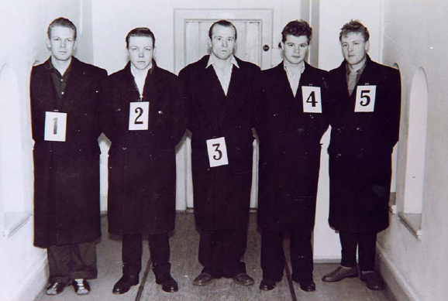
Wikipedia Commons
© Kristy Kendall & Edrolo 2017
Notes:
Image ref: https://upload.wikimedia.org/wikipedia/commons/0/04/Oppstilling-2.jpg

Slide 3
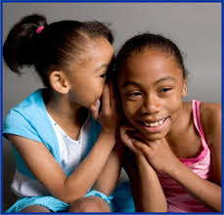
Reconstructive nature of memory
Memory is fallible
Memory is subject to personal interpretation it is dependent on a range of factors including cultural norms, emotions and values.
People store information in the way that makes the most sense to them
This is an explanation of memory which suggests that when you recall past experiences, you complete missing information by inventing some of the details, or they incorporate information received after the event in order to have a memory that ‘makes sense’.
If the process of forming a memory in the first place is construction, then every time you recall it from LTM it is a reconstruction of the original memory and those original memory traces.
https://c1.staticflickr.com/9/8383/8492516706_b989d31c76_b.jpg
© Kristy Kendall & Edrolo 2017

Slide 4
Eye witness testimony
This is a legal term referring to an account given by someone of an event that they have witnessed, such as the identification of perpetrators or details of a crime scene. These are generally used in criminal cases where individuals have to give a description of a crime to the police or the court.
Many studies that show there is much error in eye witness testimony.
Eye witness testimony has a large impact on a jury, and can lead to wrongful convictions.
Why is there error in eye witness testimony?
One major cause of the failure of eyewitness testimony lies in the reconstructive nature of memories.
Usually the eyewitness sees the perpetrator for only a few seconds, often in very poor viewing conditions such as in shadow or dim light, partially obscured or from a distance. When asked to describe the scene and the perpetrator, therefore, the witness will build on their own expectations
Check out this ‘crime’ and see how strong eye witness testimony is (4.35 min): https://www.youtube.com/watch?v=rSzPn9rsPcY

Slide 5
The longer the delay between the event and when they try to remember it, the less complete and accurate the account will be. According to the decay theory, it would be expected that some information would be lost, as a person’s memory of accidents or crimes would fade when there is a long delay between witnessing a crime and being asked to retrieve them memory of it.
If there are gaps do occur in a person’s memory, he or she may reconstruct it. This may involve filling in the missing information by making up some of the details in order to achieve a memory that ‘makes sense’ according to our attitudes and expectations about a particular event or person. This could include racial or gender bias. Media items, previous memories and stories may also cause reconstruction of memories.
Loftus has argued that, because of the reconstructive nature of memory, eyewitness memory is extremely unreliable because information from external sources received after the witnessed event can be incorporated into memory,

Slide 6
Leading questions
A leading question is a question that prompts an individual to answer in a particular way.
‘Did you see the defendant running from the scene of the crime?’ suggests that the defendant was at the scene.
‘Did you see anyone running from the scene of the crime?’ does not identify any individual.
Court
Teachers
Parents
A number of research studies have shown that people’s memories of events can be affected by leading questions, which direct the witness towards the response desired by the questioner. “Objection! Leading the witness!”
Leading questions can cause misinformation to be implanted into the memory of a witness.

Slide 7
Misinformation effect
During questioning in court or, prior to that, during the police investigation, it is possible for misinformation to be implanted in the witness’s memory.
This can gradually take on greater significance for the witness until they begin to believe that the implanted information was a genuine memory.
This is known as the misinformation effect.
Loftus and Palmer (1974) demonstrated this in an experiment where they showed participants a video of a motor accident, after which they interrogated them as if they were being cross-examined in court.

Slide 8
The work of Elizabeth Loftus (1974)
Participants viewed a video and then were asked questions immediately after
The speeds reported by the participants, presented in Table, showed that the more the word implied increased severity, the greater the estimate of the speed.
One week later, the participants were asked, ‘Did you see any broken glass in the accident?’ (there was no broken glass
Words used to describe the collision | Estimated speed (kph)
Contacted | 46.59
Hit | 54.74
Bumped into | 61.34
Collided with | 63.27
Smashed into | 65.69
WORD USED TO DESCRIBE COLLISION | PERCENTAGE REPORTING BROKEN GLASS
‘Hit’ | 14
‘Smashed into’ | 32

Slide 9
Harris (1975) also demonstrated this by asking participants questions such as
‘How tall was the basketball player?’, which drew an average 200.7 centimetres as opposed to ‘How short was the basketball player?’, which resulted in a mean response of 175.3 centimetres. This is a difference of 11.5 per cent.
Other questions showed similar results:
The mean response to the question ‘How long was the movie?’ was 130 minutes while ‘How short was the movie?’ elicited a mean response of 100 minutes.
The mean response to the question ‘Do you get headaches occasionally? If so, how often?’ was 0.7 times per week while ‘Do you get headaches frequently? If so, how often?’ had a mean response of 2.2 times per week.
It is clear from the examples given above that eyewitness testimony should be regarded with scepticism by judges, juries and the general public.
Even when the eyewitness is convinced that they are correct, research has shown there can be considerable differences between reality and recall.
Yet the vast majority of judges and prosecutors believe that a conviction should be possible even if the only evidence available is eyewitness testimony.

Slide 10
Fast five – Question 1
Memories are not exact replicas of the world because they are based on personal interpretation, what is this is known as?
© Kristy Kendall & Edrolo 2017

Slide 11
Fast five – Question 1 (Answer)
Memories are not exact replicas of the world because they are based on personal interpretation, what is this is known as?
Answer:
Reconstruction
© Kristy Kendall & Edrolo 2017

Slide 12
Fast five – Question 2
True or false: Memory is influenced by factors such as emotion.
© Kristy Kendall & Edrolo 2017

Slide 13
Fast five – Question 2 (Answer)
True or false: Memory is influenced by factors such as emotion.
Answer:
True
© Kristy Kendall & Edrolo 2017

Slide 14
Fast five – Question 3
Which researcher is well-known for their work investigating eye witness testimony?
© Kristy Kendall & Edrolo 2017

Slide 15
Fast five – Question 3 (Answer)
Which researcher is well-known for their work investigating eye witness testimony?
Answer:
Loftus
© Kristy Kendall & Edrolo 2017

Slide 16
Fast five – Question 4
What kind of questions prompt an individual to answer in a particular way?
© Kristy Kendall & Edrolo 2017

Slide 17
Fast five – Question 4 (Answer)
What kind of questions prompt an individual to answer in a particular way?
Answer:
Leading
© Kristy Kendall & Edrolo 2017

Slide 18
Fast five – Question 5
True or false: Memory is fallible.
© Kristy Kendall & Edrolo 2017

Slide 19
Fast five – Question 5 (Answer)
True or false: Memory is fallible.
Answer:
True
© Kristy Kendall & Edrolo 2017

Slide 20
Multiple choice activity
Studies by Loftus on the effect of misleading questions on eyewitness testimonies have found that
exposure to misleading questions has no impact on an eyewitness’s recollection of events.
it is unfair to expect eyewitness testimonies to be accurate, as people will remember only events that are positive.
eyewitness memories are reconstructions of events that can be manipulated by information that is given after the event.
eyewitness memories cannot be manipulated and therefore are highly reliable for use as evidence in court.
(VCAA 2013 Exam Section A Q8)
© Kristy Kendall & Edrolo 2017

Slide 21
Multiple choice (Response)
Studies by Loftus on the effect of misleading questions on eyewitness testimonies have found that
exposure to misleading questions has no impact on an eyewitness’s recollection of events.
it is unfair to expect eyewitness testimonies to be accurate, as people will remember only events that are positive.
eyewitness memories are reconstructions of events that can be manipulated by information that is given after the event.
eyewitness memories cannot be manipulated and therefore are highly reliable for use as evidence in court.
(VCAA 2013 Exam Section A Q8)
© Kristy Kendall & Edrolo 2017

Slide 22
Bringing it together
Reconstructing Memory
Study design dot point
The reconstruction of memories as evidence for the fallibility of memory, with reference to Loftus’ research into the effect of leading questions on eye-witness testimonies
© Kristy Kendall & Edrolo 2017

Slide 23
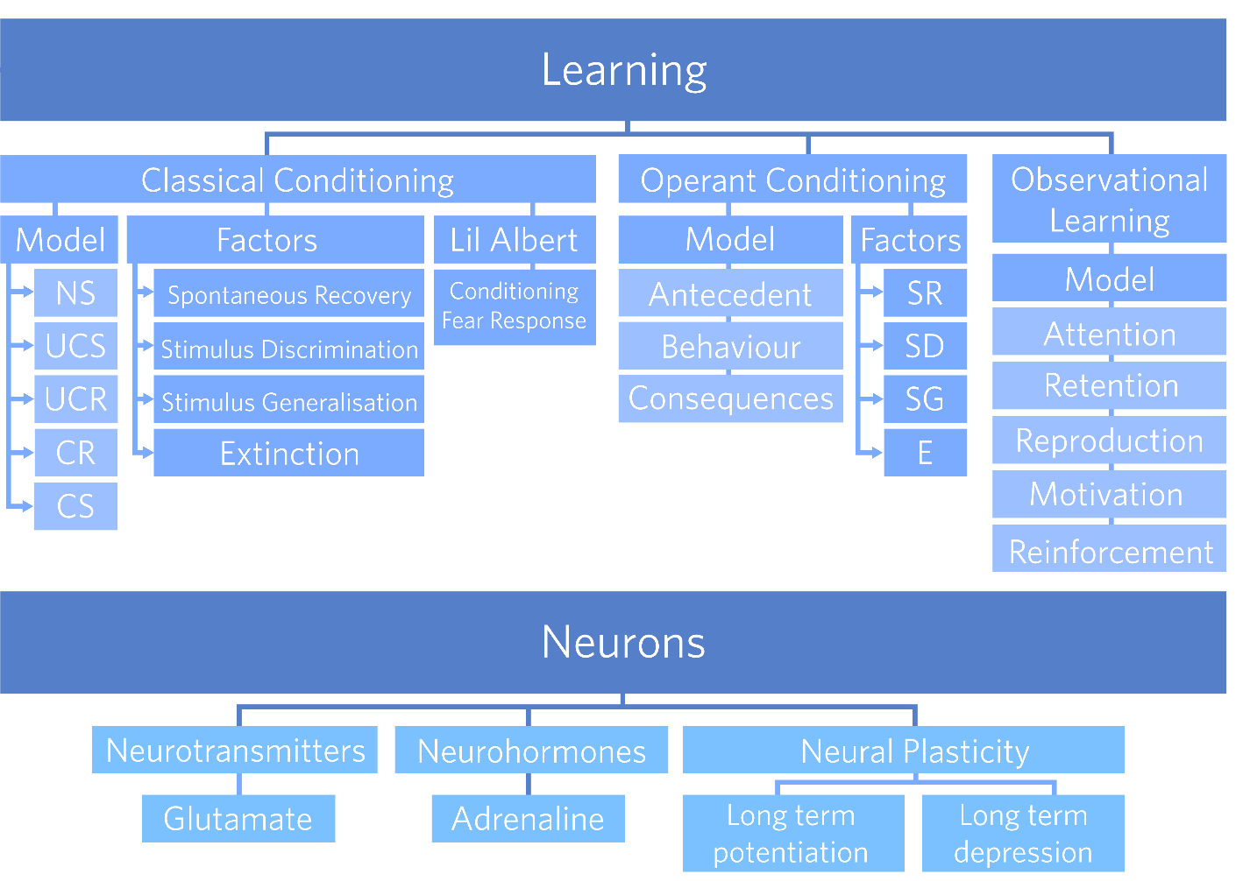
Notes:
Hi KK, you’ve got a choice of concept map layouts on the next two slides. Pick whichever you like more.

