Slide 1
Psychology
REVISION LECTURE

Slide 2
UNIT 3 AREA OF STUDY 1
How does experience affect behaviour and mental processes?

Slide 3
NERVOUS SYSTEM
FUNCTIONING

Slide 4
Nervous System Functioning
the roles of different divisions of the nervous system (central and peripheral nervous systems and their associated sub-divisions) in responding to, and integrating and coordinating with, sensory stimuli received by the body
the distinction between conscious and unconscious responses by the nervous system to sensory stimuli, including the role of the spinal reflex

Slide 5
Human Nervous System
CENTRAL NERVOUS SYSTEM
PERIPHERAL NERVOUS SYSTEM
BRAIN
SPINAL CORD
SOMATIC NERVOUS SYSTEM
AUTONOMIC NERVOUS SYSTEM
SYMPATHETIC NERVOUS SYSTEM
PARASYMPATHETIC NERVOUS SYSTEM

Slide 6
Main divisions of the nervous system...
CENTRAL NERVOUS SYSTEM
Consists of the brain and spinal cord
The spinal cord:
transmits sensory information along sensory neurons from the PNS to the brain
transmits information from the brain to the PNS, activating motor neurons
PERIPHERAL NERVOUS SYSTEM
Links the CNS to other parts of the body
is divided into the Somatic NS and Autonomic NS

Slide 7
Divisions of the PNS
SOMATIC NERVOUS SYSTEM
Transports messages between sense organs and the spinal cord
Controls voluntary bodily movement via connections with the skeletal muscles
No control over non-skeletal muscles (heart, lungs, stomach or intestines
Involves sensory (afferent) and motor (efferent neurons) SAME

Slide 8
Spinal Reflex
Function of the spinal cord, which mediates between the sensory and motor parts of the SNS
This enables the spinal reflex (or reflex arc) which is an automatic response to sensory stimuli
Reflex action occurs without the brain initially
Pain receptors are stimulated triggering sensory neurons to communicate with the spinal cord
Passes through interneuron in SC to motor neuron, to flex muscles to remove from object
Message also goes to the brain to register painful sensation

Slide 9
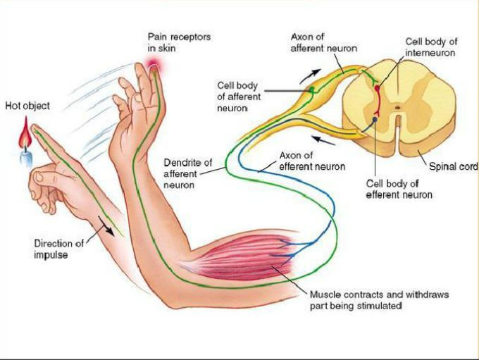

Slide 10
Divisions of the PNS
AUTONOMIC NERVOUS SYSTEM
Controls involuntary bodily activities (digestion, heart rate)
Divided into
SYMPATHETIC NS - initiates some responses and inhibits others to mobilise or immobilise the body as part of the fight-flight-freeze when threatened
PARASYMPATHETIC NS - conserves bodily functions by restoring the body to homeostasis

Slide 11
FIGHT-FLIGHT-FREEZE…
Sympathetic Arousal
Arousal is the overall alertness of an organism
F-F-F is triggered by the hypothalamus, activating the sympathetic NS
Responses include:
Increased adrenalin
Increased heart rate and blood pressure
Increased respiration
Increased muscle tension
Sweating (electrical conductivity of the skin)
Inhibited digestion
Dilated pupils
Dry mouth (inhibited saliva production)
Sugar released from the liver
Increased need to urinate (relaxed bladder)

Slide 12
Nervous System Functioning
the role of the neuron (dendrites, axon, myelin and axon terminals) as the primary cell involved in the reception and transmission of information across the synapse
the role of neurotransmitters in the transmission of neural information between neurons (lock-and-key process) to produce excitatory effects (as with glutamate) or inhibitory effects (as with gamma amino butyric acid [GABA])

Slide 13
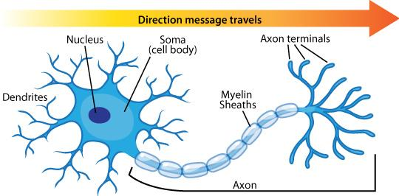

Slide 14
The Neuron - building blocks of NS
Transmit information in the form of neural impulses involving electrochemical reactions known as action potential
Action potential occurs due to the flux of ions across the membrane as is travels along the axon.
Electrical activity in axon is insulated and sped up by fatty layer called myelin sheath
Transmission of information from one neuron to the next requires the release of specialised neurotransmitters - a variety of chemicals capable of altering the activity of the neuron

Slide 15
The Neuron - building blocks of NS
Neurotransmitters are made and stored in synaptic vesicles in the axon terminal.
When the impulse reaches the terminal buttons (synaptic knobs), it triggers the vesicles to move to the surface of the pre-synaptic neuron and release the neurotransmitters
Neurotransmitters cross the synaptic gap between neurons and attach onto the receptor sites of the dendrites on the post-synaptic neuron
Neurotransmitters fit into specific receptor sites, the way a key fits in a lock, to ‘unlock’ the potential of the next neuron

Slide 16
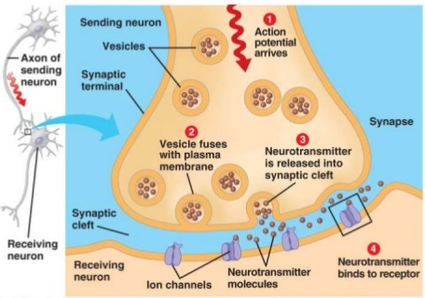
The Neuron - building blocks of NS
Depending on the chemical reaction at the dendrite receptor sites, there could be an excitatory effect (stimulates action potential in the post-synaptic neuron) or an inhibitory effect which prevents the action potential

Slide 17
The Neuron - building blocks of NS
EXCITATORY NEUROTRANSMITTERS
Nervous system’s ‘on switches’ - speed up neural activity and increase the likelihood that an excitatory signal is sent
Regulate basic bodily fuctions (F-F-F, motor movement & higher thinking) - natural stimulants; increase alertness, energy and activity
Without inhibitory systems, things can get out of control
Glutamate, dopamine, norepinephrine, acetylcholine

Slide 18
Glutamate - he’s your mate!
Major excitatory neurotransmitter
Used at the majority of fast excitatory synapses in the brain and spinal cord
Also used at most synapses that are ‘modifiable’, therefore involved in long term potentiation, creating links between neurons that form the basis of learning and long-term memory
Excess glutamate is associated with anxiety disorders, ADHD and even seizures

Slide 19
The Neuron - building blocks of NS
INHIBITORY NEUROTRANSMITTERS
Nervous system’s ‘off switches’ - decreases the likelihood that an excitatory signal is sent and slowing down neural activity
Physiologically, they act as natural tranquillisers, serving to induce sleep, promote calmness and decrease aggression
GABA & seratonin

Slide 20
GABA
Abbreviation for gamma-aminobutyric acid
Major inhibitory neurotransmitter in CNS
Plays a major role in regulating anxiety and reducing stress by calming the brain
Improves mental focus while calming the nerves
Excess of GABA could lead to sedation and impaired short-term memory

Slide 21
Nervous System Functioning
the effects of chronic changes to the functioning of the nervous system due to interference to neurotransmitter function, illustrated by the role of dopamine in Parkinson’s disease.

Slide 22
Role of dopamine in Parkinson’s
Dopamine is a major excitatory neurotransmitter
Functions are diverse - affecting memory, motor control and pleasure
Allows us to be alert and motivated and to feel satisfied
Parkinson’s disease is a progressive, degenerative neurological disorder that affects the control of body movements
Cells in the substantia nigra become impaired or die, which causes a deficiency in dopamine which is needed for smooth, coordinated function of movement
Loss of dopamine results in abnormal nerve-firing patterns in the brain

Slide 23
Parkinson’s Disease
Symptoms usually begin gradually and get worse over time
Main symptoms are:
Tremor (shaking and trembling) beginning in one hand usually then spreading to the leg
Most noticeable when stressed or tired
Rigidity or stiffness of the muscles
Pain or discomfort in an arm or leg
Anxiety and depression
Slowness of thinking, memory problems
Tiredness and disturbed sleep
Speech and swallowing problems later in the illness
Parkinson’s is incurable, drug therapy can alleviate symptoms, including dopamine stimulants

Slide 24
STRESS

Slide 25
Stress as a psychobiological process
sources of stress (eustress and distress) including daily pressures, life events, acculturative stress, major stress and catastrophes that disrupt whole communities

Slide 26
Stress
Stress involves prolonged levels of physiological arousal linked to the F-F-F response
Sympathetic NS prepares the body to deal with a stressor
Stressors are circumstances that are perceived as threatening or challenging to one’s wellbeing (daily pressures, life events, acculturative stress and major stress and catastrophes that can disrupt whole communities
Stress can have positive as well as negative effects
Stress can motivate us into action (eustress)
Stress can have negative and harmful effects (distress)
Acute stressors are more short term; chronic stressors induce a more long term effect

Slide 27
Physiological effects of stress
Adrenaline and noradrenaline stimulate the Sympathetic NS to activate and deal with immediate threat or challenge
These stress hormones speed up systems in the body to maintain alertness - prolonged release may lead to permanent changes in heart rate and blood pressure
Because of the increased ‘wear-and-tear’ on the body, cortisol is released to reduce inflammation, help repair muscles and speed up the healing process
Elevated levels of cortisol, if prolonged, can suppress the immune system

Slide 28
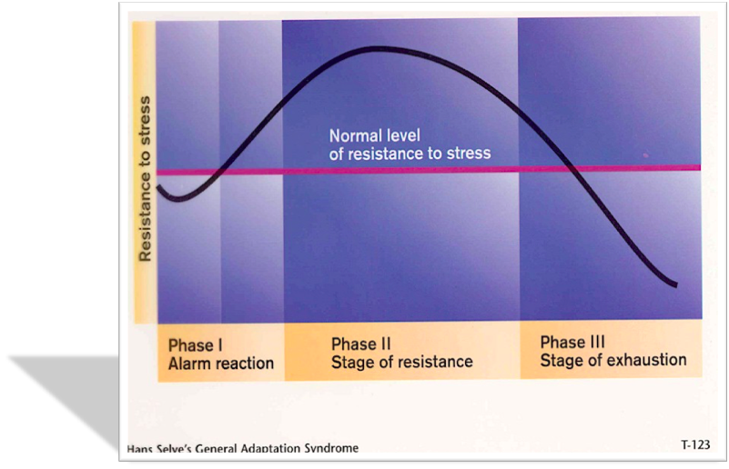
General Adaptation Syndrome

Slide 29
General Adaptation Syndrome
Hans Selye stated that the body seems to respond in the same negative manner to all different kinds of stressors (positive or negative), and that there are three different stages of ongoing stress
ALARM REACTION
First faced with the stressor
Body goes into shock and resistance to stress drops below normal
If the stressor is too overwhelming, ‘freeze’ may be initiated
Blood pressure and body temperature drop; muscle tone affected
Countershock then occurs when the sympathetic NS activates, mobilising resources to cope with the stressor (fight-flight)
Adrenaline and noradrenaline are released into the bloodstream - heart and respiratory rate increase
Headaches and stomach aches may be experienced

Slide 30
General Adaptation Syndrome
RESISTANCE - the second stage of GAS, the body adjusts to the stress through allostasis, and the normal level of coping rises
This is at high physical cost
Body is susceptible to other stressors
Ability to withstand infection is lowered over time
In most cases, stressors encountered are quickly and effectively dealt with and the organism’s state returns to normal.
If the stressor is not able to be dealt with however, and if stressors become more cumulative, then the individual will enter the exhaustion stage

Slide 31
General Adaptation Syndrome
EXHAUSTION - the final stage of the GAS, where the body’s resources are now depleted and resistance to stress has dropped dramatically below normal levels
Signs of the alarm reaction may reappear, but the effects of the stressor can no longer be dealt with
Resistance to disease is very weak, and it becomes vulnerable to physical and psychological illnesses.
While stress does not necessarily cause disease, a strong relationship has been established between chronic stress and the increased likelihood of contracting a psychosomatic illness.
Increased levels of cortisol also contribute the vulnerability of the body

Slide 32
Psychological determinants of stress
LAZARUS & FOLKMAN’S TRANSACTIONAL MODEL OF STRESS
Stress involves a transaction between the individual and the external environment
Coping will depend on the appraisal of the situation by the individual and their ability to cope
Stress is in the eye of the beholder - highly subjective

Slide 33
Transactional Model of Stress
Primary appraisal
Judge the significance of the situation
Is it irrelevant, benign-positive, stressful?
Harm/loss – imminent
Threat – might happen
Challenge – potential for growth
Secondary appraisal
Evaluate our coping options and resources
Internal and external resources - if the coping strategies are ineffective, then stress will occur
Situation can be reappraised

Slide 34
Transactional Model of Stress
Reappraisal
Going back over an earlier stressor to determine if it warrants further attention
Coping
Changing cognitive and behavioural efforts to meet stressors
An attempt to manage
Problem focused coping
Fix the source of the stress
Emotion focused coping
Strategies to deal with emotional responses to stress

Slide 35
Factors influencing stress - Social
Can influence the stress response
Relationships, lack of social skills, lack of support, bullied, discrimination, etc.
Social Readjustment – the amount of change in lifestyle after a specific event
Large changes can cause stress
Not all events are universally stressful
It does depend on the person’s perception and circumstances
EG. Leaving an abusive marriage would be less stressful than remaining married

Slide 36
Factors influencing stress - Cultural
Immigrants, refugees, asylum seekers
Acculturation – adapting the values customs and language of a new culture
Entering a new culture at a lower socioeconomic level, trouble preserving old values
Refugees – post traumatic stress
Racism - clear link to mental health problems in targets

Slide 37
Factors influencing stress - Environmental
Crowding linked to the stress response
Crowding is a subjective experience
Personal space is important
loved ones < 50cm
Good friends 50 – 150 cm
Strangers > 150 cm

Slide 38
Coping with stress
Biofeedback – feedback on a bodily response, eg. Beep when heart beats
Subjects can learn to control response using biofeedback and relaxation techniques
Often doesn’t work outside of a lab setting
Meditation
Internal attempt to bring about deeply relaxed state
Relaxation
Any activity either physical of psychological that reduces tension

Slide 39
Coping with stress
Exercise
Social interaction
Uses up stress hormones secreted by HPA
Release tension in muscles
Release of endorphins – pleasure related neurotransmitters

Slide 40
UNIT 3 AREA OF STUDY 2
How do people learn and remember?

Slide 41
NEURAL BASIS OF LEARNING & MEMORY

Slide 42
Neural basis of learning and memory
neural plasticity and changes to connections between neurons (including long-term potentiation and long-term depression) as the fundamental mechanisms of memory formation that leads to learning
the role of neurotransmitters and neurohormones in the neural basis of memory and learning (including the role of glutamate in synaptic plasticity and the role of adrenaline in the consolidation of emotionally arousing experiences).

Slide 43
Neural mechanisms of learning
Each time you have a new experience or learn something new, there are physical changes that take place in your brain
When you are exposed to a new concept, you have to make new connections between particular neurons to process it

Slide 44
Everyone loves an analogy!
The paths that animals (such as cows) make through fields.
As they keep taking the same route, they create a well-worn path.
The more they take this path, the deeper it becomes and the easier it becomes to follow
The same applies to the brain – the more we use certain processes, the more deeply they become embedded in our neural pathways

Slide 45
Synapse formation
Learning is a function of transmission of signals along the neural pathways
New synapses may be formed when new information is learned/processed
Hebb proposed that if two neurons are active at the same time, the synapses between them are strengthened
“Neurons that fire together, wire together

Slide 46
Synapse formation
Learning produces lasting chemical changes in neurons
Hebb’s hypothesis led to the discovery of LTP
Successful learning is a function of creating new synaptic connections to bring about changes in the structure of the brain

Slide 47
Neural pathways, Synapse formation & Neurotransmitters
When a new synapse is formed during learning, it either involves:
The creation of a new neural pathway (a bundle of myelin-covered neurons – white matter – which allow connection between on part of the NS and another)
The strengthening of an existing neural pathway
When learning takes place, existing synapses are moulded (changed) or new synapses are formed through the process of synaptogenesis
Synaptogenesis is particularly evident during early childhood

Slide 48
Role of Neurotransmitters
The transmission of information from one neuron to the next requires the release of specialised neurotransmitters
They cross the synaptic gap between neurons
Depending on the chemical reaction at the dendritic receptor sites, the effect could be excitatory or inhibitory
The neurotransmitter released in LTP is glutamate which stimulates the growth of filigree appendages from the pre-synaptic neuron, and dendritic spines from the post synaptic neuron

Slide 49
Role of Neurotransmitters
During learning, the axon terminals of the presynaptic neuron release a neurotransmitter called glutamate into the synaptic gap
As the process of learning occurs, the neurons form new connections with each other.
As this happens, new ‘sprouts’ called filigree appendages grow from the axon terminal of the presynaptic neuron towards the dendrites of the postsynaptic neuron
This results in a strengthening of the neural pathway between neurons, which allows newly learnt info to be transferred from one neuron to the next quicker and more effectively

Slide 50
Long Term Potentiation and Learning
Revisit of the work of Eric Kandel and the Aplysia
His work provided information about the process of learning
LTP involves (only in a laboratory setting) the electrical stimulation of presynaptic neurons which increases the likelihood that more surrounding postsynaptic neurons will fire
Researchers believe that this process happens outside the laboratory in more complex animals (including humans) when new skills/information is learnt

Slide 51
Long Term Potentiation and Learning
Think about a hungry rat put inside the Skinner box
The rat is rewarded with a food pellet each time it presses a lever (the rat soon learns that the pressing of the level leads to the getting of tasty pellets)
In the brain of the rat, learnt behaviour (pressing the lever) to get the reward (tasty pellet) will cause the release of the neurotransmitter glutamate from the presynaptic neuron into the gap
The glutamate stimulates the growth of dendritic spines on the post synaptic neuron, making it more receptive to the bursts of glutamate in the future
This results in long lasting structural changes in the rat’s dendrites and increased efficiency of neural pathways!

Slide 52
Neuroplasticity
Neuroplasticity refers to the brain’s ability to change and reorganise itself by forming new neural connections throughout life
Plasticity occurs:
At the beginning of life, when the immature brain organises itself
In cases of brain injury to compensate for lost functions or to maximise remaining functions
Throughout adulthood, whenever something new is learned or memorised

Slide 53
LTP vs Long Term Depression
 | LTP | LTD
Definition | The long-lasting strengthening of synaptic connections of neurons, resulting in the enhanced or more effective functioning of the neurons whenever they are activated, thereby improving the ability of two neurons to communicate at the synapse | In opposition to LTP, LTD serves to selectively weaken specific synapses in order to make constructive use of synaptic strengthening caused by LTP. This is necessary because, if allowed to continue increasing in strength, synapses would ultimately reach a ceiling level of efficiency, which would inhibit the encoding of new information. Hippocampal LTD may be important for the clearing of old memory traces, which contribute to the decay of memory
Associated neuronal changes | Synaptogenesis Circuit formation | Synaptic pruning Circuit pruning
Determined by | The post-synaptic neurons become more and more responsive to the pre-synaptic neurons as a consequence of repeated stimulation | Generally, the mechanism of LTD proceeds due to low-frequency stimuli or a lack of stimulation and a slow rise in post-synaptic calcium

Slide 54
Adrenaline and emotional memory consolidation
Adrenaline is released when the fight-flight response is activated.
Considerable evidence suggests that the sympathetic response also serves a long-term function by regulating memory storage for the emotional event, playing an adaptive role of how we respond in the future
Stress can cause changes in certain brain areas, like the hippocampus, pre-frontal cortex and amygdala
Moderate levels of adrenaline and cortisol can enhance memory consolidation, however lower or higher levels are less effective and may impair memory consolidation
Emotionally significant experiences tend to be well remembered
The relationship between the activation of the amygdala during encoding and recall of LTM was greatest for the most emotionally arousing stimuli

Slide 55
MODELS TO EXPLAIN LEARNING

Slide 56
Learning
Learning can be defined as any relatively permanent change in behaviour that may occur as a result of experience.
A reflex is not classified as being learned behaviour as it is innate, automatic reaction involving a simple rapid response to a specific stimuli
However, reflexes can be modified by experience

Slide 57
Models to explain learning
classical conditioning as a three-phase process (before conditioning, during conditioning and after conditioning) that results in the involuntary association between a neutral stimulus and unconditioned stimulus to produce a conditioned response, including stimulus generalisation, stimulus discrimination, extinction and spontaneous recovery
the ‘Little Albert’ experiment as illustrating how classical conditioning can be used to condition an emotional response, including ethical implications of the experiment.

Slide 58
Classical Conditioning
Conditioning is a term to describe the process of learning when behaviours, events and stimuli become associated with each other
Unconditioned behaviours are unlearned and are usually reflexive in nature
For example: sucking reflex, salivation, coughing, blinking, fright, pupil contraction

Slide 59
Classical Conditioning as a three-phase process
Classical Conditioning refers to a learning situation in which a certain unconditioned stimulus (UCS) that naturally evokes a specific, automatic unconditioned response (UCR), usually, but not always a reflex, is paired over a series of trials with a neutral stimulus (NS) that does not usually produce this response.

Slide 61
Acquisition
During the acquisition stage, repeated pairings for an association or connection between the UCS and the NS.
The UCS and the NS have to occur near each other in time or space in order to become associated
The UCS should immediately follow the NS to strengthen the association

Slide 62
After Conditioning
After conditioning, the NS (now referred to as the conditioned stimulus - CS) when presented alone will elicit the conditioned response - CR - which it did not previously produce

Slide 63
Pavlov’s experiments
Ivan Pavlov’s experiments with dogs highlighted the stages and processes involved in classical conditioning
Dogs were presented with meat powder at the same time as a bell was rung (bell being NS and meat powder being UCS, which produces the UCR of salivation)
Meat powder and bell were paired repeatedly in order for the association to take place
As a result of the connection (in time and space) of the food and the bell, the bell then became the CS and produced the CR of salivation.

Slide 64
Elements of Classical Conditioning
Stimulus discrimination - the ability to see the difference between two or more stimuli, even if they are similar. In CC, it is when the organism only responds to the original CS, but not to any other that is similar (Pavlov’s dogs only responded to that particular bell, no other)
Stimulus generalisation - involves the likelihood that stimuli that are similar in nature will elicit the same response. In CC, it is when organism responds in the same way (CR) to stimuli that are like the CS (Pavlov’s dogs may have salivated to the phone ringing)

Slide 65
Elements of Classical Conditioning
Extinction - this is the termination of the CR. In CC, extinction occurs when the UCS is no longer presented and therefore the association between in at the NS is eroded. The CS loses its strength and eventually stops producing the CR (dog stops salivating the to sound of the bell)
Spontaneous recovery - this may occur after extinction, when the CR suddenly reappears when the CS is presented (after not salivating to the bell for a period of time, the dog suddenly salivates when the bell is rung)

Slide 66
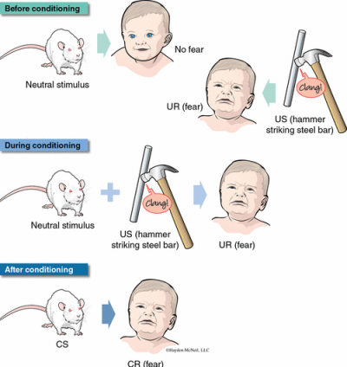
Watson and Little Albert
Watson intentionally caused the classically conditioned fear response in ‘Little Albert’
Before conditioning, Albert showed no fear towards the rat (NS)
They struck a metal bar above Albert’s head (UCS) which produced fear (UCR)
During conditioning, each time Albert reached to play with the rat (NS), they struck the bar (UCS) eliciting fear (UCR)
After conditioning, the rat (CS) now produced the fear response (CR)

Slide 67
Watson and Little Albert
Further tests revealed that Albert had generalised his fear of rats to other furry, white objects including rabbits, dogs, fur coats and a Santa Claus mask
ETHICAL CONCERNS
Little Albert’s mother was not fully informed of the experiment (informed consent)
Albert’s mother was employed by Watson, so may not have felt like she could refuse participation (voluntary participation)
Albert was distressed and suffered psychologically during the experiment (welfare of participants)
Confidentiality was preserved
Albert was not debriefed or desensitised to the conditioned emotional response

Slide 68
Models to explain learning
operant conditioning as a three-phase model (antecedent, behaviour, consequence) involving reinforcers (positive and negative) and punishment (including response cost) that can be used to change voluntary behaviours, including stimulus generalisation, stimulus discrimination and spontaneous recovery
observational learning as a method of social learning, particularly in children, involving attention, retention, reproduction, motivation and reinforcement

Slide 69
Operant conditioning
A type of learning in which the consequences that follow a response determine how likely it is that that behaviour will be repeated.
Theory of Operant Conditioning - Behaviour operates on the environment and our behaviour is instrumental in producing the consequences - Rewards/Punishments

Slide 70
Operant Conditioning
American Psychologist, B.F Skinner (1904 – 1990) believed behaviour can be reduced to the relationships between the behaviour, its antecedents (the events that precede it), and its consequences
Operant - a response (or set or responses) that occurs in the absence of any stimulus and acts upon the environment in the same way each time

Slide 71
Three Phase Model
Sequence of events
Organism is placed in a situation
Organism produces a behaviour
There is a consequence for this behaviour
This consequence determines future behaviour
Terminology
Antecedent
Behaviour by learner
Consequence: reinforcement or punishment
Behaviour continues or ceases

Slide 72
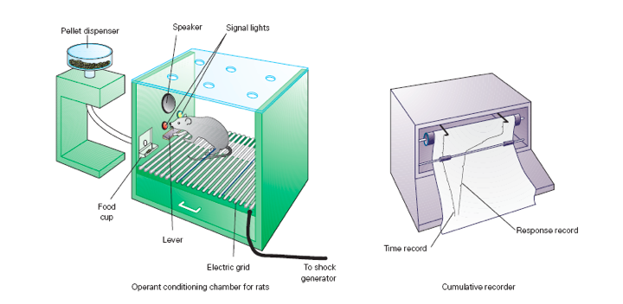
The Skinner Box

Slide 73
Reinforcement
Any stimulus (event or action) that subsequently strengthens or increases the likelihood of the response (behaviour) that it follows.
The reinforcer comes after the response (behaviour)
Reinforcement makes things stronger

Slide 74
Positive Reinforcement (+ good)
Positive Reinforcer
PLUS something GOOD
A stimulus which strengthens a response by providing a pleasant or satisfying consequence
Skinners experiment = food pellets
Money
Grades
Applause

Slide 75
Negative Reinforcement ( - bad)
Negative Reinforcer
MINUS something BAD
A stimulus that strengthens a response by the reduction, removal or prevention of an unpleasant stimulus
The behaviour that removes reduces or prevents and unpleasant stimulus is strengthened by the consequence
Skinner’s experiment = electric shock
Taking Panadol for headache
Driving slow to avoid fine

Slide 76
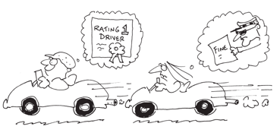
Positive Vs Negative Reinforcement
Positive reinforcement add good
Negative reinforcement take away bad
Both STRENGTHEN a response
Overall outcome is desirable to organism, just have achieved it in different ways

Slide 77
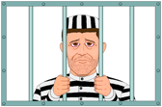
Punishment ( + BAD or - GOOD)
Positive punishment - the delivery of a stimulus following an undesirable response
PLUS BAD
Negative punishment / Response cost – the removal of a stimulus following an undesired response
MINUS GOOD
Punisher – an unpleasant stimulus that when paired with a response weakens the response or decreases the rate of responding over time
Punishers reduce unwanted behaviour
It is usually more effective to reinforce alternative desirable behaviour than it is to punish undesirable behaviour

Slide 78
Factors affecting reinforcement
Order of presentation – reinforcement needs to occur after the desired response not before! So the organism associates the reinforcement with the behaviour
Timing – Reinforcers need to occur as close in time to the desired response as possible. Most effective reinforcement occurs immediately after the desired response
Appropriateness of the reinforcer – For a stimulus to be a reinforcer it must provide a pleasing or satisfying consequence for its recipient.

Slide 79
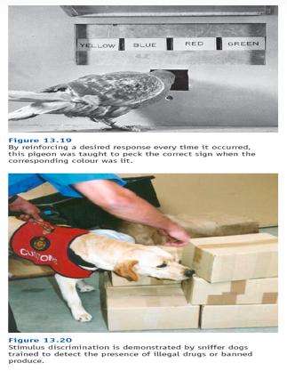
Elements of operant conditioning
•Stimulus generalization - occurs when the correct response is made to another stimulus which is similar to the stimulus for which reinforcement is obtained
•Stimulus discrimination - organism makes response to a stimulus for which reinforcement is obtained but not for any other similar stimulus

Slide 80
Elements of operant conditioning
Extinction – the gradual decrease in the strength or rate of responding after a period of non- reinforcement. Extinction occurs after the termination of reinforcement
Spontaneous recovery – the response is (after a rest period) again shown in the absence of reinforcement

Slide 81
Classical Vs Operant Conditioning
 | Classical | Operant
Key researchers | Ivan Pavlov John B Watson | BF Skinner Edward Thorndike
Basis of learning | Association between two stimuli | Associating a response with a consequence
Source of behaviour | Triggered by a stimulus | Decision by the organism
Nature of the response | Reflexive and involuntary | Voluntary
Role of the learner | The learner is passive | The learner is active

Slide 82
Observational Learning
Observational learning occurs when someone uses observation of another person's actions and their consequences to guide their future actions
Because the person being observed is referred to as a model, observational learning is often called modeling.
This is not to say that every time we watch someone do something we learn how to do it
Observational learning is a more active process than either classical or operant conditioning
It is not entirely different from conditioning.

Slide 83
Observational Learning - Vicarious Reinforcement/Punishments
Normal Operant Conditioning the learner is directly reinforced or punished
Vicarious reinforcement – viewing a model being reinforced can strengthen behaviour in an observer
Vicarious punishment – viewing a model being punished can weaken a behaviour in an observer

Slide 84
Bandura Bobo Doll Studies
All experiments involved children witnessing adult models be in the room with a bobo doll
Some models were aggressive some calm and some ignored the doll altogether
Children were then given the opportunity to play in a room with the doll
Aggressive acts by the child towards the doll were recorded

Slide 85
Observational Learning
Attention: must pay attention to the model
Retention: must remember the steps involved
Reproduction: must have the mental or physical abilities to reproduce the behaviour
Motivation: must want to perform the behaviour
Reinforcement: must believe that there will be a reward for the behaviour

Slide 86
PROCESS OF MEMORY

Slide 87
Process of memory
the multi-store model of memory (Atkinson-Shiffrin) with reference to the function, capacity and duration of sensory, short-term and long-term memory
interactions between specific regions of the brain (cerebral cortex, hippocampus, amygdala and cerebellum) in the storage of long-term memories, including implicit and explicit memories.

Slide 88
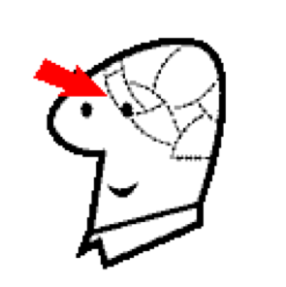
Human Memory
Not a single organ, like heart or brain
Not just in one part of the brain
Super complex, integrated systems
Not just one memory, but heaps of memory systems
One thing in common... Receive, process & store information

Slide 89
Encoding, Storage and Retrieval

Slide 90
Atkinson-Shiffrin Model
Describes three levels of memory
They function at the same time and interact with each other
Sensory Memory – entry point of information. If you pay attention to sensory information, it then goes to…
Short Term Memory (STM) – which is your actively conscious memory. Info is then transferred to…
Long Term Memory (LTM) – the relatively permanent memory store which is virtually limitless in capacity.

Slide 91
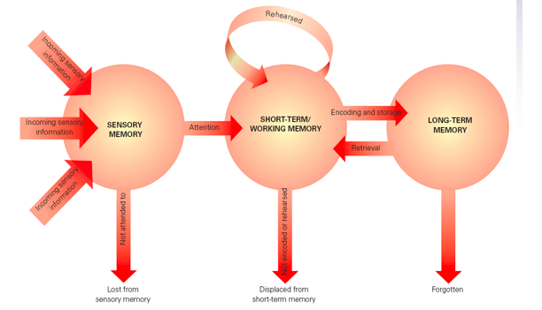
Atkinson-Shiffrin Model

Slide 92
Sensory Memory
First stage of memory
Unlimited capacity (can fit as much in it as you like)
Very short duration – rapid decay (between 0.3 – 4 seconds)
Its duration needs to be short so that the information slightly overlaps, so you see/hear the world in a smooth flow, rather than disjointed sounds/images
Iconic (visual) and Echoic (auditory)

Slide 93
Iconic Memory
Visual sensory memory (icon = picture)
Duration of about 0.3 seconds
Visual sensory information slightly overlaps, so that we see the world smoothly.
Example of iconic memory is when you write your name in the air with a sparkler, you can still see it for a bit
Bendy pencil/blurry hand

Slide 94
Echoic Memory
Auditory sensory memory (echo = sound)
Duration of about 3 – 4 seconds
We hold these memories slightly longer than visual ones

Slide 95
Short Term Memory
This is where all active thinking takes place
It might be new sensory information that you are working on, stuff you have retrieved from LTM, or a combination of both
Has a limited capacity of 7+or- 2 items
Has a limited duration of 12 – 30 seconds
Information is lost though decay (fading) or displacement (being pushed out by new)

Slide 96
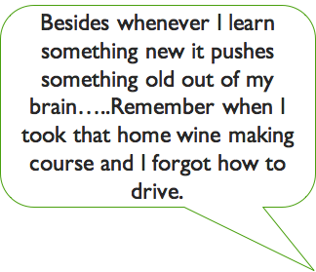

Slide 97
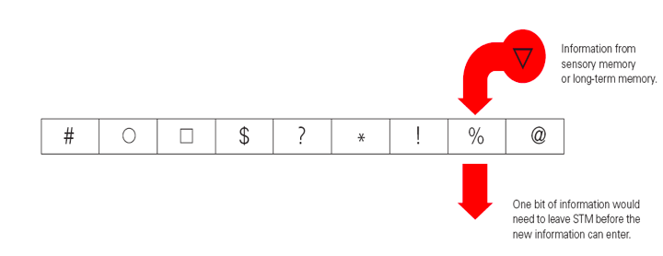
Displacement in STM

Slide 98
Improving Capacity of STM
Chunking: The grouping or packing of bits of information into larger bits or units that can be remembered as single units
Chunking expands short term memory. Chunks can be numbers, images, words, abbreviations etc.
Eg. Of chunking telephone numbers.
0417 872 009
Capacity of STM is still 7, but now its 7 bits or chunks of information

Slide 99
Improving STM Duration
Rehearsal: The process of doing something so that information can be retained in memory and then retrieved when required, can be verbal, vocal, non-verbal, sub-vocal, mental imagery etc.
Maintenance rehearsal: Involves simple, rote repetition of information being remembered can be retained. Going over and over it!
Needs to be attended to consciously – not just meaningless repetition
Elaborative rehearsal: Involves the process of linking new information in a meaningful way with information already stored in long term memory. More active and more effective, ensures that information is encoded well.
Self reference effect: Involves making new information personal and meaningful to you (also known as SALIENCE)

Slide 100
Long Term Memory
Works like the hard drive on your computer
Info is stored in a different way in LTM... It is stored according to meaning
Has a virtually unlimited capacity
Potentially permanent (unlimited duration)
Usually forgetting occurs (unable to retrieve from LTM) because we don’t use the correct cues to access it

Slide 101
Divisions of LTM
Procedural – Memory of how to do something, actions and skills, can be physical or intellectual (knowing how) learned by conditioning and practice
Declarative – Memory of specific facts or events (knowing that)
Episodic – Memory of life events, autobiographical (episodes)
Semantic – Information we have about the world. Areas of expertise, academic knowledge, important places, meaning of words, famous people or events etc. Facts that do not rely on specific time or place.

Slide 102
Long Term Potentiation
Neural basis for memory formation
Synapse strength can increase in 3 ways
Release extra neurotransmitter
Increase number of receptor sites
Growth of new synapses

Slide 103
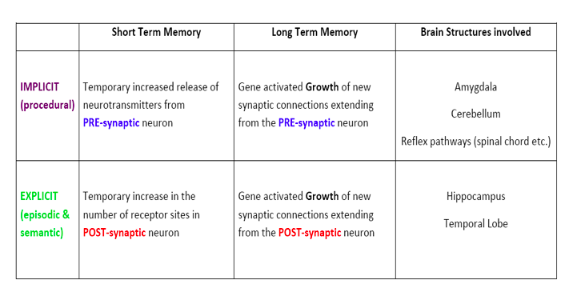

Slide 104
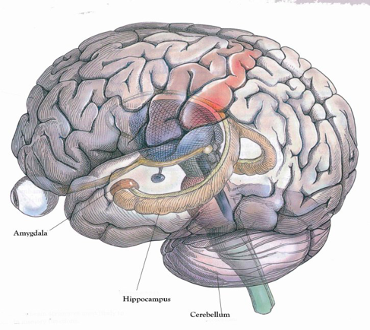
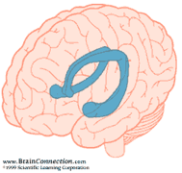
The hippocampus

Slide 105
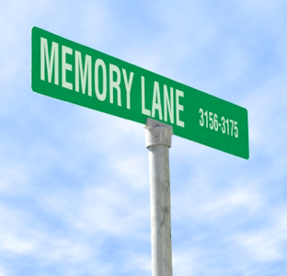
The hippo on campus lives on memory lane

Slide 106
The hippocampus
Critical in the formation, organisation and consolidation of memory
Also associated with the recall of spatial relationships in the world
Closely linked with our sense of smell

Slide 107
Medial Temporal Lobe
Inner part of this lobe towards the middle of the brain
Hippocampus is here (explicit declarative memories - consolidation)
Amygdala is here (implicit, emotional memories)

Slide 108
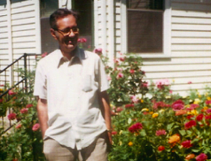
The hippocampus and the medial temporal lobe - damage and memory
Henry Molaison
Severe epilepsy
Radical surgery removes hippocampus and parts of the medial temporal lobe
Success in preventing seizures
Left with permanent anterograde amnesia (Can’t form new LTM’s)
Other mental abilities and STM fine

Slide 109
The hippocampus and the medial temporal lobe - damage and memory
Evidence that the hippocampus and temporal lobe have a role in memory formation, but not storage or retrieval
Evidence that LTM is most definitely a distinct sub system of memory (STM fine)

Slide 110
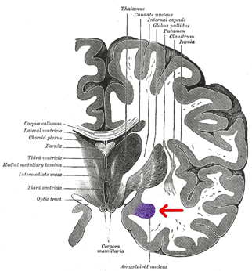
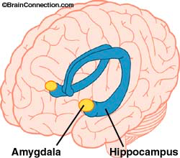
Deep within the temporal lobe - the amygdala
Mediation of fear – sympathetic arousal
Seizures involving the amygdala involve intense fear
Damage leaves a person unable to learn a fear response through classical conditioning
Involved in remembering the emotional significance of an event
Can effect the consolidation of memory – stimulation better recall, retardation poorer recall

Slide 111
Consolidation theory
Physiological changes (LTP and Axon growth) in brain cells occur when something is being learned and during a period of time immediately after the learning process has been completed
If memory is disrupted during the period of consolidation memory loss will occur
This process takes about an hour
Hippocampus and Medial Temporal Lobe involved
It is aided by REM sleep
Think of wet concrete

Slide 112
Consolidation theory
Head injury often results in memory loss for a period preceding the injury
ECT – loss of previous 30mins
Neural changes are not allowed to occur or are disrupted by injury
In humans it takes about 30 mins (roughly)

Slide 113
RELIABILITY OF MEMORY

Slide 114
Reliability of memory
methods to retrieve information from memory or demonstrate the existence of information in memory, including recall, recognition, relearning and reconstruction
the effects of brain trauma on areas of the brain associated with memory and neurodegenerative diseases, including brain surgery, anterograde amnesia and Alzheimer’s disease

Slide 115
Effects of brain damage
Brain trauma – damage inflicted through injury interferes with functioning
E.g. Brain injury, stroke, drug abuse etc
Neurodegenerative disease – decline in structure and function of neurons
E.g. Alzheimer's disease
Amnesia – Loss of memory, partial or complete, temporary or permanent

Slide 116
Amnesia
Anterograde Amnesia
Can’t make new Long Term memories
events that occur after the injury – hippocampus damage common
Cannot transfer information from STM to LTM
Korsakoff’s syndrome
Caused by chronic alcoholism
Bad diet – lack of thiamine (vitamin B)
Sometimes confabulate – make up stories to fill in the gaps in memory

Slide 117
Amnesia
Retrograde Amnesia
Cant remember old information
Events before the injury lost
Usually temporary and caused by a blow to the head
Memory of events immediately preceding the injury are permanently lost (interruption or consolidation)

Slide 118
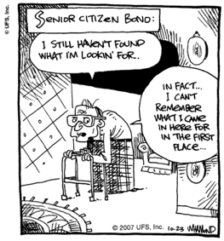
Dementia
Large group of neurodegenerative diseases
Loss of mental capacity
Loss of memory – interfering severely with the ability to function independently
Develops progressively

Slide 119
Alzheimer’s Disease
The most common form of dementia
Accounts for 50 – 70% of dementia
Neurodegenerative disease that causes wide spread cell death
Causes decline in all aspects of cognitive function
Post-mortems reveal deposits of plaque along the damaged synapses
These plaques and tangles effect neural transmission

Slide 120
Alzheimer’s Disease
100,000 Australians effected
1 in 25 over 60
1 in 8 over 80
No simple diagnostic test – really only know for sure when post-mortem conducted
Symptoms are different for each person further complicating diagnosis

Slide 121
Alzheimer’s Disease - symptoms
Typical memory loss includes
Events
Words and names
Written and verbal directions
Stories, TV, Movies, Books
Semantic memory decline
Procedural memories
Personality changes can also occur

Slide 122
Measures of retention - recall
Being asked to reproduce information with the fewest possible cues.
Free Recall – asked to remember as much information as possible in no particular order -List of grocery items
Serial Recall – asked to recall information in a particular order Names of Cities (itinerary)
Cued Recall - given a cue then asked to recall Seven Dwarfs: first letter of

Slide 123
Measures of retention - recall
Identifying correct information from among alternatives. Can retrieve more this way as recognition provides more cues for retrieving from LTM.
Recognition is more sensitive measure
Example – multiple choice Q’s

Slide 124
Measures of retention - Relearning
Even if cant recall or recognize doesn’t mean there is no memory. If relearn it and learn it more quickly the 2nd time assumption is that there was some memory available
Savings score

Slide 125
Comparing measures of retention - sensitivity
Recall worst
Recognition better
Relearning best

Slide 126
Reliability of memory
the factors influencing a person’s ability and inability to remember information, including context and state dependent cues, maintenance and elaborative rehearsal and serial position effect
the reconstruction of memories as evidence for the fallibility of memory, with reference to Loftus’ research into the effect of leading questions on eye-witness testimonies

Slide 127
Elaboration and organisation
Elaboration enables effective encoding
The more associations that are made between new information and that already in memory the more likely the information will be retrieved
Making it meaningful makes it easier to remember

Slide 128
Context and State Dependent Cues
Retrieval can be enhanced if the conditions under which the information was originally learned is recreated
Context dependent – environmental cues in a particular setting where a memory was formed that act as retrieval cues
State Dependent – internal cues that are relates to an experience may also trigger retrieval of associated memories. Associated with an individuals internal psychological and or physical state at the time the memory was formed
Information is more likely to be remembered if the person is in the same state as when they learned it

Slide 129
Serial Position Effect
Recall tends to be best for items at the end and the beginning and worst for those in the middle. Retention as a U shaped curve.
Primacy – superior recall for items at the beginning of a list
Recency – superior recall for items at the end of a list
WHY? – Items at end still in STM so remembered well, Items at start have been transferred to LTM. Middle to late to be in STM to early to be in LTM without rehearsal

Slide 130
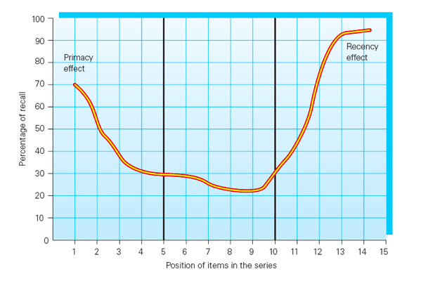
Serial Position Effect

Slide 131
Accuracy of memory - reconstruction
Memory is NOT an exact copy of the world
Memory includes some exact details
Memory includes some additions that are logically plausible, things that might have happened
Confidence in memory is no guarantee of its accuracy, in fact there is little correlation
We tend to fill in the gaps...

Slide 132
Why so many errors?
Memory is actively constructed
Retrieving memory involves active reconstruction
Over time recalling memories can change the content and meaning of a memory
Your experience of memory is NOT a guarantee that it reflects reality!

Slide 133
Loftus’ Leading Question research
The way questions are asked during eye whiteness testimony can influence memory
Shows how recall does in fact involve an active reconstruction of events, that is open to suggestion
Leading Questions – phrased in a way that suggests what the desired answer is

Slide 134
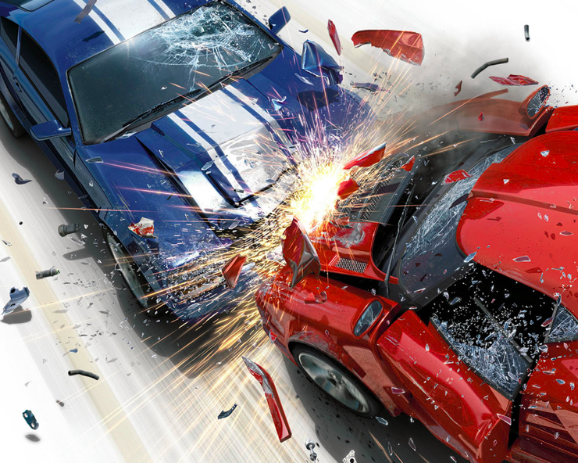

Slide 135
Loftus - study 1
Participants shown clips of car accidents
All participants asked the question – ‘About how fast were the cars going when they________ each other?’
The gap was filled with
-Smashed
-Collided
-Bumped
-Hit
-Contacted

Slide 136
Results - Study 1
VERB | MEAN SPEED ESTIMATE (MPH)
Smashed Collided Bumped Hit Contacted | 40.5 39.3 38.1 34.0 31.8

Slide 137
Loftus - Study 2
Participants again viewed accident footage
Participants asked ‘About how fast were the cars going when they________ each other?’
Gap filled with
-Hit
-Smashed
One group not asked about the speed of the cars

Slide 138
Loftus - Study 2
One week later all participants asked questions about the accidents
The critical question ‘did you see any broken glass’ was asked to all 3 groups
There was no broken glass in the film

Slide 139
Loftus study 2 results
Participants ‘recollection’ of seeing glass was influenced by how the speed question was asked
They had mixed their memory of the accident with the new false piece of information added after the event – smashed or hit
Suffered source confusion – unable to distinguish real info from false info given after the event

Conclusion – memories can be altered by post event exposure to inaccurate info during questioning

Slide 140
SlidesCarnival icons are editable shapes.
This means that you can:
Resize them without losing quality.
Change fill color and opacity.
Isn’t that nice? :)
Examples:

