Slide 1
CONTRIBUTING FACTOTRS: PHOBIS’S
STUDY DESIGN DOT POINT
the relative influences of contributing factors to the development of specific phobia with reference to: gamma amino butyric acid (GABA) dysfunction, the role of stress response and long-term potentiation (biological); behavioural models involving precipitation by classical conditioning and perpetuation by operant conditioning, cognitive bias including memory bias and catastrophic thinking (psychological); specific environmental triggers and stigma around seeking treatment (social)

Slide 2
Age of onset
For specific phobias, the age of onset depends on the phobia.
Most specific phobias develop during childhood and eventually disappear. Those that persist into adulthood rarely go away without treatment.

Slide 4
The biopsychosocial approach to specific phobia
There appear to be several complex mechanisms that contribute to the development of a specific phobia, and that are also relevant to its maintenance and treatment.
Thus, phobias are now frequently examined using the biopsychosocial approach.
Video source: https://www.youtube.com/watch?v=bf0TZ5OzF5I

Slide 5
Contributing biological factors
There are three important biological factors that contribute to the development and
maintenance of a specific phobia. These are:
> the fight-flight-freeze response
> GABA and glutamate
> genetic predisposition and inherited vulnerabilities.

Slide 6
THE FIGHT-FLIGHT-FREEZE RESPONSE
As discussed previously, our fight-flight-freeze response is important to our survival. It provides us with an instant burst of energy to deal with danger in our environment and is controlled by the sympathetic branch of the autonomic nervous system.
Once activated, stress hormones such as adrenalin and noradrenalin are released into the bloodstream to increase our heart rate and respiration rate, circulate more glucose through our body for energy, improve focus and temporarily boost our stamina to either fight the impending danger or flee to a safe place.
A person with a specific phobia of spiders will experience an intense fight-flight-freeze response when they see a spider or a milder response by simply looking at a picture of one!
These symptoms can include:
> elevated blood pressure > tremor (shaking in the hands)
> Diarrhoea > sweating
> shortness of breath > dizziness.
> skin sensation of prickling, burning or itching without identifiable physical cause
> palpitations (abnormally fast heartbeat that the person is aware of )

Slide 7
The role of the amygdala and hippocampus
the amygdala and hippocampus are located in the medial temporal lobes of the brain and are part of the limbic system.
The amygdala is vital in initiating and processing emotional responses such as fear and in forming emotional memories.
It plays a critical role in anxiety disorders such as specific phobias.
The hippocampus is involved in the formation of declarative memories such as information about the world, facts and knowledge, and episodic (autobiographical) memories.

Slide 9
So, when a person experiences a frightening event, information from all the senses is processed by the amygdala to become an emotion linked to the memory.
The memory of the frightening episode itself is consolidated by the hippocampus, to form a conscious recollection – the more frightening the event, the stronger the memory.
Importantly, the amygdala is responsible for the formation and storage of classically conditioned fear.
So, when the person is exposed to a similar stimulus, the amygdala triggers the ‘emotion’ of fear and the fight-flight-freeze response is initiated

Slide 10
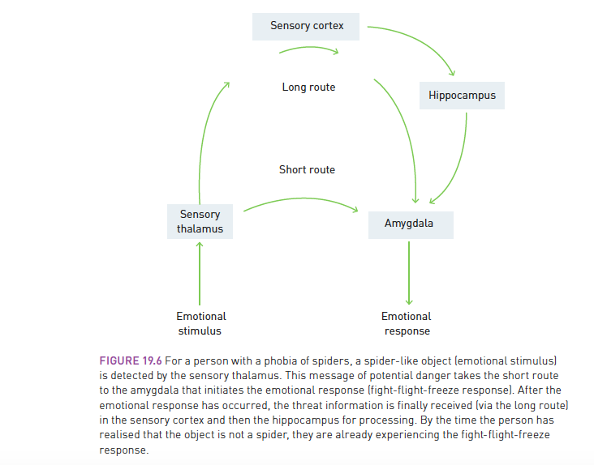

Slide 11
Biological Contributing Factors

Slide 12
GABA AND GLUTAMATE
The neurotransmitters GABA (gamma-amino butyric acid) and glutamate play an important role in maintaining the right balance in our nervous system so that our levels of anxiety (physiological arousal) remain at an optimal level.
GABA has an inhibitory role on the fight-flight-freeze response and glutamate has an excitatory role, and the two transmitters work together.
When a person has low levels of GABA, the increased presence of glutamate increases agitation and anxiety and can contribute to their developing a specific phobia

Slide 13
GABA IN SUMMARY
Gamma Amino Butyric Acid (GABA) has an inhibitory role -makes postsynaptic neuron less likely to fire.
Regulates anxiety, arousal and sleep
Gaba acts as a sedative
Low levels of GABA can mean higher levels of anxiety (not enough GABA to regulate anxiety or phobic response)
Gabaergicneurons which produce GABA

Slide 15
Long-term potentiation
Long-term potentiation is an ‘experience-dependent’ type of brain plasticity where physical changes occur as a result of the repeated stimulation of a neural pathway during learning.
What is the relevance of long-term potentiation to specific phobia?
Researchers have discovered that there is a link between long-term potentiation and memory.
A person knows if they have a phobia of spiders because every time they see one, they experience psychological distress and the fight-flight-freeze response.
The memory of this fear, ‘Spiders are eight-legged, scary and harmful’, has been consolidated by the hippocampus.
The intense physiological arousal (fight-flight-freeze response) that accompanies that thought each time they see or think they see a spider, is stored by the amygdala.

Slide 16
GENETIC PREDISPOSITION AND INHERITED VULNERABILITIES
Can a specific phobia be inherited? In a way, it can. It is not the phobia itself, however, that is inherited, but the person’s biological make up that can lead to a genetic vulnerability – such as being born with low levels of GABA.
This vulnerability is also expressed in personality:
individuals who are apprehensive about environmental objects and events are more likely to develop anxiety disorders and specific phobias.
Although a person may have the genetic predisposition to develop a specific phobia, they will not necessarily develop one.
Certain psychological, social and environmental influences will increase this likelihood.

Slide 17
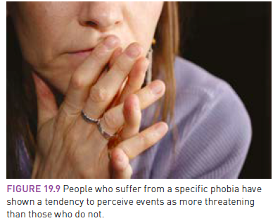
Contributing psychological factors
The psychological factors involved in developing a specific phobia refer to our thoughts, beliefs and perception about ourselves, our experiences and our environment
Essentially, we are the sum of our experiences and, depending on genetics and personality, we will interpret environmental events in our own unique way
Those who are more sensitive and anxious and feel less in control are more likely to notice events in their environment and to view them as potentially threatening, even though they may not be.
These thoughts and perceptions play a key role in developing
a specific phobia.
There are 2 models that attempt to explain phobia’s

Slide 18
THE BEHAVIOURAL MODEL
Precipitation of specific phobia through classical conditioning
The behavioral approach examines how an organism’s behaviours are influenced by environmental factors and downplays the importance of thinking processes (cognition).
According to the behavioral model, specific phobias are learnt through classical conditioning and maintained through operant conditioning.

Slide 19
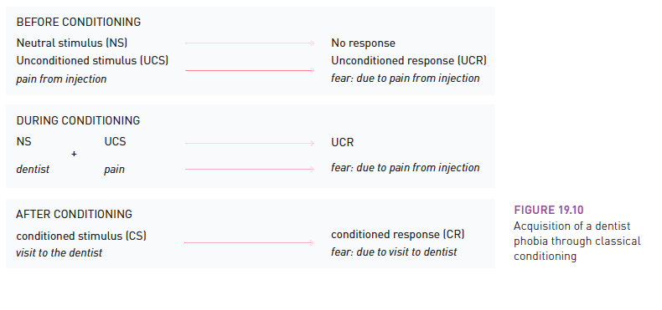
Remember the process of Classical conditioning.
We can develop a phobia of a neutral stimulus because we have been conditioned to associate it with fear.
Through this process people can develop phobias. While some people may view certain things as harmless, others have been conditioned to be afraid of them.
EG Little Albert

Slide 20
Perpetuation of specific phobia through operant conditioning
Having a specific phobia is not just as simple as learning through association.
The process of a child actively avoiding a visit to the dentist or having a tantrum that makes a session impossible has more to do with operant conditioning.
In the case of the dentist phobia, the avoidance of an unpleasant injection acts as a negative re-inforcer, removes a negative consequence, that strengthens the likelihood of that behavior being repeated
You could also say that the ‘good’ feeling of relief (at being able to avoid the injection) presents a positive reinforcement of the behavior.
While classical and operant conditioning provide convincing behavioral explanations for the acquisition of a specific phobia, they do not fully explain situations where people are phobic about objects or events that they have never experienced.

Slide 21
THE COGNITIVE MODEL
Cognitive bias = ‘systematic error in thinking that affects the decisions and judgements that people make’.
Can also involve memory bias = memory has been encoded inaccurately and influenced by the person’s distorted thinking.
Consequently, each time the person remembers the situation, object or event, it is usually more catastrophic or threatening than it really is.
Can involve catastrophic thinking = a person ruminates or obsessively thinks about a perceived threat. As the person overestimates the threat in a way that is often irrational, thoughts of worst-case scenarios lead them to an increased state of anxiety about the (often imagined) potential dangers of their specific phobia.
This situation can be worsened when the person shows an attentional bias = preference for noticing threat-relevant information as they remain more alert to their environment.

Slide 22
EG. a person who suffers from arachnophobia will remain on high alert at all times in case there is a spider nearby. This can lead to the misreading of ambiguous stimuli – such as a small piece of fuzzy black fabric – as a spider and can lead the person to believe that the probability of being harmed by a spider is greater than it actually is.

Slide 23
Cognitive bias

Slide 24
Psychological Contributing Factors

Slide 25
Contributing social factors
Social and cultural factors can contribute to the type and incidence of specific phobia.
Research has found that a child whose parent suffers from a phobia of moths, for example, is more likely to develop the same phobia as a result of simply observing their parent’s fear response and making the cognitive connection that ‘moths are dangerous’.
Sometimes, a parent, partner or friend may help to maintain the avoidance behaviour by trying to be helpful.

Slide 26
ENVIRONMENTAL TRIGGERS
In many instances, specific environmental triggers can lead to the development of a specific phobia. There are three possible environmental paths:
1 - direct exposure to a distressing or traumatic event, such as being attacked by a dog
2 - witnessing other people experiencing a traumatic event, such as seeing another person being attacked by a dog
3 - reading or hearing about dangerous situations or events, for example, developing a fear of dogs after hearing stories about children, adults or family pets being attacked by a dog.

Slide 27
PARENTAL MODELLING
Albert Bandura combined behavioural and cognitive approaches to develop social learning theory.
According to this theory a great deal of our behaviour is learnt through imitating or modelling other people’s behaviours.
According to this theory, specific phobias can be learnt by observing other people’s phobic reactions.
EG. a child is raised in a household where a parent is terrified of moths. Each time the parent sees one, they exhibit their fear by screaming and running out of the house. This increases the child’s anxiety and leads them to believe that moths are dangerous and should be avoided at all costs. Thus,children whose parents show phobic responses are more likely to develop comparable fears of similar stimuli.
Parental modelling can lead to the transmission of threat information, which is incorporated into the child’s long-term memory.

Slide 28
TRANSMISSION OF THREAT INFORMATION
The transmission of information that a person perceives as threatening is not limited to the parent and child relationship.
Information can be received from a range of different sources including the media, internet, friends and school.
A student, who is interested in travelling, might develop a fear of flying if each time they Google ‘travel or flying’ they get plane crash websites with graphic pictures or video clips.
If their fear prevents them from being able to board a plane, then threat information delivered by the internet has led to a specific phobia.

Slide 29
STIGMA AROUND SEEKING TREATMENT
As with a number of different mental health conditions, there is often a stigma attached to a person seeking treatment.
Stigma refers to a ‘mark of disgrace’ that labels a person as different and separates them from others.
A person suffering from a specific phobia may experience embarrassment, shame, distress, helplessness, sadness or anxiety as a result of their illness.
Consequently, individuals are less likely to seek or accept help and often go untreated for years.
This not only affects the person suffering with the mental disorder, but also their family and friendship group

Slide 30
Social Contributing Factors

Slide 31
Multiple choice activity
After she was bitten by a dog, Trinh developed a phobia of dogs.
Now, whenever Trinh sees a dog:
A.she experiences eustress.
B.her fight-flight response is activated.
C.her adrenaline and noradrenaline are inhibited.
D.her parasympathetic nervous system is activated

Slide 32
Multiple choice response
After she was bitten by a dog, Trinh developed a phobia of dogs.
Now, whenever Trinh sees a dog:
A.she experiences eustress.
B.her fight-flight response is activated.
C.her adrenaline and noradrenaline are inhibited.
D.her parasympathetic nervous system is activated

Slide 33
Fast five: Question 1
What kind of factor is stigma in the development of a specific phobia?
Answer:
Social

Slide 34
Fast five: Question 2
Which neurotransmitter deficiency is linked to the incidence of a phobia?
Answer:
GABA

Slide 35
Fast five: Question 3
Staying away from the phobic stimulus can strengthen the phobic behaviour through what type of learning?
Answer:
Operant conditioning

Slide 36
VCE PSYCHOLOGY UNIT 4
Interventions: Phobia
Presented by Kristy Kendall
Study design dot point:
evidence-based interventions and their use for specific phobia with reference to: the use of short-acting anti-anxiety benzodiazepine agents (gamma amino butyric acid [GABA] antagonists) in the management of phobic anxiety and relaxation techniques including breathing retraining and exercise (biological); the use of cognitive behavioural therapy (CBT) and systematic desensitisation as psychotherapeutic treatments of phobia (psychological); psychoeducation for families/supporters with reference to challenging unrealistic or anxious thoughts and not encouraging avoidance behaviours (social).

Slide 37
Evidence-based interventions
The good news for the many people who suffer the anxiety and stress associated with
a specific phobia is that treatment is available. The treatment options explored here
are
anti-anxiety medication,
relaxation techniques and exercise,
cognitive behavioural therapy,
systematic desensitisation
psychoeducation.

Slide 38
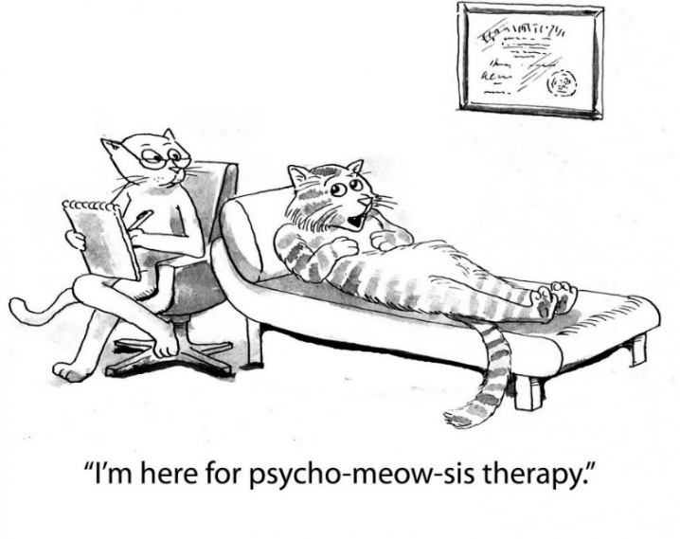
Treating phobias
Biological
Benzodiazopines & relaxation techniques
Psychological
Cognitive behavioural therapy & systematic desensitisation
Social
Psychoeducation for families
Image used under license from YAYimages

Slide 39
Biological- Anti-anxiety medication
Earlier in the chapter we discovered that low levels of GABA contributes to the development of an anxiety disorder such as a specific phobia.
Research has found that anti-anxiety drugs that mimic GABA’s inhibitory effects have been a successful form of treatment.
These include benzodiazepines such as Lorazepam (Ativan), Clonazepam (Klonopin) and Diazepam (Diastat, Diazemuls and Valium).
However, medication alone is not usually sufficient and many health professional also use other evidence-based treatments.

Slide 40
The role of GABA summary
Gamma Amino Butyric Acid (GABA) has an inhibitory role - makes postsynaptic neuron less likely to fire. It regulates anxiety, arousal and sleep.
Low levels of GABA means higher levels of anxiety (not enough GABA to regulate anxiety)
Anti-anxiety drugs that mimic the effect of GABA can be used to manage simple phobic anxiety.

Slide 41
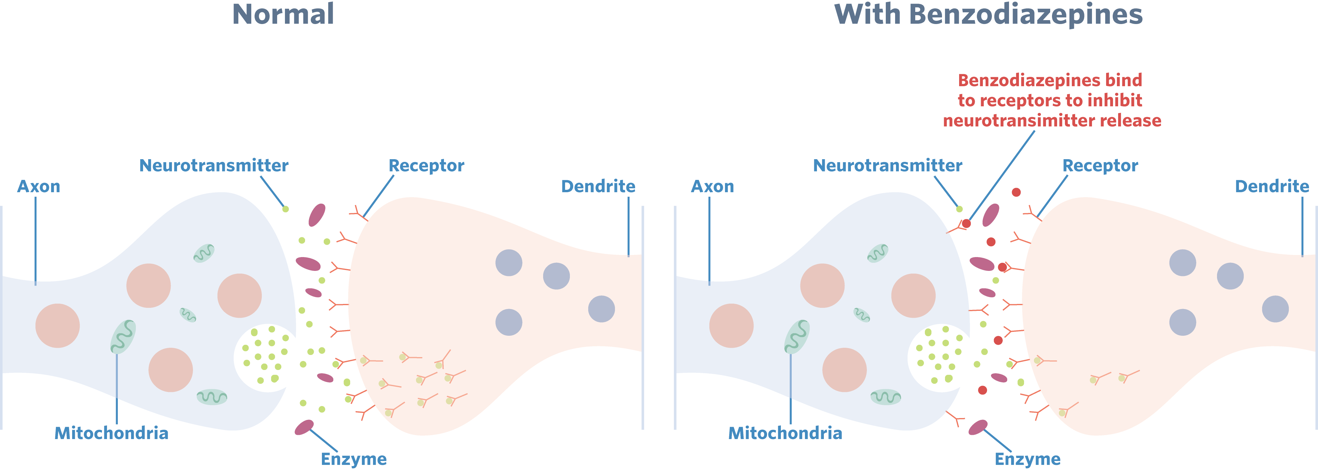
Benzodiazepine
Short acting anti-anxiety medications are known as benzodiazepines.
They work selectively on GABA receptors in the brain (antagonist)
Benzodiazepines can be used as sedatives and muscle relaxants.
Common medications are valium & xanax

Slide 42
Learning more…
Are they addictive?
Can you overdose?
Can you drive?
So many questions answered if you wish to explore deeper by visiting: http://www.health.nsw.gov.au/mentalhealth/Factsheets/Pages/benzodiazepines.aspx
Watch this video to see natural remedies that act as GABA does: https://www.youtube.com/watch?v=oDaUnKlY4w0

Slide 43
Biological- Breathing retraining and exercise
Breathing retraining and exercise are two biologically based interventions that can help to alleviate these uncomfortable physical responses:
Breathing retraining is based on the notion that when a person is stressed, they tend to ‘overbreathe’ or breathe too quickly (hyperventilation).
This can cause dizziness, palpitations, tingling in the fingers or body and pressure or tightness in the chest.
Hyperventilation is not dangerous, however, it can be frightening as it is part of a typical fight-flight-freeze response.
With breathing retraining, individuals are taught to use a slow-breathing technique to manage the effects of hyperventilation and this is recommended as soon as the person begins to feel anxious. This technique can also be used to help lower a person’s overall levels of anxiety.

Slide 44
Relaxation technique 1 summary
Breathing training – replacing incorrect breathing techniques with correct ones.
The effect of poor breathing | High blood pressure Migraines Hyperventilation Muscle tension
What is good practice? | Speed (8-12 times a minute) Nose not mouth From diaphragm Regularity Depth

Slide 45
EXERCISE
Once hormones such as adrenalin, noradrenalin and cortisol are released into the bloodstream, we experience the usual arousal symptoms and glucose is released to give us that extra energy boost needed to deal with the phobic stimulus.
If we are not physically active during one of these physiologically arousing events, we find ourselves feeling agitated and anxious
Vigorous exercise is a great way to work off this anxiety.
beta-endorphins are also produced during physical exercise and, along with serotonin and dopamine, help improve our mood and even give us a sense of euphoria

Slide 46
Relaxation technique 2 summary
Exercise
Produces positive chemicals (i.e. endorphins)
Uses negative chemicals produced in a stress response (ie adrenalin)
Images used under license from YAYimages

Slide 47
Treating phobias using psychological factors
Feelings
Create behaviour
Behaviour
Creates thoughts
Thoughts
Create feelings
Cognitive Behavioural Therapy
Uses a combination of verbal and behaviour modification techniques to help people change irrational patterns of thinking that create a phobia.
Focuses on helping the person change negative thoughts and behaviours and replaces them with more positive, realistic ones.
Cognitive
Behavioural
Therapy
Helps to crack the
vicious cycle of negative thinking & feeling

Slide 48
Psychological- Cognitive behavioural therapy
CBT uses a combination of verbal and behavioral modification techniques to help change irrational patterns of thinking that create and maintain a specific phobia.
CBT focuses on helping the person change negative, dysfunctional thoughts and replace them with more positive, realistic ones.
According to this model, there is a cycle that occurs. When a person is exposed to the object or situation (stimulus)
negative thoughts negative feelings (emotional distress) alters behaviour (actively avoids the object or situation).
Encourages individual to recognise the incidence of exposure to the threat object/environment is rare and catastrophic thoughts are not based on reality.

Slide 49
Psychological- Systematic desensitization
Based on assumption that most anxiety responses are initially acquired through classical conditioning and therefore eliminating a specific phobia can be achieved through
counter-conditioning =weakening the association between the conditioned stimulus and the conditioned response of fear or anxiety
A graded experience where a sufferer is gradually exposed to phobic stimulus while using relaxation techniques
Otherwise known as graduated exposure therapy NS + UCS = UCR CS = CR

Slide 50
3 steps involved :
Step 1 : The therapist trains the client in deep muscle relaxation.
Step 2 : The therapist helps the client build an anxiety/fear
hierarchy. The client makes a list of anxiety-causing stimuli linked
to specific phobia, from least anxiety/fear-inducing to
most anxiety/fear-inducing.
Step 3 : The client tries to work through the hierarchy, learning to
remain relaxed while imagining each stimulus on their
hierarchy. This is repeated until the person can imagine
each situation or object with little or no anxiety/fear.

Slide 51
Graduated exposure
Behaviour | Fear rating
Think about a spider
Look at a photo of a spider
Look at a real spider in a closed box
Hold the box with the spider
Let a spider crawl on your desk
Let a spider crawl on your shoe
Let a spider crawl on your sleeve
Let a spider crawl on your bare arm
Image used under license from YAYimages
Notes:
https://pixabay.com/en/soldier-daughter-child-looking-870387/

Slide 52
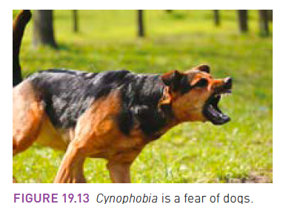
Another example of graduated exposure - dogs
1 - Teach patient relaxation techniques.
2 - Develop a hierarchy of fear with the person from what causes them the least to the most fear.
3 - Work through the hierarchy.
4 - Draw a dog on a piece of paper.
5 - Read about dogs.
6 - Look at photos of dogs.
7 - Look at videos of dogs.
8 - Look at dogs through a closed window.
9 - Look at dogs through a partly opened window.
10 - Look at dogs from a doorway.
11 - Move further out from the doorway.
12 - Have a dog on a leash brought into the room.
13 - Have a dog on a leash sit beside you.
14 - Pat the dog’s head while it is on a leash.

Slide 53
Treating phobias using social factors
Psychoeducation for families and supporters:
Psychoeducation involves educating the sufferer of the mental disorder and their family to better understand the condition and treatment options.
The information helps to dispel myths about the disorder so the individual’s more likely to feel empowered as they are helped to develop more adaptive coping strategies.
Families are encouraged to challenge unrealistic thoughts (i.e. irrational fear) and replace these with more realistic ones.
Challenge cognitive and memory bias.
Discouraging avoidance behaviours which can act as a negative reinforcer and strengthen the phobic behaviour
Encourage positive thinking.
Notes:
https://pixabay.com/en/soldier-daughter-child-looking-870387/

Slide 54
Challenging cognitive bias
Attentional bias | Tendency to selectively attend to phobia related stimuli rather than other stimuli.
Memory bias | A better recollection of phobic events and information than other information, or of negative over positive information.
Interpretative bias | Tendency to interpret non-threatening stimuli as threatening.
Notes:
https://pixabay.com/en/soldier-daughter-child-looking-870387/

Slide 55
Multiple choice activity
A psychologist treated a patient who suffered a phobia of flying. During the therapy the psychologist helped the patient to identify his unhelpful thoughts about flying, and to identify other helpful and more rational thoughts about flying.
The therapy that the psychologist used was :
cognitive behavioural therapy (CBT)
systematic desensitisation.
biofeedback
flooding
(VCAA 2012 Exam Q27)

Slide 56
Multiple choice response
A psychologist treated a patient who suffered a phobia of flying. During the therapy the psychologist helped the patient to identify his unhelpful thoughts about flying, and to identify other helpful and more rational thoughts about flying.
The therapy that the psychologist used was :
cognitive behavioural therapy (CBT)
systematic desensitisation.
biofeedback
flooding
(VCAA 2012 Exam Q27)

Slide 57
Multiple choice activity
Anxiety disorders can be managed with a group of drugs known as benzodiazepines. Benzodiazepines imitate the activity of the neurotransmitter, gamma-amino butyric acid (GABA).
Benzodiazepines work by:
activating post-synaptic neurons in the brain to calm the body and reduce arousal.
activating post-synaptic neurons in the brain to activate the body and increase arousal.
inhibiting post-synaptic neurons in the brain to calm the body and reduce arousal.
inhibiting post-synaptic neurons in the brain to activate the body and increase arousal.
(VCAA 2012 Exam Q33)

Slide 58
Multiple choice response
Anxiety disorders can be managed with a group of drugs known as benzodiazepines. Benzodiazepines imitate the activity of the neurotransmitter, gamma-amino butyric acid (GABA).
Benzodiazepines work by:
activating post-synaptic neurons in the brain to calm the body and reduce arousal.
activating post-synaptic neurons in the brain to activate the body and increase arousal.
inhibiting post-synaptic neurons in the brain to calm the body and reduce arousal.
inhibiting post-synaptic neurons in the brain to activate the body and increase arousal.
(VCAA 2012 Exam Q33)

Slide 59
Fast five: Question 1
What are the group of drugs called that mimic GABA in the brain?

Slide 60
Question 1 (Response)
What are the group of drugs called that mimic GABA in the brain?
Answer:
Benzodiazapine

Slide 61
Fast five: Question 2
Drugs that block the brains neuortransmitters are known as what?

Slide 62
Question 2 (Response)
Drugs that block the brains neuortransmitters are known as what?
Answer:
Antagonist

Slide 63
Fast five: Question 3
Which sort of factor is CBT?

Slide 64
Question 3 (Response)
Which sort of factor is CBT?
Answer:
Psychological

Slide 65
Fast five: Question 4
Which learning principle is systematic desensitisation based on?

Slide 66
Question 4 (Response)
Which learning principle is systematic desensitisation based on?
Answer:
Classical conditioning

Slide 67
Fast five: Question 5
Which for of factor in treating a phobia is psychoeducation for family?

Slide 68
Question 5 (Response)
Which for of factor in treating a phobia is psychoeducation for family?
Answer:
Social

Slide 69
VCE PSYCHOLOGY UNIT 4
Interventions: Phobia
Presented by Kristy Kendall
Study design dot point:
evidence-based interventions and their use for specific phobia with reference to: the use of short-acting anti-anxiety benzodiazepine agents (gamma amino butyric acid [GABA] antagonists) in the management of phobic anxiety and relaxation techniques including breathing retraining and exercise (biological); the use of cognitive behavioural therapy (CBT) and systematic desensitisation as psychotherapeutic treatments of phobia (psychological); psychoeducation for families/supporters with reference to challenging unrealistic or anxious thoughts and not encouraging avoidance behaviours (social).

Slide 70
The copyright in substantial portions of this material is owned by the Victorian Curriculum and Assessment Authority. Used with permission. The VCAA does not endorse this product and makes no warranties regarding the correctness or accuracy of its content. To the extent permitted by law, the VCAA excludes all liability for any loss or damage suffered or incurred as a result of accessing, using or relying on the content. Current and past VCAA exams and related content can be accessed directly at www.vcaa.vic.edu.au
We do our best to make these slides comprehensive and up-to-date, however there may be errors.
We'd appreciate it if you pointed these out to us!

