Slide 1
VCE PSYCHOLOGY
What is observational learning?
Presented by Kristy Kendall
Study design dot point
Observational learning as a method of social learning, particularly in children, involving attention, retention, reproduction, motivation and reinforcement.
© Kristy Kendall & Edrolo 2017

Slide 2
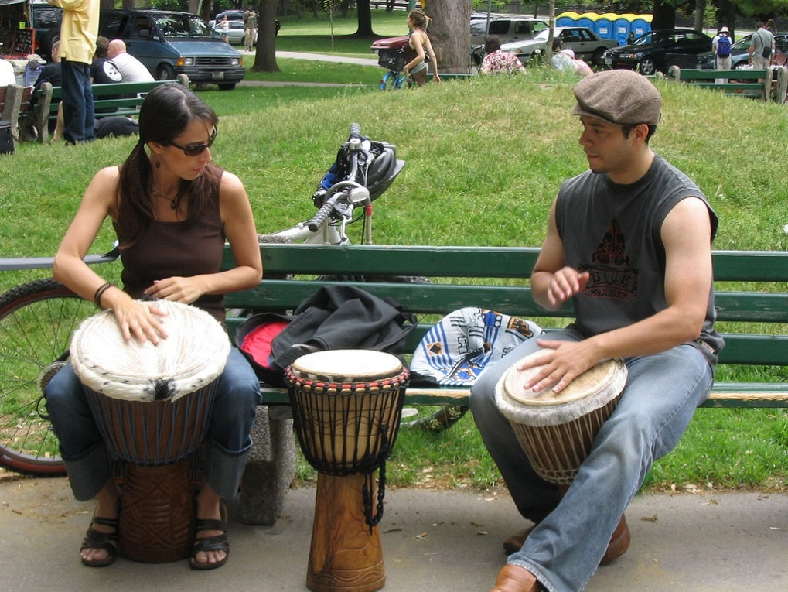
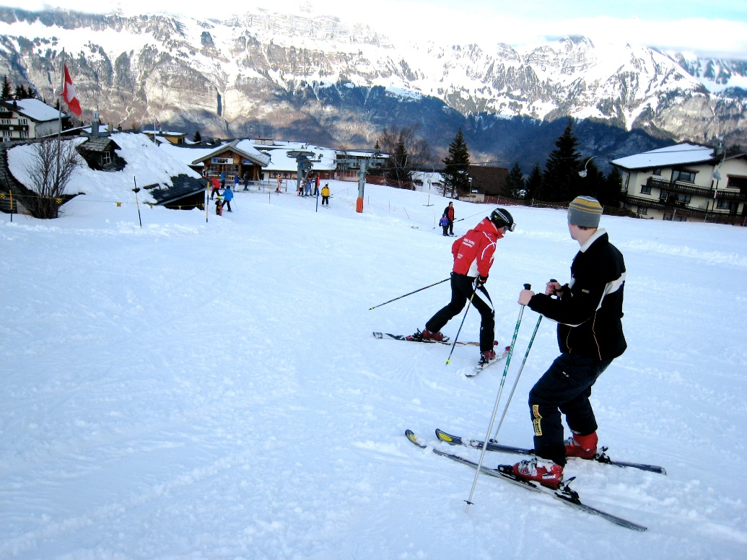
https://upload.wikimedia.org/wikipedia/commons/1/11/Learning_djembe.jpg
https://upload.wikimedia.org/wikipedia/commons/e/e0/Skiing_lesson_at_Flumserberg.jpg
© Kristy Kendall & Edrolo 2017

Slide 3
Social learning theory
Higher level animals do not need to learn through direct experience, they can learn indirectly from observing and imitating others.
A way by which individuals learn values, behaviours and attitudes from others in their social environment.
Learning by observing and watching others (the model) and their consequences to guide future behaviour. So social learning happens via observational learning.
The Model - the person whose behavior the subject watches and imitates
Modeling - The process of observing and imitating a specific behavior
Social learning is a more active process than either classical or operant conditioning

Slide 4
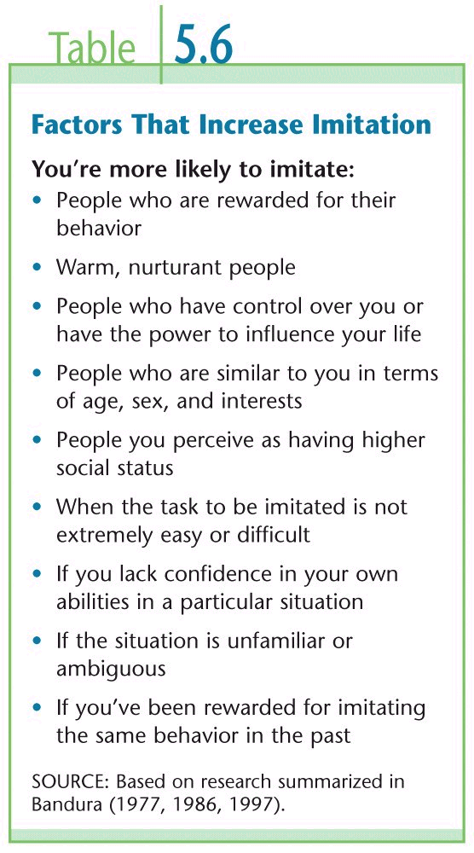
YouTube video – Dancing baby
Social learning can start at a very young age….
https://www.youtube.com/watch?v=kU9MuM4lP18

Slide 5
Vicarious Learning
Learning by seeing the consequence of another’s behavior
Vicarious conditioning is when an individual watches a model’s behavior being either reinforced or punished, and modifies their behavior accordingly.
Vicarious reinforcement occurs when a model’s behaviour is reinforced, and therefore increases the likelihood of the observer behaving in a similar way.
Vicarious punishment occurs when a model’s behaviour is punished, and therefore decreases the likelihood of an observer behaving in a similar way.

Slide 6
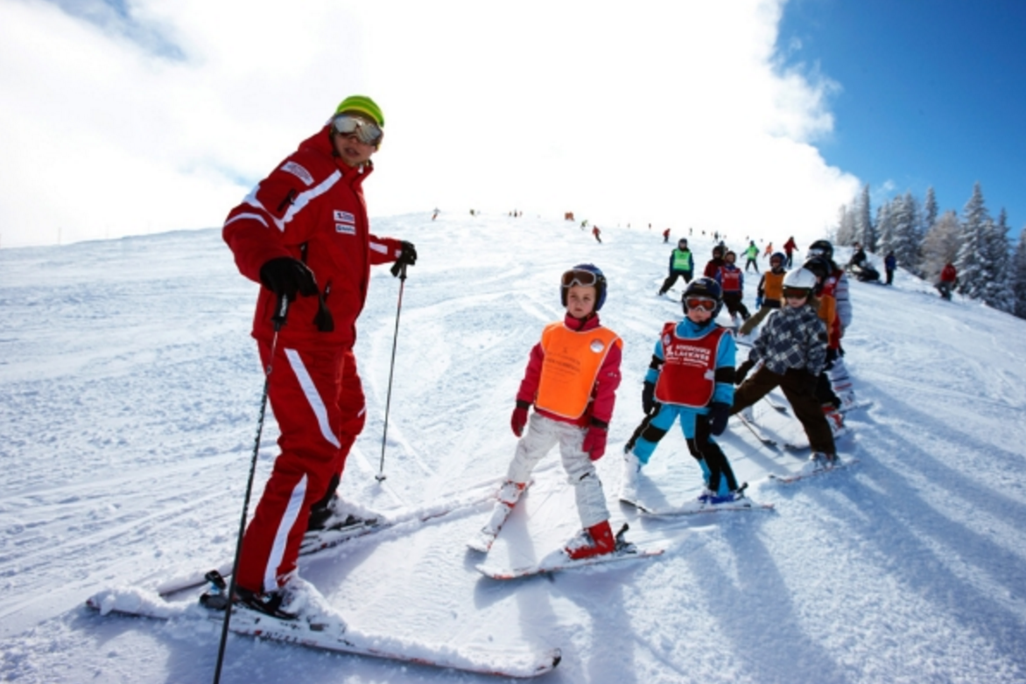
Attention
Retention
Reproduction
Motivation
http://www.trekking.cl/ski2015/
Reinforcement
© Kristy Kendall & Edrolo 2017

Slide 7
Processes in social learning
Attention: learner actively watches model.
Retention: learner stores mental representation of behaviour.
Reproduction: learner has the mental and physical ability to perform the behaviour.
Motivation: the learner must want or have a desire to imitate the behaviour.
Reinforcement: a positive outcome means the learner is more likely to repeat the behaviour.
© Kristy Kendall & Edrolo 2017

Slide 9
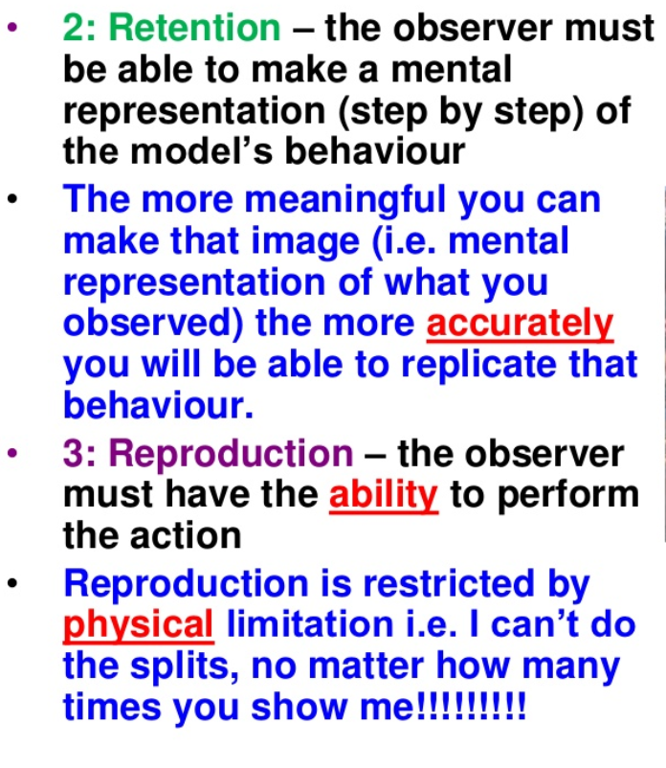

Slide 11
Motivation and reinforcement
Types of Motivation | Types of Reinforcement
Intrinsic Extrinsic | Self reinforcement (feeling good about your own achievements External reinforcement (desiring approval from others) Vicarious reinforcement (watching others being reinforced)
© Kristy Kendall & Edrolo 2017

Slide 12
YouTube video - Masterchef
So which kind of behaviour is best to be learnt through observational learning?
How many cooking shows do you know?
https://www.youtube.com/watch?v=Olye1M0AwV4
© Kristy Kendall & Edrolo 2017

Slide 13
Fast five – Question 1
What is the type of learning known as where an individual learns from watching another persons behaviour?
© Kristy Kendall & Edrolo 2017

Slide 14
Fast five – Question 1 (Answer)
What is the type of learning known as where an individual learns from watching another persons behaviour?
Answer:
Social learning
© Kristy Kendall & Edrolo 2017

Slide 15
Fast five – Question 2
What type of watching must a learner do in the attention stage?
© Kristy Kendall & Edrolo 2017

Slide 16
Fast five – Question 2 (Answer)
What type of watching must a learner do in the attention stage?
Answer:
Active
© Kristy Kendall & Edrolo 2017

Slide 17
Fast five – Question 3
What is the second stage of social learning?
© Kristy Kendall & Edrolo 2017

Slide 18
Fast five – Question 3 (Answer)
What is the second stage of social learning?
Answer:
Retention
© Kristy Kendall & Edrolo 2017

Slide 19
Fast five – Question 4
What kind of reinforcement is it if you are reinforced through someone else’s actions?
© Kristy Kendall & Edrolo 2017

Slide 20
Fast five – Question 4 (Answer)
What kind of reinforcement is it if you are reinforced through someone else’s actions?
Answer:
Vicarious
© Kristy Kendall & Edrolo 2017

Slide 21
Fast five – Question 5
In which stage is a 5 year old least likely to be able to learn how to drive through social learning?
© Kristy Kendall & Edrolo 2017

Slide 22
Fast five – Question 5 (Answer)
In which stage is a 5 year old least likely to be able to learn how to drive through social learning?
Answer:
Reproduction
© Kristy Kendall & Edrolo 2017

Slide 23
Multiple choice activity
Mike had never cooked before, although in the past he had spent time in the kitchen with his mother when she was cooking.
The first night he tried, Mike was able to cook spaghetti even though he had never cooked it before and did not have a recipe.
In terms of observational learning, which of the following elements enabled Mike to be able to cook spaghetti?
attention, reproduction
motivation, incubation
cognition, ‘ah ha’ experience
cognitive representation, stimulus generalisation
(VCAA 2012 Exam 2 Section A Q19)
© Kristy Kendall & Edrolo 2017

Slide 24
Multiple choice (Response)
Mike had never cooked before, although in the past he had spent time in the kitchen with his mother when she was cooking.
The first night he tried, Mike was able to cook spaghetti even though he had never cooked it before and did not have a recipe.
In terms of observational learning, which of the following elements enabled Mike to be able to cook spaghetti?
attention, reproduction
motivation, incubation
cognition, ‘ah ha’ experience
cognitive representation, stimulus generalisation
(VCAA 2012 Exam 2 Section A Q19)
© Kristy Kendall & Edrolo 2017

Slide 25
Short Answer Activity – Write a response
Jodie wants her daughter to learn how to cook. Describe how Jodie could teach her daughter cooking skills, using all the elements of observational learning.
(5 marks)
(VCAA Unit 4 - 2004 Q8b)
© Kristy Kendall & Edrolo 2016

Slide 26
Short Answer - Response
Jodie wants her daughter to learn how to cook. Describe how Jodie could teach her daughter cooking skills, using all the elements of observational learning.
(5 marks)
(VCAA Unit 4 - 2004 Q8b)
© Kristy Kendall & Edrolo 2016

Slide 27
Short Answer Activity – Mark your response
Jodie wants her daughter to learn how to cook. Describe how Jodie could teach her daughter cooking skills, using all the elements of observational learning.
(5 marks)
Marking Criteria | Mark allocation
Describe the element attention and relate the scenario | 1 mark
Describe the element retention and relate the scenario | 1 mark
Describe the element reproduction and relate the scenario | 1 mark
Describe the element motivation and relate the scenario | 1 mark
Describe the element reinforcement and relate the scenario | 1 mark
(VCAA Unit 4 - 2004 Q8b)
© Kristy Kendall & Edrolo 2016

Slide 28
Bringing it together
What is observational learning?
Presented by Kristy Kendall
Study design dot point
Observational learning as a method of social learning, particularly in children, involving attention, retention, reproduction, motivation and reinforcement.
© Kristy Kendall & Edrolo 2017

