Slide 1
VCE PSYCHOLOGY
NEUROTRANSMITTERS AND NEUROHORMONES
Study design dot point
The role of neurotransmitters and neurohormones in the neural basis of memory and learning (including the role of glutamate in synaptic plasticity and the role of adrenaline in the consolidation of emotionally arousing experiences).

Slide 2
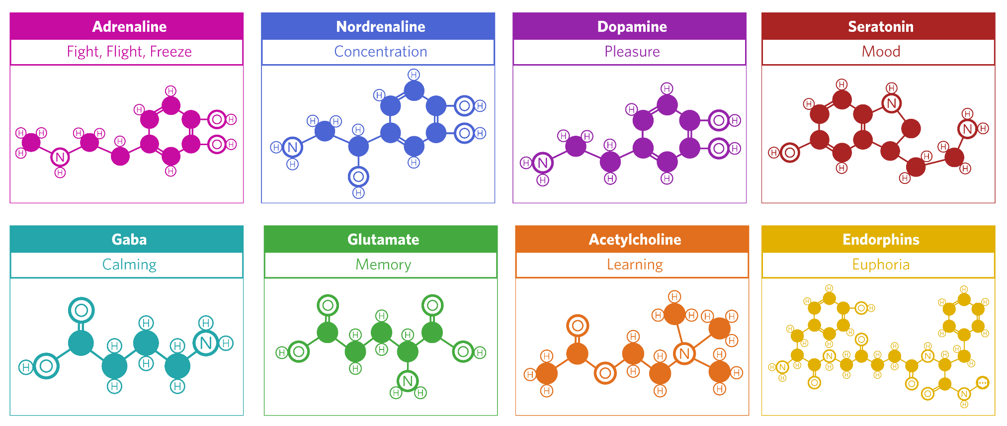

Slide 3
Neurotransmitters and neurohormones in memory and learning
Some neurotransmitters help memory storage while others can disrupt it. It is known that different types of memory and learning are assisted by the neurotransmitters, glutamate, serotonin and acetylcholine, and the hormone, adrenaline.
Different neurotransmitters tend to have different roles in learning and memory. Researchers have yet to entirely isolate or explain every effect of each one. Generally, they all enable communication of the information being learned and initiate or contribute to important structural changes at the synapse that help ensure the memory is durable and long-lasting when formed

Slide 4
Some neurohormones also have roles in learning and memory. Like neurotransmitters, neurohormones are chemical messengers that are manufactured by neurons and released from axon terminals. Unlike neurotransmitters, they are not released into the synaptic gap. Instead, they are released into capillaries (tiny blood vessels) where they are absorbed into the bloodstream and carried to target neurons or cells.

Slide 5
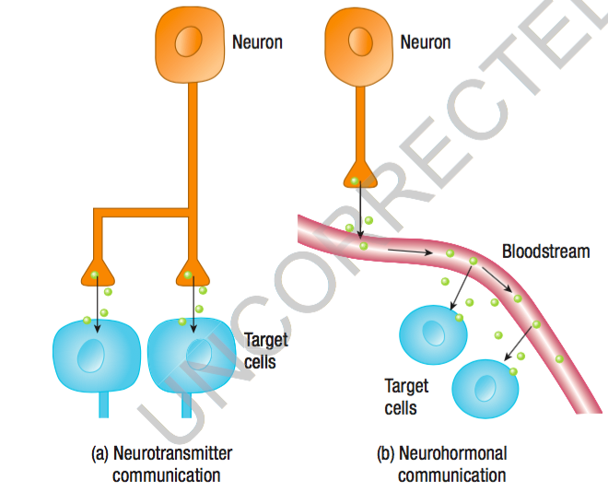

Slide 6
Glutamate and synaptic plasticity
Glutamate is the main excitatory neurotransmitter throughout the brain and enhances information transmission by making postsynaptic neurons more likely to fire.
In learning and memory, glutamate plays crucial roles in the synaptic changes that occur. In particular, it promotes the growth and strengthening of synaptic connections between neurons within a neural pathway that subsequently represents the memory of what has been learned.
LTP and LTD are important forms of synaptic plasticity that occur at synapses within several brain regions, particularly areas with significant roles in learning and memory (such as the cerebral cortex, hippocampus and cerebellum).
Given glutamate’s excitatory effect, it has a vital role in LTP and LTD. Generally, the more often that glutamate can excite an adjacent neuron, the more it contributes to LTP (and vice versa for LTD).

Slide 7
Specific types of glutamate receptors also have to be present on the dendrites of postsynaptic neurons for glutamate to have these effects.
Two of these receptors are commonly called AMPA and NMDA and glutamate has to have an effect on both of them. Without these receptors at the specific sites where glutamate is received, any message carried in glutamate cannot be ‘accepted’ by a postsynaptic neuron.
Generally, AMPA prepares the postsynaptic neuron to accept glutamate then clears out so that NMDA can accept the glutamate. Glutamate will then excite the postsynaptic neuron and convey its message.
In addition, the next time glutamate is released from the presynaptic neuron, it will have a larger excitatory effect on the postsynaptic neuron because of the previous chemical effects it had on AMPA and NMDA. For example, there will be more AMPA receptors so the postsynaptic neuron is more likely to fire in response to presynaptic neurotransmitter release. This chemical process contributes to LTP and can also initiate growth of new dendritic spines on postsynaptic neurons, resulting in additional synaptic connections

Slide 8
Glutamate in Summary
Main excitatory neurotransmitter
Well know for its role in cognition, learning and memory
Glutamate can bind neurons together through synaptic plasticity involved in long term potentiation
© Pixabay
Notes:
https://pixabay.com/en/child-girl-young-caucasian-1073638/

Slide 9
Role of adrenaline in the consolidation of emotionally arousing experiences
Lasting memories are not created immediately at the time of a new experience. A period of time is required to ensure the experience becomes long-lasting when transferred to long-term memory for storage. Consolidation is the process by which this is achieved.
Consolidation is the biological process of making a newly formed memory stable and enduring after learning. Time is required after learning takes place to enable the new information to consolidate (‘set’) as a durable long-term memory.

Slide 10
New incoming information is temporarily stored in short-term memory before its transfer to long-term memory. Research evidence indicates that if consolidation is disrupted, new information may not transfer from short-term to long-term memory or will not be stored well in long-term memory if it arrives there. The outcome depends on the timing of the disruption. Consolidation appears to be a gradual process, and the information being remembered is particularly vulnerable to disruption for at least 30 minutes following learning
The consolidation of information during transfer from short-term to long-term memory can be compared to writing your name in wet concrete. Once the concrete has set (the information has consolidated in long-term memory), your name (the information) is relatively permanently ingrained. But while it is setting (the process of consolidation), it can be interfered with (altered) or erased (completely lost).

Slide 11
Because consolidation is time-dependent, the process is exposed to various factors that can influence the strength or durability of the memory being formed during the consolidation period. One such factor involves stress hormones, particularly the adrenaline and cortisol secreted by the adrenal glands.
There is considerable research evidence that adrenaline has an important role in the consolidation of specific types of memories. In particular, adrenaline can enhance the consolidation of long-term memories of emotionally arousing experiences. This means that these types of events are more likely to be well remembered (but not necessarily more accurately).
You probably know from personal experience that emotionally significant experiences tend to be well remembered. This is very common for both pleasant and unpleasant events.

Slide 12
When released during heightened emotional arousal, adrenaline induces the release of noradrenaline (also called epinephrine) in the amygdala, which is located deep within the brain and has a crucial role in emotions. It is believed that the presence of noradrenaline during consolidation may then activate the amygdala to signal to the nearby hippocampus that details of the relevant experience are significant and its long-term storage should be strengthened.
For example, participants given a drug that promotes release of adrenaline when viewing emotionally arousing images will have an enhanced memory of those images compared to control or placebo groups. Conversely, participants given a drug that inhibits the release of adrenaline later have more trouble remembering details of the images

Slide 13
Adaptive Value
Some psychologists have proposed that longer-lasting memories of emotionally arousing experiences, particularly for important or threatening events, has adaptive value as these memories can guide our behaviour in appropriate ways in the future.
However, in other circumstances it can be a problem, such as in the case of post-traumatic stress disorder (PTSD), which is a condition where victims suffer symptoms such as sleep disturbances and flashbacks due to a traumatic event.
people suffering from PTSD are often haunted by memories and images of highly arousing, emotionally traumatic events to a point where it becomes unbearable. The ordeal they underwent keeps resurfacing over and over again. Each time the event resurfaces, adrenaline may be released, thereby maintaining the strength of the memory each time it is reconsolidated

Slide 14
Adrenaline in Summary
Adrenalin (epinephrine) can enhance long term memory
Important for encoding emotional memories
Ensures memory strength relates to memory importance
New course available – studying with a crocodile to aid memory:
https://www.youtube.com/watch?v=8hij53lqEDs
© Pixabay
Notes:
https://pixabay.com/en/animal-canine-cartoon-dog-pet-1299573/

Slide 15
Excitatory vs Inhibitory
Stimulating vs Calming
© Kristy Kendall & Edrolo 2017

Slide 16
Fast five – Question 1
Which type of neurotransmitter can affect a group of neurons?
© Kristy Kendall & Edrolo 2017

Slide 17
Fast five – Question 1 (Answer)
Which type of neurotransmitter can affect a group of neurons?
Answer:
Neurohormone
© Kristy Kendall & Edrolo 2017

Slide 18
Fast five – Question 2
Which neurotransmitter is known for its role in memory and learning?
© Kristy Kendall & Edrolo 2017

Slide 19
Fast five – Question 2 (Answer)
Which neurotransmitter is known for its role in memory and learning?
Answer:
Glutamate
© Kristy Kendall & Edrolo 2017

Slide 20
Fast five – Question 3
Is this neurotransmitter excitatory or inhibitory?
© Kristy Kendall & Edrolo 2017

Slide 21
Fast five – Question 3 (Answer)
Is this neurotransmitter excitatory or inhibitory?
Answer:
Excitatory
© Kristy Kendall & Edrolo 2017

Slide 22
Fast five – Question 4
Which hormone is said to enhance emotional memory formation?
© Kristy Kendall & Edrolo 2017

Slide 23
Fast five – Question 4 (Answer)
Which hormone is said to enhance emotional memory formation?
Answer:
Adrenaline
© Kristy Kendall & Edrolo 2017

Slide 24
Fast five – Question 5
True or false: There are no negative effects from too much glutamate in your system.
© Kristy Kendall & Edrolo 2017

Slide 25
Fast five – Question 5 (Answer)
True or false: There are no negative effects from too much glutamate in your system.
Answer:
False
© Kristy Kendall & Edrolo 2017

Slide 26
Multiple Choice Activity
Which of the following is not a role of the neurotransmitter glutamate?
Glutamate activates the post-synaptic neuron.
Glutamate produces long-lasting changes to the synapse during long-term potentiation.
Glutamate is an inhibitory neurotransmitter.
Glutamate stimulates the release of dopamine which promotes the growth of dendritic spines.
© Kristy Kendall & Edrolo 2016

Slide 27
Multiple Choice (Response)
Which of the following is not a role of the neurotransmitter glutamate?
Glutamate activates the post-synaptic neuron.
Glutamate produces long-lasting changes to the synapse during long-term potentiation.
Glutamate is an inhibitory neurotransmitter.
Glutamate stimulates the release of dopamine which promotes the growth of dendritic spines.
© Kristy Kendall & Edrolo 2016

Slide 28
Bringing it together
NEUROTRANSMITTERS AND NEUROHORMONES
Presented by Kristy Kendall
Study design dot point
The role of neurotransmitters and neurohormones in the neural basis of memory and learning (including the role of glutamate in synaptic plasticity and the role of adrenaline in the consolidation of emotionally arousing experiences).
© Kristy Kendall & Edrolo 2017

