Slide 1
VCE PSYCHOLOGY
Descriptive Statistics
Presented by Kristy Kendall
Study design dot point
systematically generate, collect, record and summarise both qualitative and quantitative data
process quantitative data using appropriate mathematical relationships and units
organise, present and interpret data using tables, bar charts, line graphs, percentages, calculations of mean as a measure of central tendency and understanding of standard deviation as a measure of variation around the mean

Slide 2
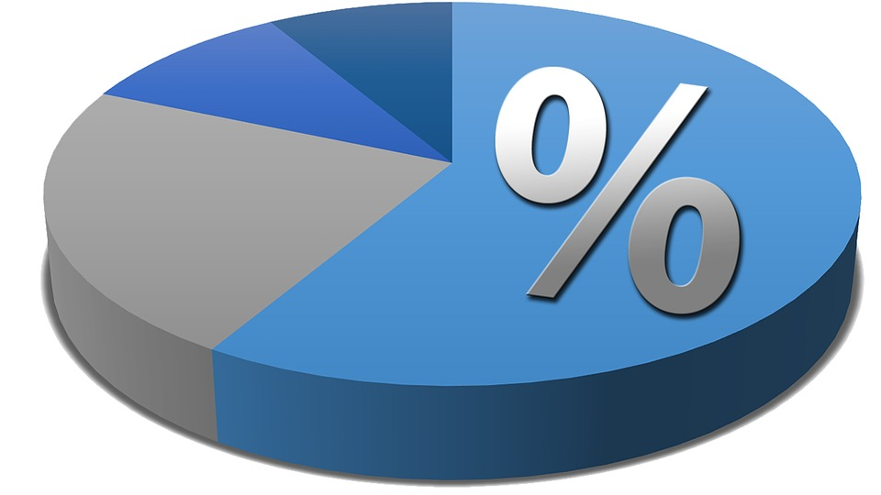
73.6% of all statistics are made up
Source: Pixabay
Notes:
Source: https://pixabay.com/en/pie-chart-percentage-diagram-1522882/

Slide 3
Data
Raw data
Qualitative vs Quantitative Data
Descriptions, opinions and arguments (eg interview)
Numerical and categorical data (eg rating scale)
What use is raw data?
Raw data is all the individual scores on their own. They mean nothing until they are organised and summarised to make meaning of the data received.
Source: Freepik
Notes:
Source: ://www.freepik.com/free-vector/magnifying-glass-data-analysis_761448.htm

Slide 4
Qualitative vs Quantitative Questions
What do you like about school?
What do you like about school?
How do you feel about your teacher?
Age?
Number of hours worked?
Source: Pixabay
Notes:
https://pixabay.com/en/speech-balloon-talk-bubble-1019777/

Slide 5
Descriptive statistics
Mathematical calculations that describe, organise and summarise the data.
Measures of central tendency: Mean, median and mode
Measures of variance: describe the spread of scores from the mean eg range and standard deviation
Presentation of data: Frequency distribution tables, bar graphs, line graphs, percentages, etc
NO conclusions can be drawn from descriptive statistics

Slide 6
Measures of central tendency
Mean | The ‘average’ score: Add all scores together and divide by the number of pieces of data
Median | The ‘middle’ score: Place all scores in order and find the centre (if shared then find mean)
Mode | The most ‘frequent’ score: Tally the number of times each score appears
A) 5, 2, 3, 3, 3, 4, 2, 2.
B) 6, 7, 2, 3, 2, 6, 6, 6, 7.

Slide 7
Measures of central tendency
When the results are fairly evenly distributed about the central value, the mean is a useful representation of the data.
When there are extreme scores in the data set, the median is a more representative measure.
Video source:
https://www.youtube.com/watch?v=oNdVynH6hcY

Slide 8
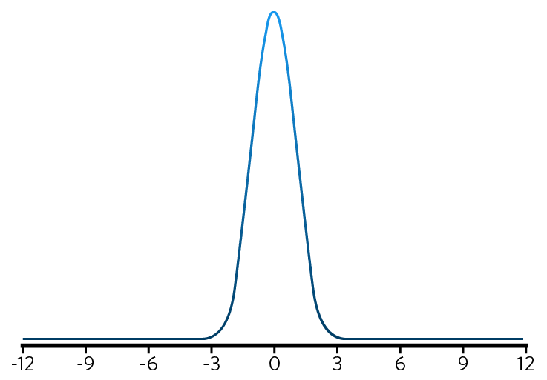
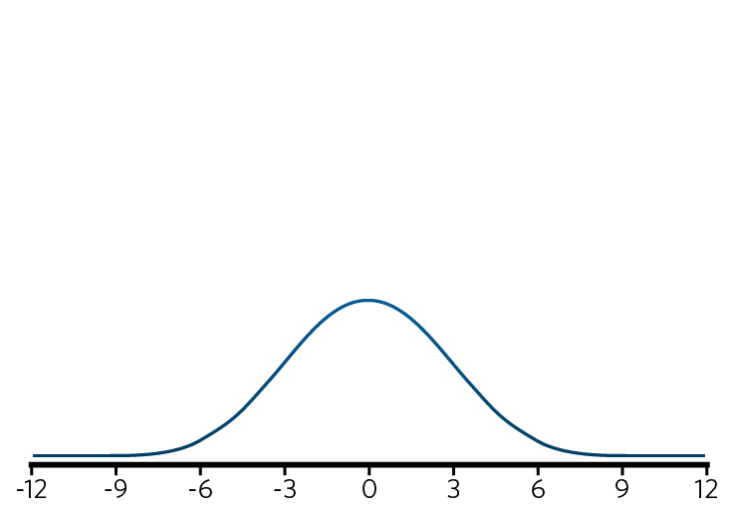
Measures of variability
Range = the difference between the highest and lowest scores in a distribution.
Standard deviation = measures the spread of scores around the mean. The higher the standard deviation, the greater the range of values within the sample.

Slide 9
Percentages
Frequently used as a descriptive statistic.
Provides a basis of comparison as a proportion of the whole
Calculated by multiplying the ratio by 100
eg 20/25 X 100 = 80%
Source: Pixabay
Notes:
https://pixabay.com/en/percent-percentage-percent-sign-76213/

Slide 10
Frequency distributions tables
Graph or table that organises data to show how often (frequently) a score occurs in a set of data.
12
10
8
6
4
2
No of children in group | Frequency
1 | 6
2 | 10
3 | 12
4 | 8
5 | 9
Frequency
1 2 3 4 5
Number of children in a group

Slide 11
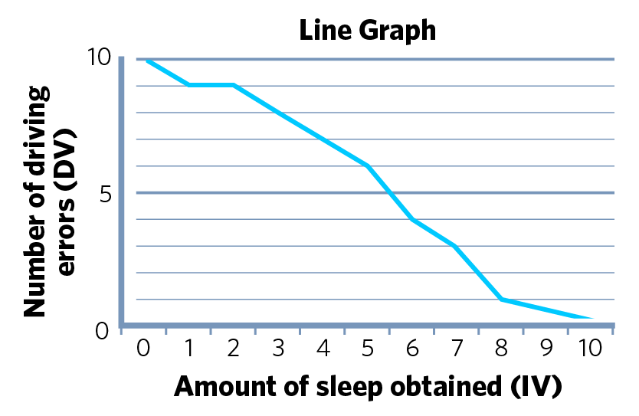
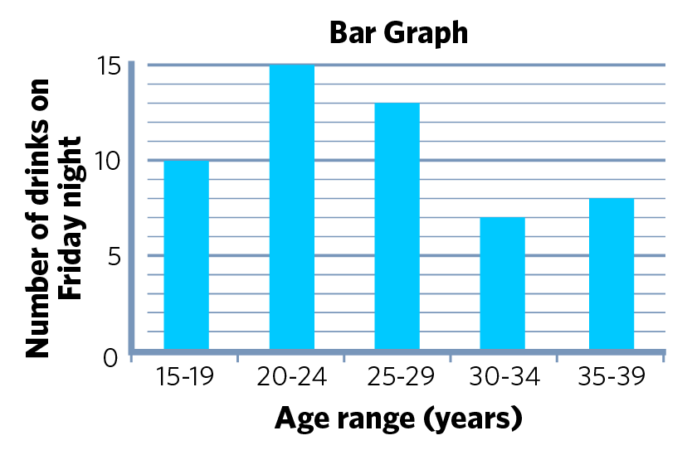
Other types of graphs
Used to indicate the relationship between two factors
Discrete vs Continuous data
Shows how frequently something occurs by using discrete bars

Slide 12
Multiple choice activity
Maggie and Tom are two healthy 15-year-old high school students who participated in a sleep study. During the study, they had to record their respective number of hours of sleep. They submitted their sleep records to the researchers at the end of the study.
The type of data collected in Maggie’s and Tom’s sleep records was
A. qualitative only.
B. quantitative only.
C. counter balancing.
D. both qualitative and quantitative.
(VCAA 2012 Unit 3 Q4)

Slide 13
Multiple choice - Response
Maggie and Tom are two healthy 15-year-old high school students who participated in a sleep study. During the study, they had to record their respective number of hours of sleep. They submitted their sleep records to the researchers at the end of the study.
The type of data collected in Maggie’s and Tom’s sleep records was
A. qualitative only.
B. quantitative only.
C. counter balancing.
D. both qualitative and quantitative.
(VCAA 2012 Unit 3 Q4)

Slide 14
Multiple choice activity
As part of an experiment, a psychologist records the number of correct responses on a memory test. He records the following scores: 11, 15, 17, 24, 19, 28, 27, 28, 15, 15, 15, 19, 16
The mode for this set of data is
A. 15 B. 17 C. 19
D. 27
(VCAA 2015 Q61)

Slide 15
Multiple choice - Response
As part of an experiment, a psychologist records the number of correct responses on a memory test. He records the following scores: 11, 15, 17, 24, 19, 28, 27, 28, 15, 15, 15, 19, 16
The mode for this set of data is
A. 15 B. 17 C. 19
D. 27
(VCAA 2015 Q61)

Slide 16
Multiple choice activity
As part of an experiment, a psychologist records the number of correct responses on a memory test. He records the following scores: 11, 15, 17, 24, 19, 28, 27, 28, 15, 15, 15, 19, 16
The median for this set of data is
A. 15 B. 17 C. 18
D. 19
(VCAA 2015 Q62)

Slide 17
Multiple choice - Response
As part of an experiment, a psychologist records the number of correct responses on a memory test. He records the following scores: 11, 15, 17, 24, 19, 28, 27, 28, 15, 15, 15, 19, 16
The median for this set of data is
A. 15 B. 17 C. 18
D. 19
(VCAA 2015 Q62)

Slide 18
VCE PSYCHOLOGY
Qualitative / quantitative data
Study design dot point
systematically generate, collect, record and summarise both qualitative and quantitative data
process quantitative data using appropriate mathematical relationships and units
organise, present and interpret data using tables, bar charts, line graphs, percentages, calculations of mean as a measure of central tendency and understanding of standard deviation as a measure of variation around the mean

Slide 19
Fast five – Question 1
What sort of data uses numerical or categorical data?

Slide 20
Fast five – Question 1 (Answer)
What sort of data uses numerical or categorical data?
Answer:
Quantitative

Slide 21
Fast five – Question 2
Statistics that describe, organise and summarise data are known as what? Descriptive

Slide 22
Fast five – Question 2 (Answer)
Statistics that describe, organise and summarise data are known as what?
Answer:
Descriptive

Slide 23
Fast five – Question 3
The most frequently occurring number in a data set is known as what? Mode

Slide 24
Fast five – Question 3 (Answer)
The most frequently occurring number in a data set is known as what?
Answer:
Mode

Slide 25
Fast five – Question 4
The mean and median are both measures of what? Central tendency

Slide 26
Fast five – Question 4 (Answer)
The mean and median are both measures of what?
Answer:
Central tendency

Slide 27
Fast five – Question 5
The spread of data surrounding the mean is measured by what? Standard deviation

Slide 28
Fast five – Question 5 (Answer)
The spread of data surrounding the mean is measured by what?
Answer:
Standard deviation

Slide 29
The copyright in substantial portions of this material is owned by the Victorian Curriculum and Assessment Authority. Used with permission. The VCAA does not endorse this product and makes no warranties regarding the correctness or accuracy of its content. To the extent permitted by law, the VCAA excludes all liability for any loss or damage suffered or incurred as a result of accessing, using or relying on the content. Current and past VCAA exams and related content can be accessed directly at www.vcaa.vic.edu.au
We do our best to make these slides comprehensive and up-to-date, however there may be errors.
We'd appreciate it if you pointed these out to us!

