Slide 1
VCE PSYCHOLOGY
Atkinson-shiffrin model of memory
Study design dot point
The multi-store model of memory (Atkinson-Shriffin) with reference to the function, capacity and duration of sensory, short-term and long-term memory

Slide 2
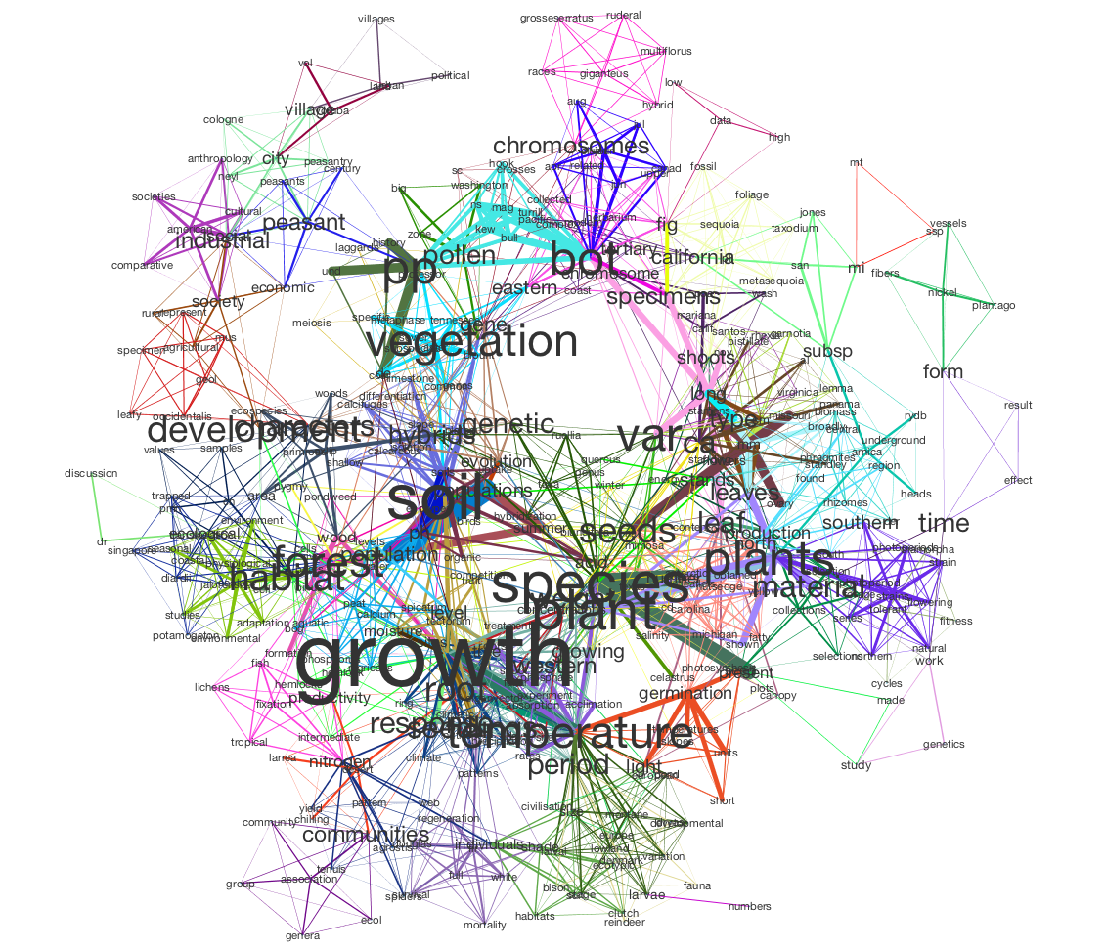

Slide 3
What is memory?
To understand the different models of memory, it is helpful to be familiar with the memory process. In fact, it is similar to the way we use a computer.
Memory is an active processing system
Memory depends on three sequential processes called encoding, storage and retrieval (recovering info when needed)
Memories pass through many different stores to be consolidated
They are not an exact replica of the world at the time they are recovered for use (although some people have amazing memory abilities…...
https://www.youtube.com/watch?v=OQ8zFs2epWU)
© Kristy Kendall & Edrolo 2017

Slide 4
Information processing model
Encoding
Storage
Retrieval
Converting information into a useable form for storage
Retaining information over time for future use
Accessing previously stored information for use
Encoding refers to the process of putting information into a form which will allow it to t in with your personal storage system. If you strike the ‘X’ key on your computer and press ‘Enter’, an electronically coded message representing ‘X’ goes into the computer memory. The same happens when we put an idea into our brain, but for us the idea is changed into an electrochemical
Storage is keeping information in the brain so that we can use it later on – like saving it to the hard drive of a computer. We store the information in an organised way to make it easier for us to recover memories when we need them.
Retrieval is the process of getting information back from memory so that we can use it – like opening a le on a computer and getting a document on the screen.
Retrieval relies on using the right cues so that we can get to the correct location in our brain; again, just like using the correct folder and file name to
open a computer file.

Slide 5
The analogy of a computer for memory fits quite well for encoding and retrieval, but it is inadequate for storage.
The brain does not store a memory like an object in one place. Each memory is spread out over a huge population of cells throughout different regions of our brain.
Storage is also a dynamic process whereby human memories change over time and, again – unlike a computer hard drive – human memories are rough copies rather than exact replicas of information.
The analogy of a computer as a model for human memory is useful because, as research progresses, it can be modified and adapted to include new findings.
Atkinson and Shifrin’s multi-store model of memory describes three stores of memory that are separate but function simultaneously to create our ability to encode, store and retrieve information.

Slide 6
Atkinson - Shiffrin model
Storage
Incoming sensory information
Long Term Memory
Sensory Memory
Short Term Memory
Encoding
Retrieval
Response Output
Sensory registers
Visual Auditory
Touch, taste and smell
Long-term memory
Permanent memory store
Temporary Working Memory
Control processes: Rehearsal
Retrieval strategies
The model describes memory as a ow of information with inputs, processes and outputs. Environmental input, or information from our surroundings, enters through our sensory memory, also called our sensory register. The short-term memory then processes and stores this input. In our short-term memory information is rehearsed and can then be stored more permanently in our long-term memory to retrieve later on.
The short term-memory retrieves information from the long-term memory to output information such
as when we reminisce with friends, remember formulas for an exam or recall someone’s name.

Slide 7
Sensory Memory
Sensory memory relates to memory within our sense organs. It is where information in our environment is received by our senses. If the information is unique, different, interesting, relevant or in some other way attracts our attention, then it is transferred to short-term memory. Sensory memory is different to short- term and long-term memory because it has an unlimited capacity but only a very brief duration.
We have a sensory store for each of the five senses. Each sensory store is able to hold information for anything between a fraction of a second to several seconds (it varies from one sense to another). The information held in sensory memory has not yet entered our awareness and, if we don’t pay attention to it, it never will!
The information in sensory memory is not processed. We say that the energy is brie y stored in its raw form before the traces fade or decay.

Slide 8
Functions of Sensory memory
Sensory memory prevents us from being overwhelmed by the huge amounts of incoming sensory information. Its duration is very brief, but long enough for our brain to determine whether it is important enough to be transferred to our short-term memory. Our senses are bombarded with information every second of our normal waking consciousness. It is impossible for us to pay attention to all of this information, so our sensory registers act like filters for what is relevant to what we are doing or thinking at any given moment. The brief duration (rapid decay) of sensory memory is necessary. Otherwise, we would be unable to process new incoming information. The rapid decay also allows us to perceive our world as smooth and ongoing, and to hear sounds just long enough to understand whole words and sentences.

Slide 9
Types of Sensory Memory
Iconic memory refers to our visual sensory memory. Icon is from the Greek word meaning ‘image’.
Iconic memory lasts for about 0.3 seconds. This explains why we can see moving pictures from a series of still shots projected onto a movie screen. We are still storing the image of one still shot when it is replaced by the next frame, so the illusion of movement is created. This is why movies run at 64 frames per second
Echoic memory refers to our auditory (sound) sensory memory.
Echoic memories are stored in our sensory memory for a slightly longer period than iconic memories: about 3–4 seconds. This is necessary because we need to register information in its entirety before we can make it meaningful; hence the delayed reaction. We may appear not to hear a question, but as we focus, we realize we can actually make sense of what was said and are able to give an answer – often interrupting the speaker who is in the process of repeating the question! This occurs because the sound is ‘held’ long enough in echoic memory.
If we then consciously attempt to remember the question, the information is moved to short term memory. If not, it is lost.

Slide 10
Short Term Memory
Short-term memory allows us to retain information for enough time to use it; for example, looking up a telephone number and keeping it in your awareness long enough to dial it.
Incoming sensory information that is sufficiently attended to may pass into the short-term memory. We routinely draw information from the long-term memory to the short-term memory to evaluate and understand information that we are working on at a given moment
E.G Mental Arithmetic

Slide 11
Duration and capacity of short-term memory
Short-term memory is distinguished from sensory memory and long-term memory because it has only a brief duration of approximately 12–30 seconds and a brief capacity of only 5–9 pieces of information. When this capacity is reached, new information can only be put into the short-term memory by displacing existing information.

Slide 12
Improving STM duration
Rehearsal: The process of doing something so that information can be retained in memory and then retrieved when required, can be verbal, vocal, non-verbal, sub-vocal, mental imagery etc.
Maintenance rehearsal: Involves simple, rote repetition of information being remembered can be retained. Going over and over it!
Needs to be attended to consciously – not just meaningless repetition
Elaborative rehearsal: Involves the process of linking new information in a meaningful way with information already stored in long term memory. More active and more effective, ensures that information is encoded well.
Self reference effect: Involves making new information personal and meaningful to you (also known as SALIENCE)

Slide 13
Maintenance Rehearsal
For short-term memory to last its potential of approximately 12 to 30 seconds, there must be no interference. Interference occurs when new information enters the short-term memory and pushes out information that is in our immediate awareness.
To retain information in our short-term memory, we usually find ourselves using a process called maintenance rehearsal.
If you say something over and over (either aloud or sub-vocally in your head) that you want to keep in your immediate awareness, then you may also increase the chances of this information being moved into your long-term memory.

Slide 14
Long Term Memory
It works very much like the hard drive on your computer – the information is encoded and stored and, as long as you know enough about it (like the name of a document or the folder it is in), you can retrieve it.
The way information is stored in long-term memory is different from sensory memory and short-term memory. In long-term memory, information is encoded by its meaning (that is, semantically) and stored in semantic networks.

Slide 15
Duration and capacity of long-term memory
It is hard to identify just how long the duration of long-term memory might be. Sometimes, previously stored memories are thought to be forgotten but, with the appropriate cues, they will suddenly come flooding back into conscious awareness. Long-term memories are maintained because of physiological changes to the neurons and their connections with other neurons.
Similarly, it is difficult to determine the capacity of long-term memory and there is probably no way of finding its limits.
It is generally considered that ‘forgetting’ long-term memories is due to poor retrieval cues rather than capacity limitations. There are also difficulties in measuring the capacity of long-term memory, where different methods of retrieval will produce different results.

Slide 16
Different types of long-term memory
Procedural memory is the memory of how to do things. It includes tying shoelaces, writing, tapping in your banking PIN and using a knife and fork. You may retain procedural memories even after you have forgotten being taught to do these things in the first place.
Declarative memory is
the memory of meaningful events.
Involves memory for facts,
events and general knowledge.

Slide 18
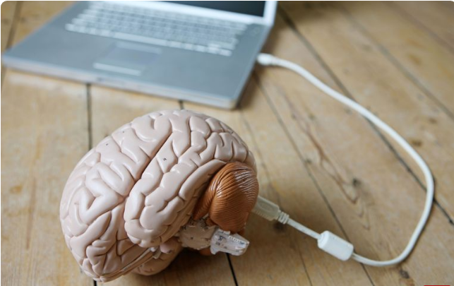
Explicit and Implicit memory
Information that you have to consciously work to remember is known as explicit memory, while information that you remember unconsciously and effortlessly is known as implicit memory

Slide 19
Explicit
When you are trying to intentionally remember something (like a formula for your statistics class or a list of dates for your history class), this information is stored in your explicit memory. We use these memories every day, from remembering information for a test to recalling the date and time of a doctor's appointment. This type of memory is also known as declarative memory since you can consciously recall and explain the information.
There are two major types of explicit memory:
Episodic memory: These are your long-term memories of specific events, such as what you did yesterday or your high school graduation.
Semantic memory: These are memories of facts, concepts, names, and other general knowledge information.

Slide 20
Implicit
Things that we don't purposely try to remember are stored in implicit memory. This kind of memory is both unconscious and unintentional.
Procedural memories, such as how to perform a specific task like swinging a baseball bat or making toast, are one type of implicit memory since you don't have to consciously recall how to perform these tasks.
Some examples of implicit memory include singing a familiar song, typing on your computer keyboard, daily habits, and driving a car. Riding a bicycle is another great example. Even after going years without riding one, most people are able to hop on a bike and ride it effortlessly.

Slide 21
 | Sensory Memory | Short Term Memory | Long Term Memory
Duration | 0.2-4 secs | 18-30 secs | Unlimited
Capacity | Unlimited | 5-9 items | Unlimited
Can take 30 mins to be consolidated.
It can easily be disrupted in this time before consolidation.
© Kristy Kendall & Edrolo 2017

Slide 22
Fast five- Question 1
What is the term used to describe converting information into a useable form for storage?
© Kristy Kendall & Edrolo 2017

Slide 23
Fast five- Question 1 (Answer)
What is the term used to describe converting information into a useable form for storage?
Answer:
Encoding
© Kristy Kendall & Edrolo 2017

Slide 24
Fast five- Question 2
What is the initial entry point for memory?
© Kristy Kendall & Edrolo 2017

Slide 25
Fast five- Question 2 (Answer)
What is the initial entry point for memory?
Answer:
Sensory memory
© Kristy Kendall & Edrolo 2017

Slide 26
Fast five- Question 3
Where are memories retrieved from?
© Kristy Kendall & Edrolo 2017

Slide 27
Fast five- Question 3 (Answer)
Where are memories retrieved from?
Answer:
Long Term Memory
© Kristy Kendall & Edrolo 2017

Slide 28
Fast five- Question 4
What is the maximum number of items that are thought to be able to be stored in STM?
© Kristy Kendall & Edrolo 2017

Slide 29
Fast five- Question 4 (Answer)
What is the maximum number of items that are thought to be able to be stored in STM?
Answer:
Nine
© Kristy Kendall & Edrolo 2017

Slide 30
Fast five- Question 5
What is the duration of LTM?
© Kristy Kendall & Edrolo 2017

Slide 31
Fast five- Question 5 (Answer)
What is the duration of LTM?
Response:
Unlimited
© Kristy Kendall & Edrolo 2017

Slide 32
Multiple choice activity
Which of the following best describes the sequential stages of the formation of new memory according to the Atkinson–Shiffrin multi-store model of memory?
sensory memory, short-term memory, long-term memory
long-term memory, sensory memory, short-term memory
short-term memory, long-term memory, sensory memory
sensory memory, long-term memory, short-term memory
(VCAA 2012 Exam 1Section A Q18)
© Kristy Kendall & Edrolo 2017

Slide 33
Multiple choice (Response)
With reference to Bandura’s research in which children watched an adult model interact aggressively with a Bobo doll, which statement is most correct?
Children never imitated the adult model’s behaviour.
Boys and girls were equally aggressive to the Bobo doll in all conditions.
Children who watched the adult model being punished were less likely to imitate aggressive behaviour.
Girls always imitated the adult model’s behaviour, whereas boys did not imitate the adult model’s behaviour.
(VCAA 2012 Exam 2 Section A Q17)
© Kristy Kendall & Edrolo 2017

Slide 34
Bringing it together
Atkinson-shiffrin model of memory
Study design dot point
The multi-store model of memory (Atkinson-Shriffin) with reference to the function, capacity and duration of sensory, short-term and long-term memory
© Kristy Kendall & Edrolo 2017

