Slide 1
Unit 3 Psychology
Area of Study 2
Memory

Slide 2
Life without memory...?
What would your life be like without a memory?
Without somewhere to store everything you know about... well, everything!

Slide 3
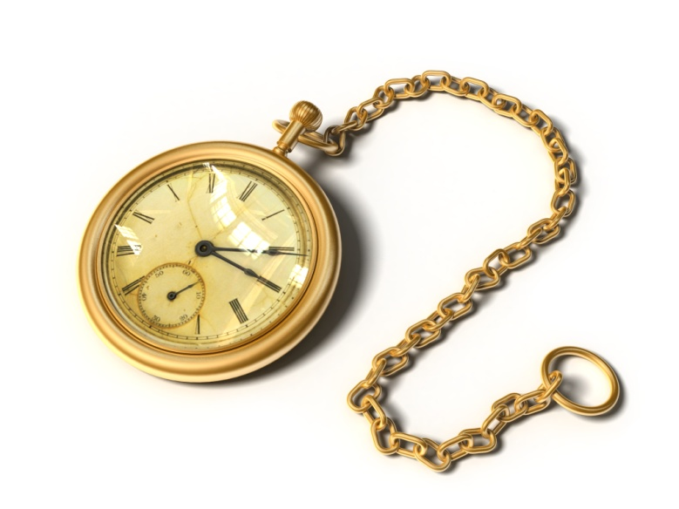
Life without memory...?
You wouldn’t be able to remember what happened 2 seconds ago, 30 minutes ago or 10 years ago!

Slide 4
Life without memory...?
Even something really simple like brushing your teeth or trying your shoelaces would be really difficult because you would have no memory of how to do them...

Slide 5
Human memory
Not a single organ, like heart or
brain
Not just in one part of the brain
Super complex, integrated systems
Not just one memory, but heaps of memory systems
One thing in common... Receive, process & store information

Slide 6
Memory as a computer?
Active process
Receives , organises, stores
and recovers information
Can be compared to a
computer – similar processing
Does not passively receive and store info... Makes decisions about what is important (saved) and what is ignored (not saved)

Slide 7
Memory as a computer?
Stores info in a logical way – easy to retrieve later
Both deal with info in a similar way – 3 key processes... Encoding, storage and retrieval

Slide 8
Encoding, Storage & Retrieval
Changing the raw sensory information into a code that our brain can understand
Whether we remember something or not usually depends on how well we encode
Storage
Accessing stored information so that we can use it
Relies on the right hints or cues to be able to access the right information
Retaining information in our brains so that we can use it at a later stage
Stored in a logical, meaningful way
Encoding
Retrieval

Slide 9
Atkinson-Shiffrin’s Multi-store Model of Memory
Describes human memory as consisting of three distinguishable kinds of memory.
Each represents a stage through which information passes sequentially.
Sensory Memory – entry point of information. If you pay attention to sensory information, it then goes to…
Short Term Memory (STM) – which is your actively conscious memory. Info is then transferred to…
Long Term Memory (LTM) – the relatively permanent memory store which is virtually limitless in capacity.

Slide 10
Structural Features
Control Processes
Permanent built-in features that do not vary between situations
EG: function, storage capacity, duration
Selected and used by each individual and may vary
EG: attention, rehearsal, retrieval strategies

Slide 11
Atkinson-Shiffrin’s Multi-store Model of Memory

Slide 12
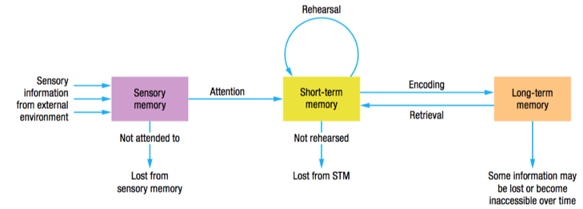

Slide 13
Sensory Memory
First stage of memory
Unlimited capacity (can fit as much in it as you like)
Very short duration – rapid decay (between 0.3 – 4 seconds)
Its duration needs to be short so that the information slightly overlaps, so you see/hear the world in a smooth flow, rather than disjointed sounds/images
Iconic (visual) and Echoic (auditory)

Slide 14
Iconic Memory
Visual sensory memory (icon = picture)
Duration of about 0.3 seconds
Visual sensory information slightly overlaps, so that we see the world smoothly.
Example of iconic memory is when you write your name in the air with a sparkler, you can still see it for a bit
Bendy pencil/blurry hand

Slide 15
Echoic Memory
Auditory sensory memory (echo = sound)
Duration of about 3 – 4 seconds
We hold these memories slightly longer than visual ones… why do you think that is?

Slide 16
Eidetic memory...

Slide 17
Short Term Memory (STM)
This is where all active thinking takes place
It might be new sensory information that you are working on, stuff you have retrieved from LTM, or a combination of both
Has a limited capacity of 7+or- 2 items
Has a limited duration of 12 – 30 seconds
Information is lost though decay (fading) or displacement (being pushed out by new)

Slide 18
Besides whenever I learn something new it pushes something old out of my brain…..Remember when I took that home wine making course and I forgot how to drive.

Slide 19
Displacement in STM

Slide 20
Memory test...
Memorise these numbers...
You have 20 seconds
1....982....18....91....177....420....0....1

Slide 21
Now write them down...
Here are the numbers again..
1....982....18....91....177....420....0....1
Was that easy or difficult? Explain why...

Slide 22
Look at it a different way...
1....982....18....91....177....420....0....1
What if I arranged them like this...
1982......1891......1774......2001

Slide 23
Improving STM capacity
Chunking: The grouping or packing of bits of information into larger bits or units that can be remembered as single units
Chunking expands short term memory. Chunks can be numbers, images, words, abbreviations etc.
Eg. Of chunking telephone numbers.
0417 872 009
Capacity of STM is still 7, but now its 7 bits or chunks of information

Slide 24
Improving STM duration...
Rehearsal: The process of doing something so that information can be retained in memory and then retrieved when required, can be verbal, vocal, non-verbal, sub-vocal, mental imagery etc.
Maintenance rehearsal: Involves simple, rote repetition of information being remembered can be retained. Going over and over it!
Needs to be attended to consciously – not just meaningless repetition
Elaborative rehearsal: Involves the process of linking new information in a meaningful way with information already stored in long term memory. More active and more effective, ensures that information is encoded well.
Self reference effect: Involves making new information personal and meaningful to you (also known as SALIENCE)

Slide 26
Long Term Memory (LTM)
Works like the hard drive on your computer
Info is stored in a different way in LTM... It is stored according to meaning
Has a virtually unlimited capacity
Potentially permanent (unlimited duration)
Usually forgetting occurs (unable to retrieve from LTM) because we don’t use the correct cues to access it

Slide 27
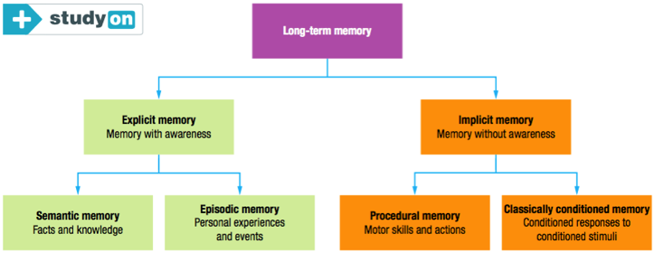
Divisions of LTM

Slide 28
Explicit Memory
•Memory that occurs when information can be consciously or intentionally retrieved or stated - declarative = I do declare...
•Words, images or both
•Also called ‘declarative memories’
•Most common tests of explicit memory include recall & recognition
•Two subtypes: episodic and semantic.

Slide 29
Explicit memory - episodic
•Memory of personally experienced events.
•Time, place, feelings.
•Personal diary, said to be autobiographical.
•Allows you to connect past and present.
The “episodes” of your life

Slide 30
Explicit memory - semantic
•Memory of facts and knowledge about the world.
–Facts & knowledge learned at school
–Everyday facts & general knowledge
–Meaning of words
–Rule
–Areas of expertise
•These memories do not include time and place
EG: Knowing that Madrid the capital of Spain

Slide 31
Implicit memory
•Memory that does not require conscious or intentional retrieval.
•You may not be aware of remembering as it usually occurs effortlessly.
•Also referred to as ‘non-declarative’
•Two subtypes: procedural memory and classically-conditioned memory.

Slide 32
Implicit memory - procedural
•Memory of motor skills and actions that have been learned previously.
–Eg: how to brush your teeth or ride a bike.
•Little or no conscious effort to retrieve.
•They are difficult to put into words – you just ‘know’

Slide 33
Implicit memory - CC
•Usually involved in fear/anxiety
–Eg: You are afraid to go to the dentist due to past experience which have caused anxiety, even though you may not be able to state this explicitly.
•Taste aversion and one-trial learning

