Slide 1
VCE PSYCHOLOGY UNIT 4
Measuring
consciousness
Study design dot points:
the measurement of physiological responses to indicate different states of consciousness, including electroencephalograph (EEG), electromyograph (EMG), electro-oculograph (EOG) and other techniques to investigate consciousness (measurement of speed and accuracy on cognitive tasks, subjective reporting of consciousness, including sleep diaries, and video monitoring)
changes in levels of alertness as indicated by brain waves patterns (beta, alpha, theta, delta) due to drug-induced altered states of consciousness (stimulants and depressants)

Slide 2
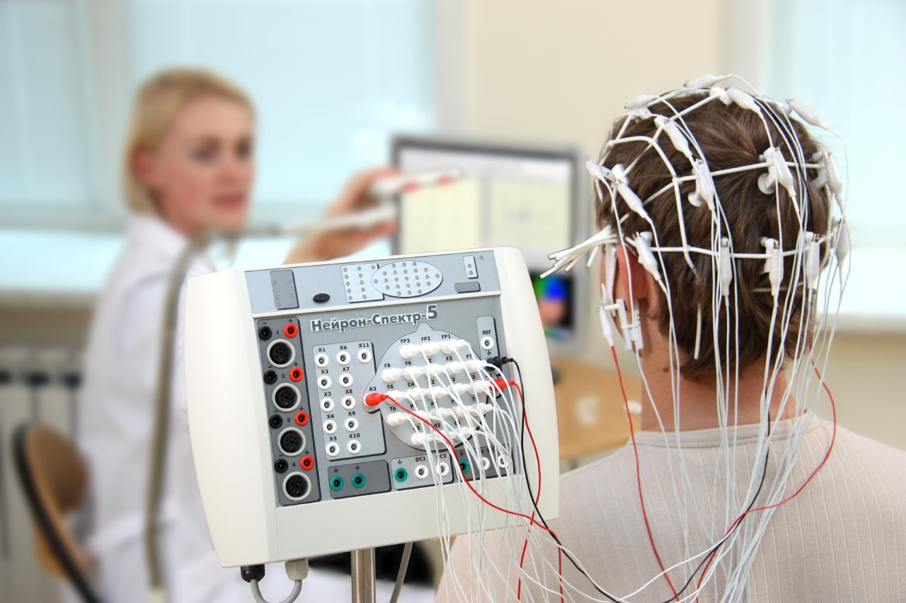
Images used under license from en.wikimedia.org
Notes:
https://commons.wikimedia.org/wiki/File:Musical_brainwave_performance_at_deconism_gallery.jpg

Slide 3
As we know consciousness is a subjective and private experience and is ever-changing (dynamic), self-reflective and central to our sense of self. But how do psychologists study consciousness?
The methods used can include (but are not limited to):
measurement of physiological responses, such as electroencepholgraphy (EEG), electro-oculography (EOG) and electromyography (EMG)
behavioural and cognitive measures, such as measurement of speed and accuracy on cognitive tasks and video monitoring
self-report (subjective) measures, such as sleep diaries.

Slide 4
How do I tell if I am in an ASC?
There are many different things that can be measured to determine if an individual is an an ASC.
Behavioural and performance measures such as measurement of speed and accuracy on cognitive tasks are one way to gather evidence for someone experiencing an ASC.
Other measures include:
Physiological indicators | Psychological indicators
Heart rate Body temperature Galvanic Skin Response Eye movement Muscle movement Brainwaves | Content limitations Perceptual and cognitive distortions Emotional awareness Self control Time orientation

Slide 5
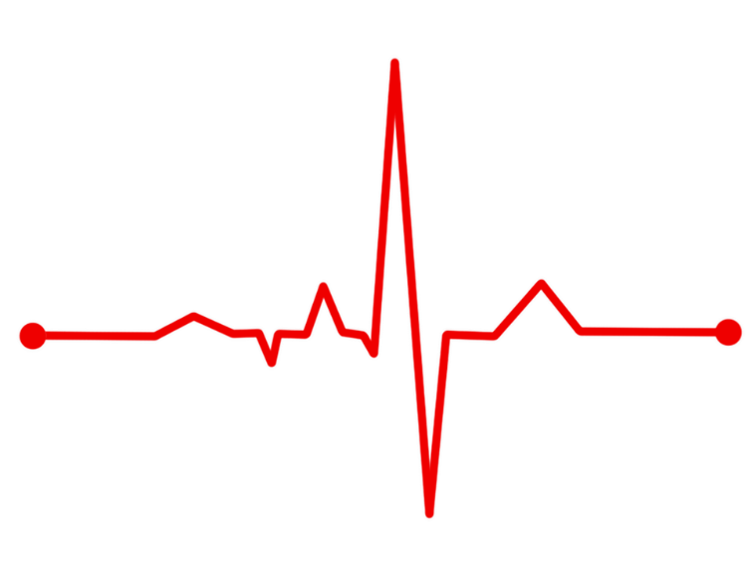
Physiological indicators
Heart rate
Body temperature
Galvanic Skin Response – measures the electrical conductivity of the skin
Measurable changes in physiological responses are probably the most reliable and least subjective means of indicating different states of consciousness during sleep and wakefulness.
there are weaknesses with using this method alone. It is limited in its ability to identify the participant’s private and personal conscious experience
The three main devices used to study states of consciousness, especially sleep, are the electroencephalograph, the electro-oculargraph and the electromyograph.
Images used under license from Pixabay

Slide 6
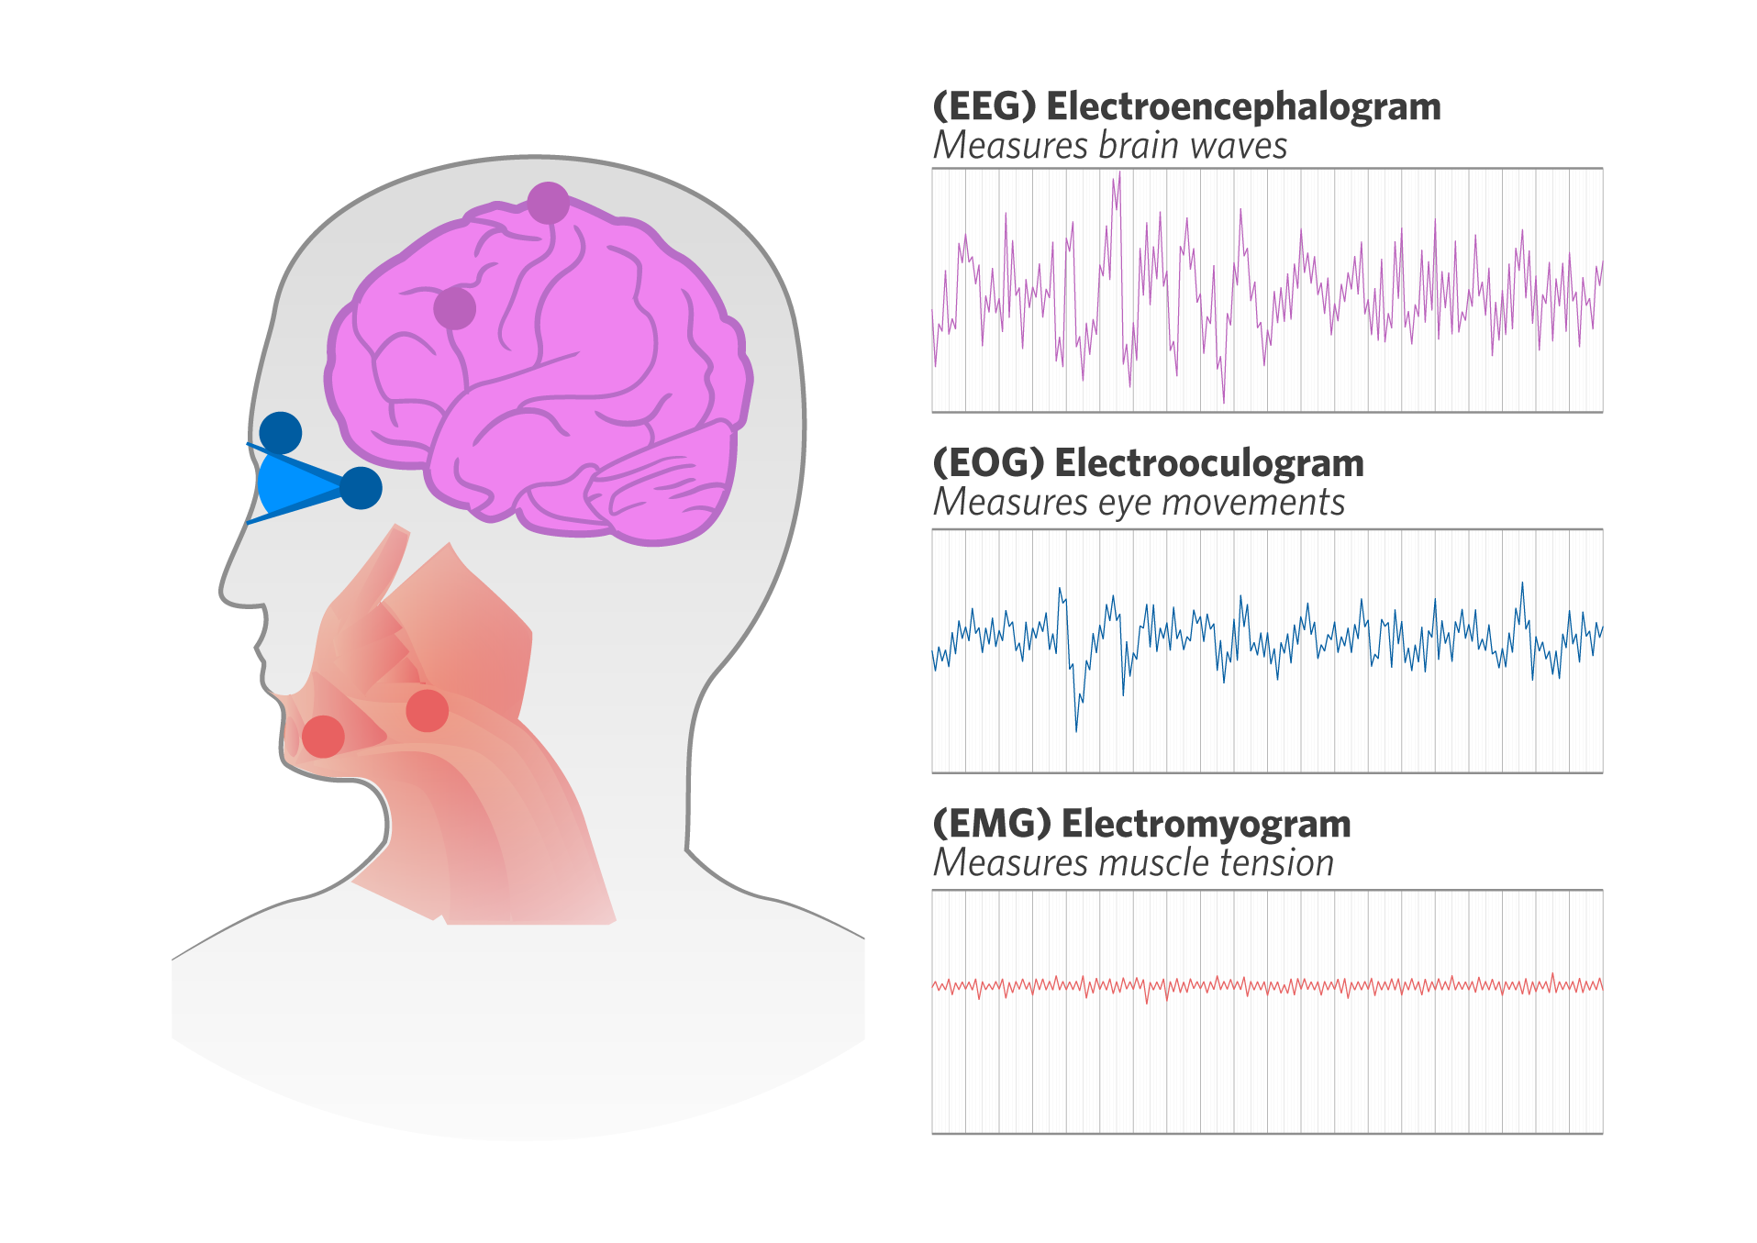
Important devices for measuring sleep
(EEG) Electroencephalograph
Detects, amplifies and records electrical activity of the brain (in the form of brainwaves)
(EOG) Electro-oculargraph
detects, amplifies and records electrical activity of the muscles surrounding the eyes
(EMG) Electromyograph
Detects, amplifies and records electrical activity of the muscles of the body.
Notes:
Can we please edit the definitions of these measurements:
Electroencephalograph (EEG) – detects, amplifies and records electrical activity of the brain (in the form of brainwaves)
Electro-oculargraph (EOG) – detects, amplifies and records electrical activity of the muscles surrounding the eyes.
Electromyograph (EMG) – detects, amplifies and records electrical activity of the muscles of the body.

Slide 7
Electroencephalograph
The electroencephalograph (EEG) is a device that detects, amplifies and records electrical activity in the brain in the form of brainwaves. It does this by monitoring the electrical activity of the brain that is detectable on the outside of the skull. Many tiny electrodes are placed on the skull in a symmetrical pattern (see Figure 13.2). These electrodes measure the very small voltages created by the synchronised activity of large numbers of neurons in the cerebral cortex.
EEG recordings indicate changes in brainwave activity associated with changes to states of consciousness, such as when a person is drowsy or alert, falls asleep, and the various stages of sleep, including the stage in which we are most likely to experience dreaming

Slide 8
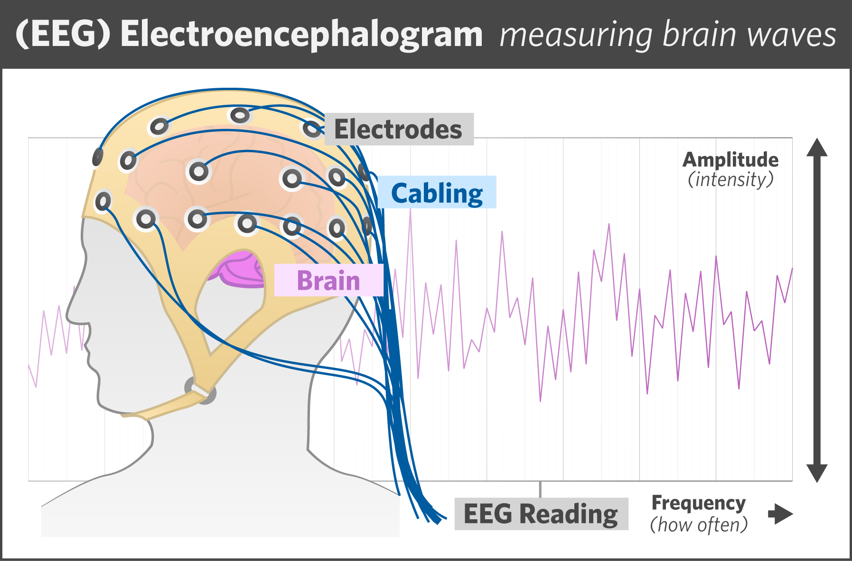
Electroencephalograph (EEG)
Electroencephalograph (EEG) – detects, amplifies and records electrical activity of the brain (in the form of brainwaves)
EEGs have so many uses - here one researcher explains how she uses an EEG: https://www.youtube.com/watch?v=YtbP8klTBZ0

Slide 9
BRAINWAVE PATTERNS
Brainwave patterns may vary in frequency (that is, the number of brainwaves per second). High-frequency brainwave patterns indicate faster brainwaves as demonstrated by more waves per unit of time (usually seconds). Frequency is measured in hertz (Hz: vibrations per second).
Brainwaves may also vary in amplitude (that is, the height of the peaks and troughs of the curved graph that represents brainwave activity). Amplitude is measured in microvolts (μV).
When we are awake and alert, we exhibit fast (high-frequency) and small (low- amplitude) brainwaves, known as beta waves. When we are awake but relaxed, we tend to exhibit alpha waves. In deep NREM sleep, we exhibit slow (low-frequency) and big (high-amplitude) brainwaves, known as delta waves. During stage 2 of NREM we experience medium frequency theta waves.

Slide 10
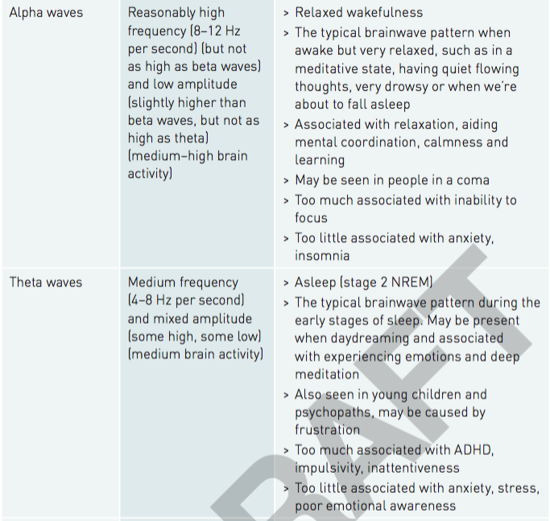

Slide 11
Other patterns or features, usually not very long-lasting, can occur during these brainwaves.
K-complexes (sharp rise and fall in amplitude, lasting or about two seconds)
sleep spindles (periodic bursts of rapid frequency) are indicative of stage 2 non–rapid eye movement (NREM) sleep.
Sawtooth waves are random, fast waves that are slightly bigger than alpha waves. They resemble waves for being awake but occur among the beta-like waves observed during rapid eye movement (REM) sleep. Sawtooth waves are associated with dreaming.

Slide 12
Summary of different brain waves
Our degree of alertness is associated with a range of different brain wave patterns.

Slide 13
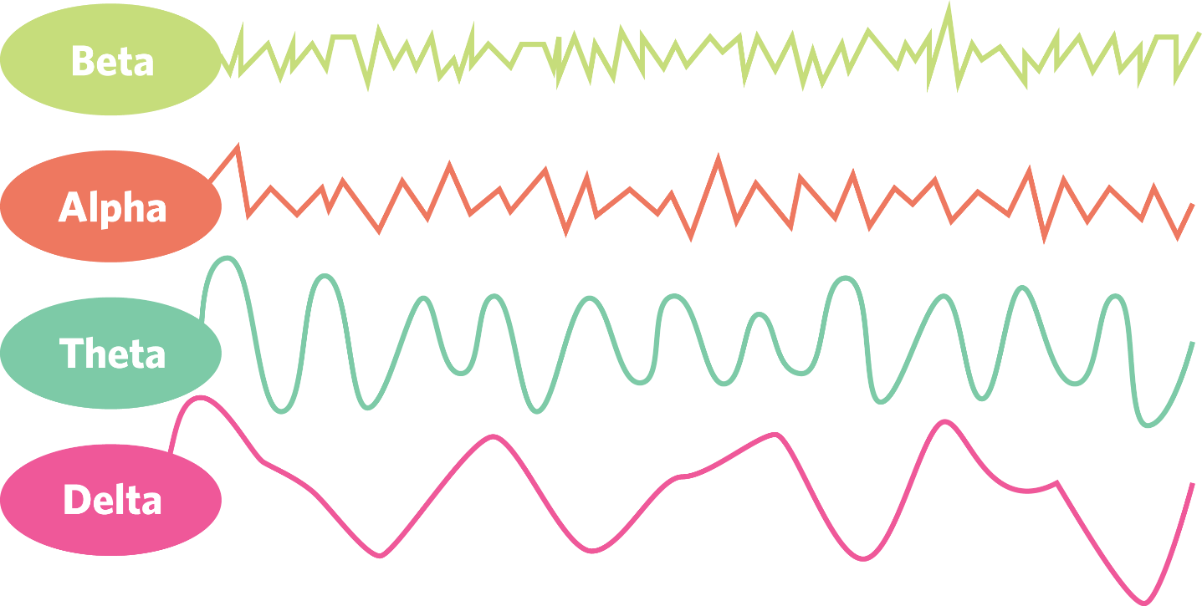
Brainwave | Frequency | Amplitude

Slide 14
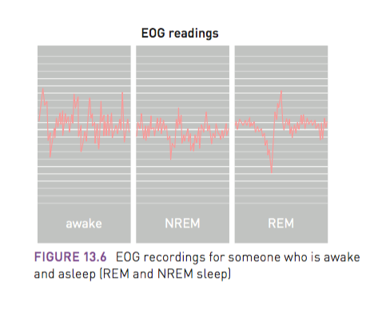
Electro-oculograph
The electro-oculograph (EOG) is a device that detects, amplifies and records electrical activity in the muscles that allow the eye to move. It measures changes in voltage as the eyes move and rotate in their sockets. Electrodes are attached to areas on the face around the eyes and the recording procedure is similar to that used for the EEG.
The EOG is particularly useful to determine whether a person is in REM or NREM sleep.
When we are awake, our eyes may move rapidly
depending on what we are doing visually at the
time.
EG. If you are staring out a window or thinking deeply
about an issue, there will be little eye movement.
If you are looking for a friend in a crowd, you
would expect more eye movement.

Slide 15
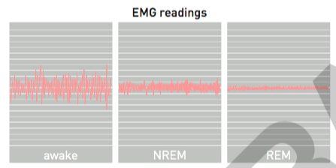
Electromyograph
Another device used to measure the stages of sleep is the electromyograph (EMG). The electromyograph is a device that detects, amplifies and records the electrical activity of muscles. Electrodes are attached to the skin directly above the muscles (usually the ones located under the chin) and the recording procedure is similar to that of an EEG and EOG.
The EMG can be useful to determine whether a person is awake or asleep and, if asleep, whether it is REM or NREM sleep. When someone is awake, activity on the EMG recordings varies between moderate and high, depending on the activity at the time.
During sleep, the activity is moderate to
low during NREM sleep (with some mild
spasms associated with light sleep) and
virtually non-existent during REM sleep.

Slide 17
Behavioural and cognitive measurements
We can use behavioural and cognitive measures to study consciousness, such as measuring a person’s performance on certain tasks. Behavioural and cognitive measures are more objective measurements than self-reports
Speed and accuracy on cognitive tasks
Measuring the speed and accuracy of cognitive tasks such as thinking, problem solving, language and reasoning during different times of the day or different states of consciousness can inform us of the characteristics associated with normal waking consciousness and altered states

Slide 18
Speed and accuracy on cognitive tasks
We can measure the speed and accuracy on performing the task over time, with the idea that as the task becomes more automatic, we become quicker and more accurate
Cognitive tasks: tasks that require mental processes and that have an easily specified correct outcome.
The speed and accuracy of responding are two measurements that are commonly used with cognitive tasks.
Measurement of speed: involves response or reaction time to a stimulus, usually measured in milliseconds.
For example: recording the time it takes to identify a hazard in a driving simulator and respond accordingly (hit the brakes or course correct).
Measurement of accuracy: the number of correct responses and incorrect responses (errors) made by the individual.
For example: the number of road stimuli correctly attended to in a driving simulator.

Slide 19
Subjective reporting
Subjective reporting measures, such as self-reporting or video monitoring, are also used to measure states of consciousness. While they may not be as accurate as EEG, EMG and EOG, they can still provide significant insight into our experience of consciousness.
Sleep diaries are often used when a person is experiencing sleep troubles such as sleep apnoea or insomnia and these can help sleep experts understand the participant’s experience. These are one form of self report

Slide 20
Self-reporting
Subjective reporting involves using self-reporting methods to obtain data. This data is considered subjective as it is based on a person’s opinion, interpretation, point or view or judgement. This type of data can be biased and inaccurate.
One type of subjective report to measure consciousness is a sleep diary.
Sleep diary: a self-reported record of an individual’s sleep and waking time activities, usually over the course of several weeks.
Sleep diaries are used to record information such as:
-Time of going to bed
-Time sleep began
-Number and length of time when waking during a night’s sleep
-Time of waking up in the morning
-How rested the person feels
-How tired they feel during the day
-Medications, stimulants or depressants taken
-Diet

Slide 21
Video monitoring
Video monitoring: most commonly used in the study of sleep and sleep disturbances or disorders.
Video monitoring, can provide an insight into how we behave in different states of consciousness.
Sleep labs or sleep centres will have a room with a camera installed. A person is then recorded as they sleep as normal.
Physiological changes are recorded on video to be examined by professionals.
Responses commonly observed include:
-Changes in posture or body position
-Amount of ‘tossing and turning’
-Sleep-related breathing problems
-What happens when waking from a nightmare or night terror
-Behaviours associated with sleepwalking

Slide 22
Measuring sleep Summary
Research Method | Description | Advantages | Limitations
Physiological measurements, including EEG, EOG and EMG
Measurement of speed and accuracy on cognitive tasks
Video monitoring
Self-reports, including subjective measures such as sleep diaries
Notes:
https://commons.wikimedia.org/wiki/File:U.S._Army_Sgt._1st_Class_Bobby_M._Scharton,_a_platoon_sergeant_with_the_17th_Fires_Brigade,_7th_Infantry_Division,_lies_down_during_a_sleep_study_at_Madigan_Army_Medical_Center,_Joint_Base_Lewis-McChord,_Wash_131122-A-BB790-286.jpg

Slide 23
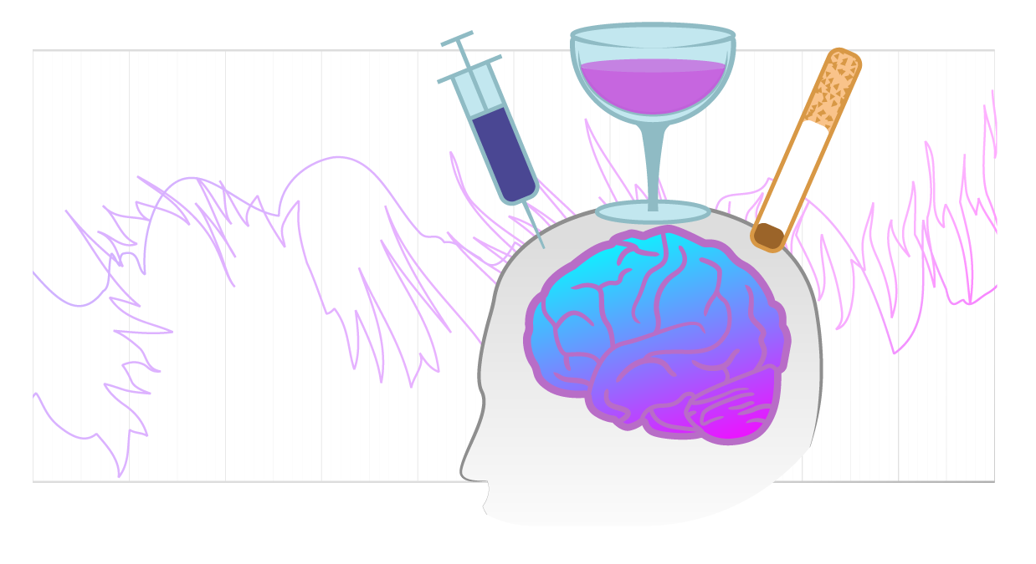
Drug use and brainwaves
Prescribed and legal drugs play a central role in our medical practice, having enormous benefits for our health and wellbeing, but also serious side effects as all drugs have hidden (or not so hidden) dangers. Illegal and prohibited substances have also infiltrated our society, often in unsavory and dangerous ways.
Psychoactive drugs are chemical substances that affect the nervous system and brain activity. They cross the blood–brain barrier and then alter our brain chemistry, usually by modifying (increasing or decreasing)
the activity of certain neurotransmitters
As a result, they impact on our consciousness by
altering thoughts, feelings, perceptions and behaviours.
Notes:
https://www.pexels.com/photo/gray-blister-pack-140123/

Slide 24
DEPRESSANTS
Depressants decrease (depress) nervous system activity. As such, they tend to decrease levels of alertness and can increase the presence of lower frequency brainwaves, such as delta, theta and alpha.
Depressants can be prescribed to help treat anxiety and insomnia and play a role in anaesthetics. They are dangerous in high doses as they may slow down the nervous system to the point of death. Alcohol, barbiturates and benzodiazepines are depressants commonly used in our society
Alcohol is often consumed to deliberately alter that person’s state of consciousness. The degree to which a person experiences the effects of alcohol depends on the rate of consumption, but generally as the level of alcohol in the blood increases, alertness decreases.

Slide 25
STIMULANTS
Stimulants increase (stimulate) nervous system activity. As such, they tend to increase the level of alertness and the presence of higher frequency brainwaves, such as alpha, beta and gamma.
They also increase autonomic nervous system activity, such as blood pressure and heart rate. There is a wide range of stimulants and how and why they are used and the dangers involved vary. Some stimulants, including nicotine, cocaine and amphetamines, are highly addictive and pose very serious and life-threatening side effects.
Notes:
Caffeine
When you have caffeine, your nervous system is quickly aroused and your brain’s beta-wave activity, and often gamma-wave activity, are increased, especially for those who are regular caffeine users. It is rapidly absorbed into the bloodstream and can still be traced some 24 hours after consumption.
Caffeine increases alertness and reduces sleepiness. In small doses, it may help you concentrate and may improve memory. However, high doses can make you feel very anxious and give you trouble sleeping

