Slide 1
VCE PSYCHOLOGY UNIT 3
HOW DO PEOPLE LEARN TO REMEMBER?

Slide 2
VCE PSYCHOLOGY
WHAT IS LEARNING AND MEMORY?
Study design dot point
Neural plasticity and changes to connections between neurons (including long-term potentiation and long-term depression) as the fundamental mechanisms of memory formation that leads to learning.

Slide 4
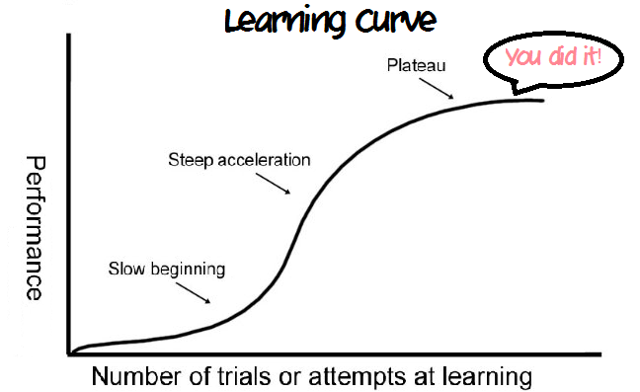
What is learning?
Learning is a relatively permanent change in behaviour that occurs as a result of experience. (remember the S curve)
(not called learning if it’s something that happens developmentally, or just goes away)
© Kristy Kendall & Edrolo 2017

Slide 5
Learning comes in many forms
Except for a range of physiological responses that are involuntary and normally occur automatically, such as breathing, digesting food, secreting hormones and blinking, most of what you do each day depends to a large degree on learning.
Your attitudes, values, beliefs, opinions, interests and decisions all involve learning. Many of our emotions are also learned or influenced signifi­cantly by learning.
Points to remember:
Learning can be intentional or unintentional
Learning can be easy or difficult
There are few behaviours that can not be learned (reflex actions, maturation and fixed action patterns in animals)
Learning happens in a variety of ways

Slide 6
What is memory?
Imagine for a moment what life would be like without your memory. You would have no recollection of what happened to you 2 seconds ago, 10 minutes ago or even 10 years ago. Without memory, every moment would be a new experience. Each person you met would be a stranger and each task you tackled would be a new challenge
Memory is an active information processing system that encodes, stores and recovers information when we need it.

Slide 7
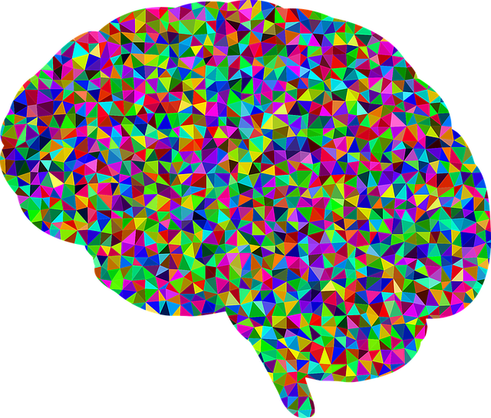
Memory is unique for all
Trillions of pieces of information bombard our senses. We only respond to a portion of this
how do we know what to respond to? How much can we remember (can only remember a little bit of what we respond to) For how long?
Memory is not a perfect replica of the world it is your personal interpretation.
Memories can change over time
Memories can be lost (psych problems, physical damage, disuse over time)
© Pixabay

Slide 8
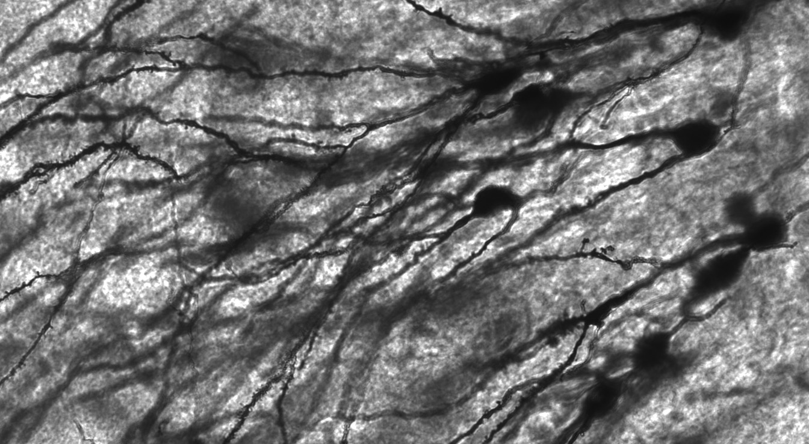
A memory trace….
You can see a memory due to changes in neural connections !!!

Slide 9
NEURAL PLASTICITY AND CHANGES TO CONNECTIONS BETWEEN NEURONS
we examine the neural basis of learning and memory, focusing on the brain’s plasticity and changes to connections between neurons that enable learning and memory to take place and demonstrate that learning and memory are actually inseparable.
The brain is capable of learning throughout the lifespan because of its neural plasticity. Neural plasticity refers to the way the brain changes in response to stimulation from the environment and is linked to the ability of the brain’s synapses to be modified

Slide 10
Developmental/Adaptive Plasticity
Developmental plasticity refers to the sequence of stages that the human brain progresses through from infancy to adulthood.
Changes to the brain occur more frequently in the foetal stage and in babies, children and adolescents. This process will diminish with age
Association areas of the cerebral cortices retain plasticity throughout life as a result of what is known as adaptive plasticity. During this process, adult humans continue to develop synapses as a result of stimulating experiences and changes in their environment.
Adaptive plasticity depends on the processes of Rerouting and Sprouting

Slide 11
Rerouting: An undamaged neuron that has lost its connection with an active neuron may seek a new active neuron and communicate with it instead.
Sprouting: The growth of more dendritic spines with more branches to enable new connections to be made.
Bothe enable the brain to compensate for brain injury and adapt to new experiences via the process of learning

Slide 13
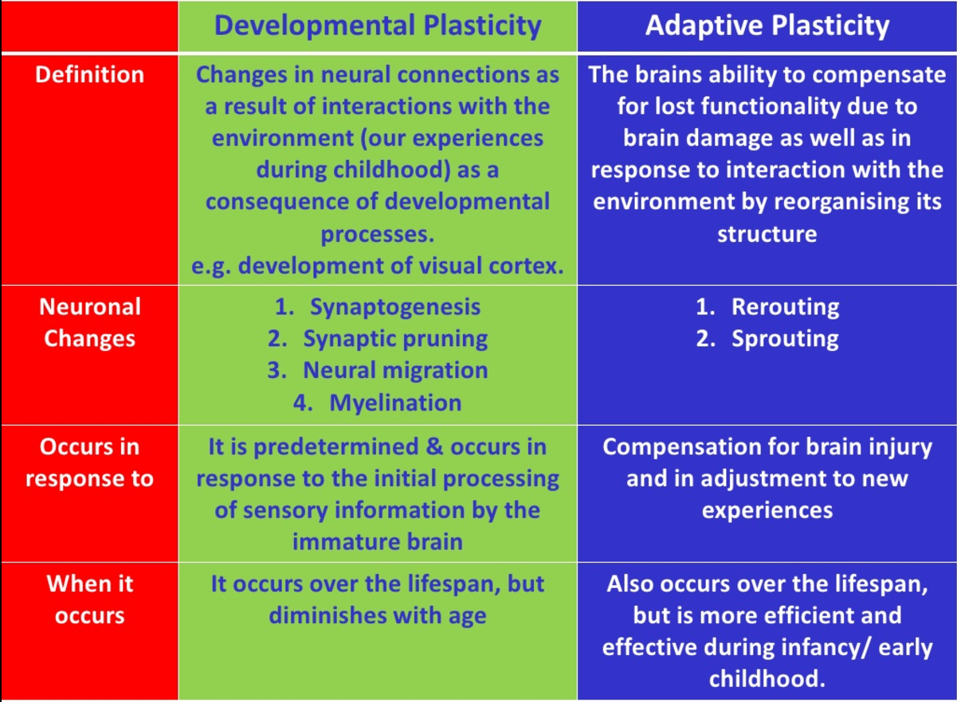

Slide 14
> proliferation – in the fetus where neurons grow and divide
> migration – where the cells move to the position they will occupy in the
developed nervous system
> circuit formation – where axons grow outwards and connect to adjacent neurons – neural impulses travel along these connections
> circuit pruning – at about ages 2–3 and again during early adolescence, circuits
that have not been used are ‘pruned’
> myelination –starts during fetal development to early adulthood (about age 23), myelin sheathing
is growing and insulating the axons to aid transmission of impulses from one neuron to the next.
Stages of developmental plasticity
Proliferation
Migration
Circuit formation
Circuit pruning
Myelination

Slide 15
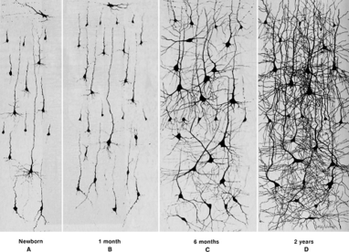
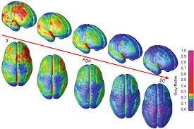
Optimal periods for neural development
Tthe brain of a developing individual is even more plastic than that of an adult, particularly at specific times in development when it seems that the brain is more responsive to certain types of experiences. This is one reason why young children tend to learn a new language more quickly than do adults. Similarly, infants tend to recover more quickly from brain damage than do adults due to the greater plasticity of their brain.

Slide 16
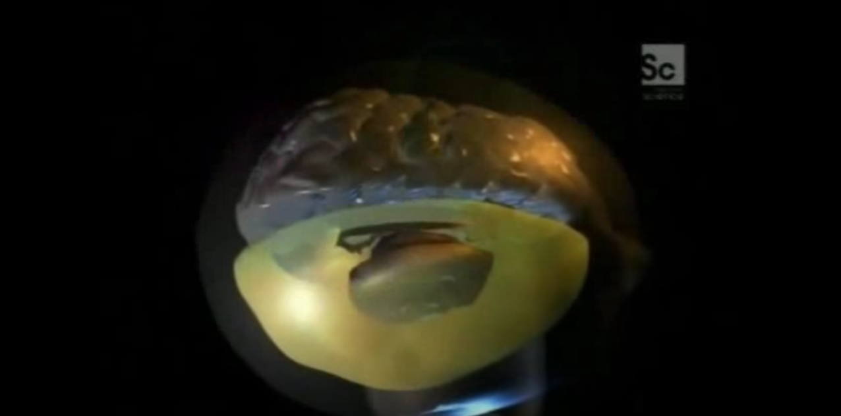
Neural plasticity
Developmental or adaptive?
Watch the remarkable story of Jody, the little girl with half a brain.
https://www.youtube.com/watch?v=VaDlLD97CLM
© Kristy Kendall & Edrolo 2017

Slide 17
Synaptic Plasticity
Synaptic plasticity refers to the ability of the synapse to change over time.
Change may occur through growth or formation of new synaptic connections that strengthen the synapse.
Change may occur through disuse of synaptic connections that weaken or eliminate the synapse.
Synaptic plasticity enables a flexible, efficient and effectively functioning nervous system. It is also the biological basis of learning and memory
Canadian psychologist Donald Hebb (1904–1985) is credited with the idea that learning involves the establishment and strengthening of neural connections at the synapse
For example, learning a list of new spelling words, to use a pogo stick, to play a harmonica or any other task will establish new neural connections, and regular practice of the task will strengthen these connections with the result that you get better at the task, become more efficient and make fewer mistakes

Slide 18
Hebb’s Rule: ‘neurons that fire together, wire together
According to Hebb when neurotransmitter is repeatedly sent across the synaptic gap, presynaptic and postsynaptic neurons are repeatedly activated at the same time.
When a presynaptic and a postsynaptic neuron are active at the same time, this changes the structure or chemistry of the synapse, strengthening the connections between these two neurons at the synapse.
When the synaptic connection is strengthened, this makes them more likely to fire together again and to transmit their signals more forcibly and efficiently in the future.
Conversely, not firing together — for example, through disuse — weakens the connections between neurons and also makes them less likely to fire together at the same time in the future.
Hebb’s explanation of changes to synaptic connections between neurons during learning is known as Hebb’s rule or Hebbian learning and is often summarized as ‘neurons that fire together, wire together’.

Slide 19
Neural processes involved in memory/learning
Synaptogenesis
the formation of a synapse between neurons
When learning takes place (and depending on the type of learning), existing synapses are sometimes moulded or new synapses are formed in a process known as synaptogenesis.
During learning, the terminal buttons of the presynaptic neuron release a neurotransmitter
called glutamate into the synapse between the presynaptic neuron and the dendrites of a neighbouring postsynaptic neuron. As the
process of learning and forming memory for new information or a new skill is acquired, the
neurons form new connections with each other.
The more a particular neural pathway is activated during learning, the more likely it is to be strengthened, and the less likely the learning will be forgotten.

Slide 20
Long-term potentiation (LTP)
Increase in synaptic strength through high frequency stimulation of synaptic pathway (related back to Hebb’s Rule)
The effect of LTP is to improve the ability of two neurons — a presynaptic and a postsynaptic neuron — to communicate with one another at the synapse
LTP strengthens synaptic connections to enable postsynaptic neurons to be more easily activated. The postsynaptic neurons become more and more responsive to the presynaptic neurons as a consequence of repeated stimulation by neurotransmitters.
The more that the connection is activated, the more the connection is strengthened. The more the connection is strengthened, the more the relevant neural pathway is strengthened, increasing the efficiency in transferring information along the pathway and decreasing the likelihood that what has been learned will be forgotten.
In addition, the more we use the information being remembered, the more the LTP process strengthens the pathway, making it easier to retrieve that information.

Slide 21
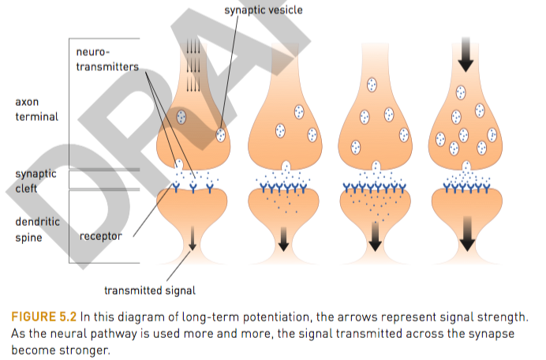
Strengthening of synaptic connections involves the formation of an increased number of vesicles, leading to an increased number of neurotransmitters being released, which in turn stimulates an increase in growth of dendritic spines to receive more neurotransmitters. LTP is one example of synaptic plasticity.

Slide 22
Long-term depression: ‘use it or lose it’
Just as long-term potentiation can strengthen a synapse, a similar process can weaken an existing synapse – all that has to happen is for the frequency of the electrical stimulation to be reduced
This results from lack of stimulation of pre- and postsynaptic neurons or prolonged low level stimulation. Basically, a postsynaptic neuron becomes less responsive to the neurotransmitter released by a presynaptic neuron and the effect is to weaken the synaptic connection and therefore weaken or even silence communication at the synapse (Bliss & Cooke, 2011).
It is believed that LTD may be just as important It is believed that LTD may be just as important for learning and memory as LTP. The weakening or elimination of unused synapses through LTD may prune unimportant or unwanted connections, leaving only the important connections that have been strengthened through repeated use by LTP.
LTD may enable old memories or unused connections and pathways for previously learned information or skills to be cleared out.
The process follows the ‘use it or lose it’ rule.

Slide 23
Fast five – Question 1
What is a relatively permanent change in behaviour as a result of experience?
© Kristy Kendall & Edrolo 2017

Slide 24
Fast five – Question 1 (Answer)
What is a relatively permanent change in behaviour as a result of experience?
Answer:
Learning
© Kristy Kendall & Edrolo 2017

Slide 25
Fast five – Question 2
What is an information processing system used to encode, store and recover information?
© Kristy Kendall & Edrolo 2017

Slide 26
Fast five – Question 2 (Answer)
What is an information processing system used to encode, store and recover information?
Answer:
Memory
© Kristy Kendall & Edrolo 2017

Slide 27
Fast five – Question 3
What is physical evidence of a memory known as?
© Kristy Kendall & Edrolo 2017

Slide 28
Fast five – Question 3 (Answer)
What is physical evidence of a memory known as?
Answer:
Memory trace
© Kristy Kendall & Edrolo 2017

Slide 29
Fast five – Question 4
What is the forming of a synapse known as?
© Kristy Kendall & Edrolo 2017

Slide 30
Fast five – Question 4 (Answer)
What is the forming of a synapse known as?
Answer:
Synaptogenesis
© Kristy Kendall & Edrolo 2017

Slide 31
Fast five – Question 5
What is the first stage of developmental plasticity?
© Kristy Kendall & Edrolo 2017

Slide 32
Fast five – Question 5 (Answer)
What is the first stage of developmental plasticity?
Response:
Proliferation
© Kristy Kendall & Edrolo 2017

Slide 33
Multiple choice activity
During learning, the role of neurotransmitters is to
transmit electrical impulses along the axon of a neuron.
receive chemical messages from the synaptic gap between neurons.
transmit chemical messages across the synaptic gap between neurons.
inhibit transmission of electro-chemical impulses across the synapse between neurons.
(VCAA 2012 Q1)
© Kristy Kendall & Edrolo 2017

Slide 34
Multiple choice (Response)
During learning, the role of neurotransmitters is to
transmit electrical impulses along the axon of a neuron.
receive chemical messages from the synaptic gap between neurons.
transmit chemical messages across the synaptic gap between neurons.
inhibit transmission of electro-chemical impulses across the synapse between neurons.
(VCAA 2012 Q1)
© Kristy Kendall & Edrolo 2017

Slide 35
Bringing it together
WHAT IS LEARNING AND MEMORY?
Study design dot point
Neural plasticity and changes to connections between neurons (including long-term potentiation and long-term depression) as the fundamental mechanisms of memory formation that leads to learning.
© Kristy Kendall & Edrolo 2017

