Slide 1
Data, conclusions and generalizations
Research methods continues!!!

Slide 2
TYPES Of DATA
The main difference between primary and secondary data is in who collects the original data.
Primary data is data collected directly by the researcher (or through others) for their own purpose, usually to test a hypothesis. It is collected from the source and is sometimes described as ‘ First hand’.
Secondary data is data that has been collected by someone other than the original user for their own purpose. It has been collected by some other individual or organisation (like second-hand).
For example, if you access data in a journal, book or at a website to complete a learning activity or SAC, then you will be using secondary data.
The Australian Bureau of Statistics is a widely used source of secondary data, as are the results reported by researchers in journal articles.

Slide 3
Advantages and disadvantages
Both types of data have their advantages and limitations. Primary data offers tailored information sought by the researcher to test a hypothesis on a topic of their choosing. To the researcher, there is little doubt about the quality of the data collected. They are also responsible for the quality of their data, but it can be time-consuming to collect and process.
Secondary data tends to be readily available and can usually be accessed in less time, especially if you know where and how to look. There can be uncertainty about its quality because it was collected for another purpose and there is often a need to comb through it to find what you’re looking for.

Slide 4
Qualitative and quantitative data
Primary and secondary data may be qualitative or quantitative.
Qualitative data is information about the ‘qualities’ or characteristics of what is being studied. They are descriptions, words, meanings, pictures and so on.
Quantitative data is numerical information on the ‘quantity’ or amount of what is being studied; that is, how much of something there is. This type of data is usually expressed in the form of units of measurement or numbers, such as raw scores, percentages, means, standard deviations and so on.

Slide 5
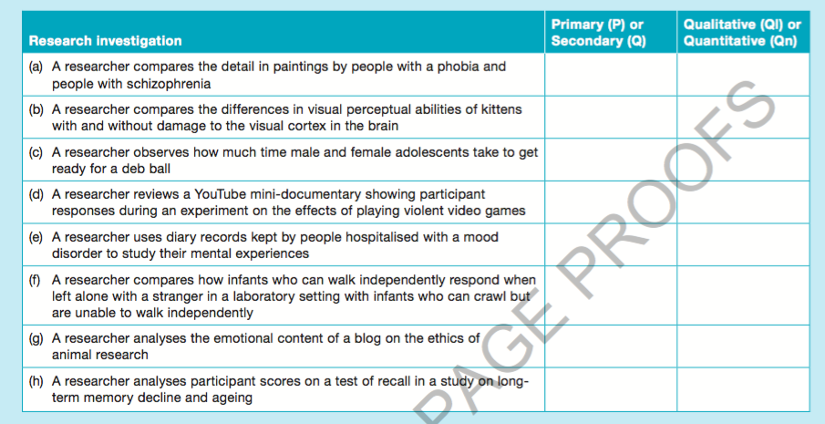

Slide 6
ORGAniSinG, PRESEnTinG AnD inTERPRETinG DATA
Statistics are essentially mathematical procedures. Two main types of statistics are used in psychology.
Descriptive statistics are used for analyzing, organizing, summarizing, presenting and describing results. If you have ever plotted a graph or calculated a percentage, you have already used descriptive statistics.
inferential statistics are used for interpreting and giving meaning to the results. Like descriptive statistics, inferential statistics involve the use of mathematical procedures. However, unlike descriptive statistics, inferential statistics involve judgments about the results. Inferential statistics apply a test of statistical significance to determine the extent to which chance factors may account for the results.

Slide 7
Different forms of descriptive stats
Includes
Tables
Bar charts
Graphs
Lines graphs
Percentages % = subtotal × 100
total 1
Mean as a measure of central tendancy (best used when scores evenly spread)
median as a measure of central tendancy (best used when scores widely spread)
standard deviation as a measure of variation around the mean

Slide 8
Conclusions and generalisations
When the results have been evaluated, evidence- based conclusions need to be drawn.
A conclusion is a decision about what the results obtained from research mean. All conclusions must be based on evidence (the results), be consistent with the evidence and relevant to what was actually investigated.

Slide 9
2 types of conclusions
Was the hypothesis supported/rejected
Was the hypothesis is supported or rejected on the basis of the results obtained. This requires careful examination of the results so that an objective (‘unbiased’) judgment can be made.
Although the results may indicate that the hypothesis is supported, the results may have been influenced by variables other than (or in addition to) the IV. Therefore, uncontrolled extraneous variables and potential confounding variables also need to be considered when drawing a conclusion. The researcher must be confident that any change in the DV was due to the IV alone and not any other variable.
a hypothesis may be supported/refuted (rejected), but it cannot be ‘proven’ true. This is because there may still be alternative explanations, some of which are not yet known or even thought of, that could better explain the outcome(s) that has been observed.

Slide 10
2. Can we generalization.
A generalization is a decision or judgment about how widely the findings of a research study can be applied, particularly to other members of the population from which the sample was drawn.
making a generalisation is a process of forming an idea about whether findings obtained from a limited number of cases (the sample) can be extended to apply to an entire class of objects, events or people (the population).
generalizing the results from the sample to the population is risky if the sample is not representative of the population of interest. Like any other conclusion, a generalization must also be based on the results obtained and must consider the potential extraneous and confounding variables,

Slide 11
The extent to which results can be generalized also depends on the topic studied. Many psychologists believe that researchers who study topics such as sensory processes and biological or physiological factors that underlie behaviour can more easily generalize their results. These phenomena are usually not affected by individual differences
Researchers who study topics such as personality, social behavior, attitudes, consciousness and learning or memory strategies tend to be less likely to generalize their findings. In these areas, the effect of the IV is often influenced by the individual characteristics of the person

