Slide 1
UNIT 4 AOS 1 How do levels of consciousness affect mental processes and behaviour?

Slide 2
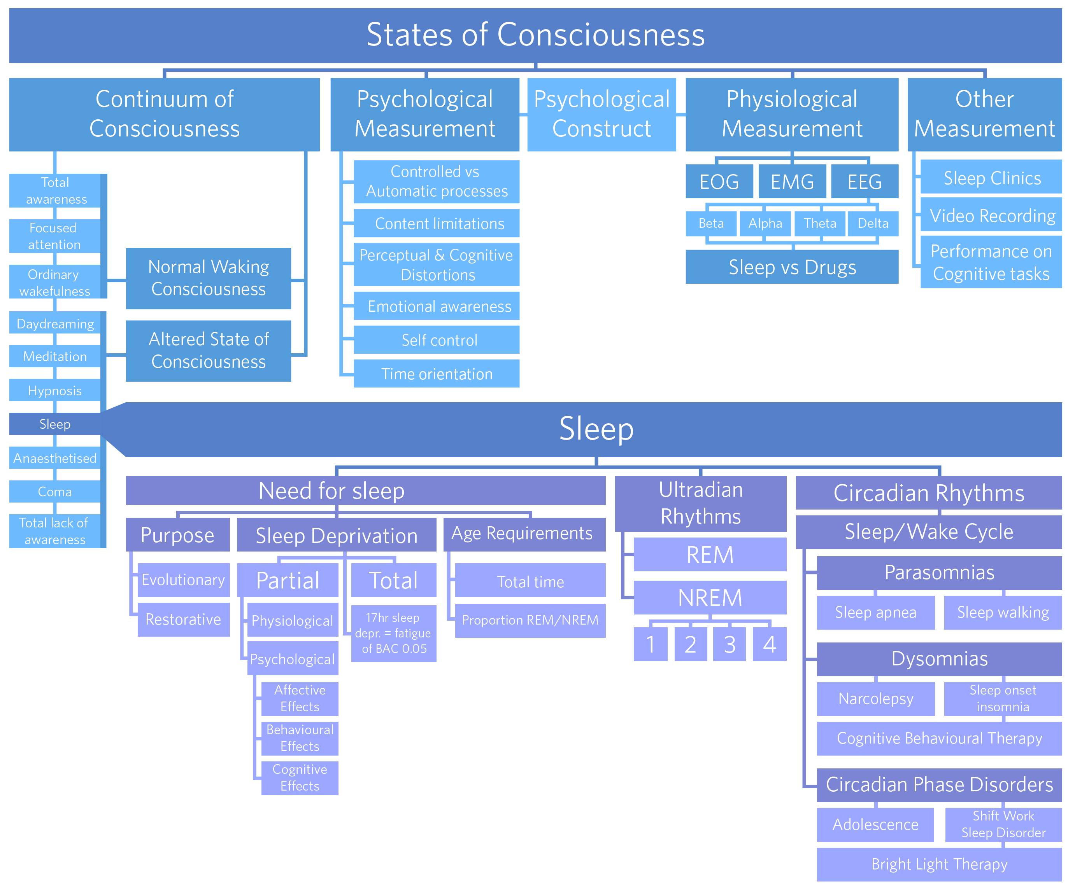
Notes:
Go over the areas – pointing out what’s new, what is not there and what is retained.

Slide 3
Dot Point #1: The consciousness continuum
consciousness as a psychological construct that varies along a continuum, broadly categorised into normal waking consciousness and altered states of consciousness (naturally occurring and induced)

Slide 4
Consciousness: Self Reflection Task

Slide 5
Self Reflection Task
1. Briefly describe your pattern of thought
Random: e.g. My foot is itchy; I wonder what I got on my Psychology Exam; I’m tired
Sequential: e.g. I’m hungry; I wonder what’s for lunch; Did I bring enough money for the canteen

Slide 6
3. Record the respective proportions of the categories that entered your awareness
Compare your results with others in the class
4. What factors do you feel would influence your awareness?
5. Based on your experience in this activity, write your OWN brief definition of consciousness
Category | Proportion (%)
Physiological
Emotional
Cognitive (factual or belief)
Awareness of external stimuli

Slide 7
What is consciousness?
The awareness of our thoughts, feelings and our environment at any moment in time.
Selective
Personal
Continuous
Changing

Slide 8
Psychological (Hypothetical) construct
Consciousness is said to be a “Psychological Construct” as it is an example of a psychological phenomenon that we know exists but cannot directly observe. We can measure its effects.
EXAMPLE: a student may look like they are attending in class but they might be thinking about what they need to do afterschool and not paying attention – ie: daydreaming (purposely induced)
Notes:
Image Free for personal and commercial use - No attribution required
http://passel.co/photos/480911/

Slide 9
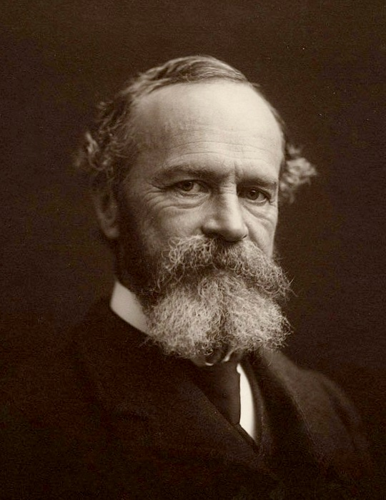
States of consciousness
William James (1890)… ’stream of consciousness – ever changing and flowing’
Our level of consciousness can be placed on a continuum, which ranges from being highly focused and alert through to having no thoughts, feelings or sensations at all.
William James in the 1890s
Source: en.wikimedia.org/
Notes:
https://upload.wikimedia.org/wikipedia/commons/9/9c/William_James_b1842c.jpg

Slide 10
Continuum of awareness activity

Slide 11
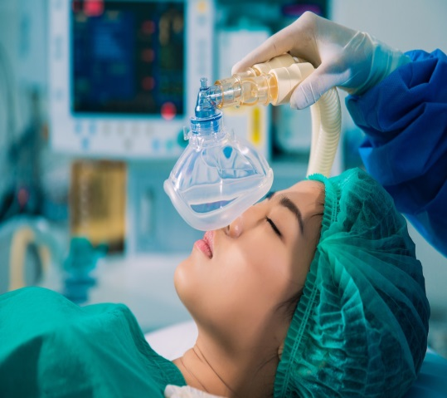
Continuum of Awareness
Total awareness
Focussed (NWC) attention
Ordinary (NWC) wakefulness
Daydreaming (ASC)
Meditation (ASC)
Hypnosis (ASC)
Sleep (ASC)
Anaesthetised (ASC)
Coma (ASC)
Total lack of awareness

Slide 12
Normal waking consciousness vs altered state of consciousness
Normal waking consciousness | Alerted states of consciousness
Focus attention Ordinary awareness Divided attention Controlled processes Automatic processes | Naturally occurring Sleep Daydreaming coma | Induced Mediation Alcohol-induced state Hypnosis Anaesthetised coma Sleep

Slide 13
Types of altered states of consciousness
Daydreaming – a naturally occurring altered state of consciousness where there is shift in awareness from external events → internal thoughts
Meditation – a purposely induced altered state of consciousness, where an individual is highly focused on an internal thought at the expense of other stimuli
Alcohol-induced state - a purposely induced altered state of consciousness, where a substance slows or depresses the brain and nervous system
Notes:
Image Free for personal and commercial use - No attribution required
http://passel.co/photos/480911/

Slide 14
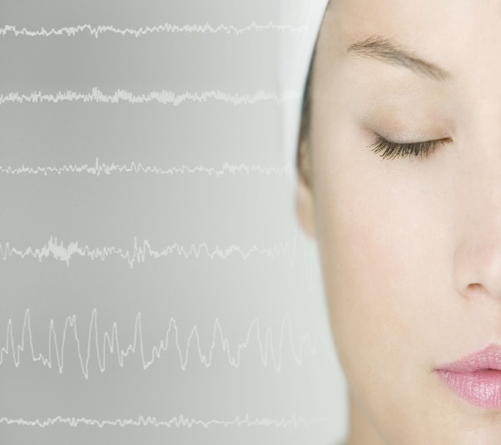
NWC vs ASC
Normal Waking Consciousness – awareness of your thoughts, feelings and behaviours, including internal and external events. Example.....
Altered State of Consciousness – any state characteristically different from normal waking consciousness in terms of awareness, thoughts, feelings and behaviours. Example....
Source: Startup Stock Photos
Source: Shutterstock
Source: Pixabay

Slide 15
Guided Meditation Activity
https://www.youtube.com/watch?v=i50ZAs7v9es
 | Anxiety levels BEFORE | Anxiety levels AFTER | Heart rate BEFORE | Heart rate AFTER
Difference scores
Anxiety level scale of 1 = very calm, 2 = calm, 3 = slightly tense, 4 = tense, 5 = very tense

Slide 16
Debrief:
How do you feel?
If you liked it, why? If you didn’t like it, why not?
Where did they notice tension in the body? Did it change? How? How do those areas feel now?

Slide 17
Scenario task

Slide 18
Youtube clips
https://www.youtube.com/watch?v=ir8XITVmeY4
https://www.youtube.com/watch?v=jReX7qKU2yc
https://www.youtube.com/watch?v=9PW1fwKjo-Y
https://www.youtube.com/watch?v=Sj43XjziamY
Homer trying to alter his state of consciousness
http://watchseries.do/series/the-simpsons/season/14/episode/2

Slide 19
Questions
Pg. 226 Review 12.1 Q1-3
Pg. 228 Review 12.2 Q1-3

Slide 20
Notes:
Go over the areas – pointing out what’s new, what is not there and what is retained.

Slide 21
Dot Point #2: Features of states of Consciousness
Changes in a person’s psychological state due to levels of awareness, controlled and automatic processes, content limitations, perceptual and cognitive distortions, emotional awareness, self-control and time orientation

Slide 22
The following characteristics/features help determine whether you are experiencing normal waking consciousness or an altered state of consciousness and highlight the changes in psychological state

Slide 23
The Stroop Effect

Slide 24
The Stroop Effect
Tendency is to automatically read the word
Reading is an automatic process
Takes much longer to state the colour of the ink as we have to prevent automatic processing and impose controlled processing

Slide 25
http://watchseries.do/series/the-simpsons/season/14/episode/2
Homer trying to alter his state of consciousness
List the various effects that Homer experienced while in an altered state of consciousness

Slide 26
Pg. 229-236: Comparing normal waking consciousness and altered states of consciousness
Feature | Normal waking consciousness | Altered states of consciousness
Awareness: How aware you are of the internal and external environment | Awake and generally aware of internal and external events. A good sense of place, time and reality e.g. Aware of the dogs barking outside | level of awareness either decreases or increases compared to normal waking consciousness e.g. When suffering from a fever, for example, you become less aware and therefore may not notice that the dogs are barking outside

Slide 27
Able to fairly accurately perceive the amount of time that has passed. e.g. when it feels as if 10 minutes have passed, about 10 minutes have actually passed | Emotional awareness: changes to emotional responses and the way they are experienced | Time orientation: estimation of time may be distorted, appear to move faster or slower | Cognitive distortions: changes in thinking such as illogical or disorganised thinking or delusions.
Able to think logically and clearly. Able to memorise and recall information accurately. e.g. better able to solve mathematical problems | Experience emotions that are appropriate. e.g. Feeling happy after receiving 90% on your SAC | Content limitation: The type of information that enters conscious awareness and can be controlled | Emotions may be dulled or heightened or may not be appropriately expressed. e.g. inappropriate emotional response such as laughing at someone that got hit by a car
Unable to coordinate actions and behaviours. Loss of inhibitions. e.g. you could be daydreaming (thoughts are internal) and unware that you are dribbling. | Able to complete automatic processes e.g. Talking and typing at the same time | Self-control: changes in ability to maintain self-control, such as co-ordinating movement | Able to complete controlled processes e.g. Learning to use a computer
Some automatic processes are impaired e.g. During an alcohol induced state reaction time is increased. | Unable to accurately perceive time; may feel as if time passes faster or slower. e.g. Woken up after a nap, may have slept for an hour, but felt you have been asleep for ages | Experience distorted perceptions of the world; may experience hallucinations or delusions. Reduces or heightens the experience of pain. e.g. During a drug induced state can make perceptions more vivid, colours brighter, tastes and smells appear stronger, noises louder, dull or highly sensitive touch. Hallucinations (hearing voices etc.) | Experience illogical thoughts that are fragmented. Unable to remember information accurately. e.g. during a daydreaming state you are less likely to hear what the teacher is saying in the classroom
Able to coordinate a sequence of movements and include fine motor skills. e.g. can walk along a footpath without falling over or running into people | Able to accurately perceive the world. Experience sensations that are real. e.g. have a clear awareness of the people in the classroom | Awareness: How aware you are of the internal and external environment | Controlled Processes: Involve conscious, alert awareness and mental effort.
Perceptual distortions: changes in sensory experiences such as hallucinations or heightened sensitivity to pain. | Automatic Processes: Require little conscious awareness and mental effort. | Level of awareness either decreases or increases compared to normal waking consciousness e.g. When suffering from a fever, for example, you become less aware and therefore may not notice that the dogs are barking outside | Lose control over what may enter. Illogical and disorganised e.g. During an alcohol induced state, your thoughts tend to be less logical, rational and sequential
Awake and generally aware of internal and external events. A good sense of place, time and reality e.g. Aware of the dogs barking outside | Limited ability to complete controlled processes e.g. have difficulty multitasking | Able to control what information enters. Information is organised and logical. e.g. When you are reading your psychology textbook you are able to read through the content in a logical manner

Slide 28
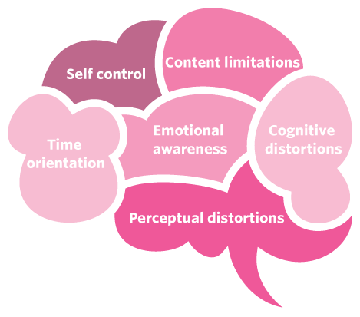
Psychological indicators

Slide 29
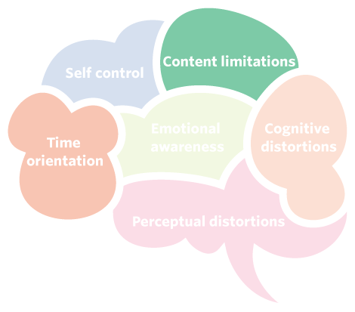
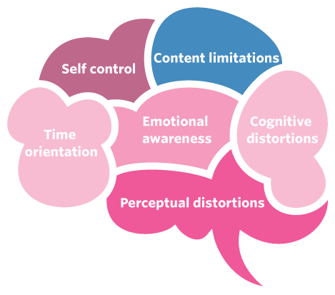
NWC vs ASC: Content limitations
NWC | ASC
Content is limited in type and amount. | Content is fairly unlimited, mainly due to lack of control.
Very few bizarre thoughts.
Image used under license from en.wikipedia.org

Slide 30
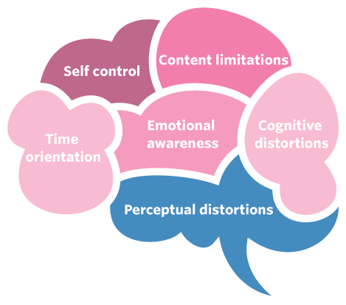
NWC vs ASC: Perceptual distortions
NWC | ASC
Sensations reflect reality | Perceptions can be dulled, e.g.
Perception is clear leading to heightened awareness of surroundings. | Perception can be heightened, e.g.
 | Sometimes perception is so distorted that people may lose their sense of identity.
Image used under license from en.wikipedia.org

Slide 31
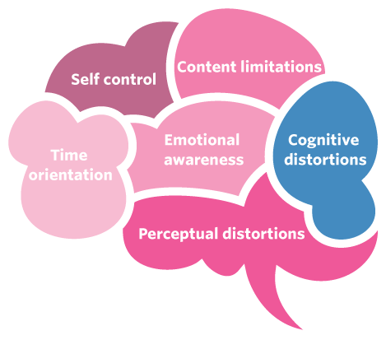
NWC vs ASC: Cognitive distortions
NWC | ASC
Cognition usually logical and organised. | Cognition is illogical and fragmented.
Effective memory functioning. | Memory is impaired.
Capable of analytical and logical thinking. | Cognitive distortions may occur, e.g. think people are trying to kill you.
Image used under license from en.wikipedia.org

Slide 32
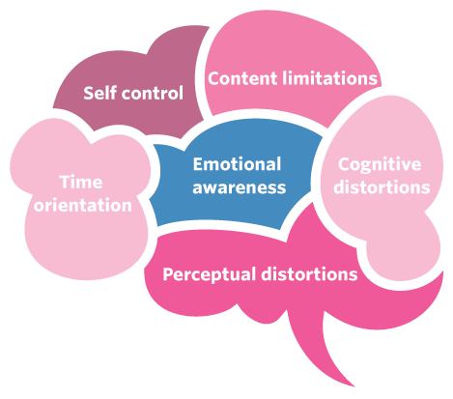
NWC vs ASC: Emotional awareness
NWC | ASC
Show normal range of appropriate emotions. | Emotional responses tend to be: Inappropriate, e.g. Heightened, e.g. Dulled, e.g.

Slide 33
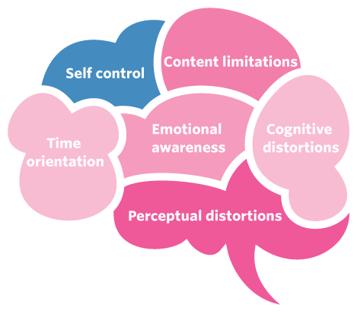
NWC vs ASC: Self-control
NWC | ASC
Awareness of self. | Self-control is compromised, e.g.: Asleep Drunk Hypnotised
Conscious ability to take control of behaviour.
Some psychological and physical limitations to self-control.

Slide 34
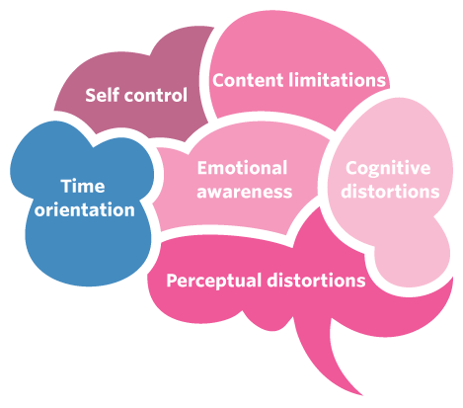
NWC vs ASC: Time orientation
NWC | ASC
Perception of time is accurate -e.g. 1 hour feels like 1 hour. | Sense of time is distorted - i.e. time could be perceived to be moving quicker or slower.
Awareness of past, present and future events.

Slide 35
Pg. 237 Investigate 12.5
Pg. 237 Review 12.3 Q1-3

Slide 36
Chapter Review Questions
Pg. 240 Q1-19

Slide 37
Chapter review answers
Test your understanding
Multiple choice
1 B; 2 D; 3 C; 4 D; 5 C; 6 D; 7 B; 8 D; 9 D; 10 D

Slide 38
Short answer
11. Define ‘consciousness’ and outline the idea that consciousness varies according to states.
Consciousness can be defined as the awareness of our own thoughts, feelings and perceptions (internal events) and our surroundings (external stimuli) at any given moment. Our level of awareness of internal events and external surroundings is known as a state of consciousness. States of consciousness are viewed as constantly changing on a continuum of awareness. States of consciousness are divided into two broad categories – normal waking consciousness and altered states of consciousness.
12a. Explain the concept of a psychological construct, giving consciousness as an example.
Psychological constructs are used to understand or explain things that we believe exist but cannot see, touch, or measure in any way. Consciousness is a psychological construct because it is believed to exist, but we are unable to physically measure it, so descriptions are ‘constructed’ to explain it.
b. Name some other psychological constructs you have been studying in Psychology this year.
Attitudes, personality, learning, mental health

Slide 39
13. Describe the defining difference between normal waking consciousness and altered states of consciousness.
Normal waking consciousness is the baseline state. An altered state of consciousness can be defined as any state of consciousness that deviates from normal waking consciousness, in terms of marked differences in our level of awareness, perceptions, memories, thinking, emotions, behaviours and sense of time, place and self-control.
14a.What is the ‘continuum of awareness’?
A range of different levels of awareness of internal state and external environment that a person may experience, going from deep unconsciousness to heightened awareness
b. Where does altered states of consciousness tend to be situated on the continuum of awareness?
An altered state of consciousness may reflect either heightened or reduced awareness.
15. Can we experience more than one state of consciousness during normal waking consciousness? Explain your answer.
When we have a real sense of place and time (normal waking consciousness), we experience many states of consciousness with different levels of awareness. We usually represent these continuous and ever-changing states by the term ‘normal waking consciousness’.

Slide 40
16. Give one example of naturally occurring altered states of consciousness and one example of deliberately induced altered states of consciousness.
Sleep is an example of a naturally occurring altered state of consciousness. An example of a deliberately induced altered state of consciousness is one caused by taking psychotic drugs.
17. Our psychological state of consciousness is tied to a number of different characteristics. Name and describe some of these characteristics.
•Level of awareness: that is, greater or less awareness of internal and external events
•Controlled and automatic processes: those on which you must actively focus to successfully complete the task, and those that require little mental effort and attention, respectively
•Content limitations: that is, the level of control to limit what you want to attend to
•Perceptual and cognitive distortions: the degree of awareness and efficiency of your perceptions and cognitions (thoughts and memories)
•Emotional awareness: the experience of emotions (feelings)
•Self-control: the ability to maintain self-control, usually in terms of monitoring behaviours
•Time orientation: the ability to correctly perceive the speed at which time passes

Slide 41
18. Playing ‘Advance Australia Fair’ on the piano can change with experience from being a controlled process to being an automatic process. Explain what this means.
When we first learn a new skill, it is difficult and thus a controlled process requiring a high level of awareness. When someone becomes more experienced, the skill becomes easier, requiring less awareness and attention. A good response will highlight understanding of automatic processes in terms of the ability to play ‘Advanced Australia Fair’ on the piano.
19. Marcel is working outside on an extremely hot day. As a result, he is experiencing an altered state of consciousness. What is he likely to experience, in terms of:
a. content limitations?
b. perceptual and cognitive distortions?
c. perception of time?
Content limitations may diminish, he may experience difficulty concentrating (cognitions) and he may become unaware of time orientation. A good response may describe these characteristics further by using an example and clearly displaying what is meant by each characteristic (e.g. understanding what content limitations means).

Slide 42
Notes:
Go over the areas – pointing out what’s new, what is not there and what is retained.

Slide 43
Dot Point #3/4: Measuring Consciousness
the measurement of physiological responses to indicate different states of consciousness, including electroencephalograph (EEG), electromyograph (EMG), electro-oculograph (EOG) and other techniques to investigate consciousness (measurement of speed and accuracy on cognitive tasks, subjective reporting of consciousness, including sleep diaries, and video monitoring)
changes in levels of alertness as indicated by brain wave patterns (beta, alpha, theta, delta) due to drug-induced altered states of consciousness (stimulants and depressants)

Slide 44
How do I tell if I am in an ASC?
There are many different things that can be measured to determine if an individual is an an ASC.
Behavioural and performance measures such as measurement of speed and accuracy on cognitive tasks are one way to gather evidence for someone experiencing an ASC.
Other measures include:
Physiological indicators | Psychological indicators
Heart rate Body temperature Galvanic Skin Response Eye movement Muscle movement Brainwaves | Content limitations Perceptual and cognitive distortions Emotional awareness Self control Time orientation

Slide 45
Physiological indicators
Heart rate
Body temperature
Galvanic Skin Response – measures the electrical conductivity of the skin
Images used under license from Pixabay

Slide 46
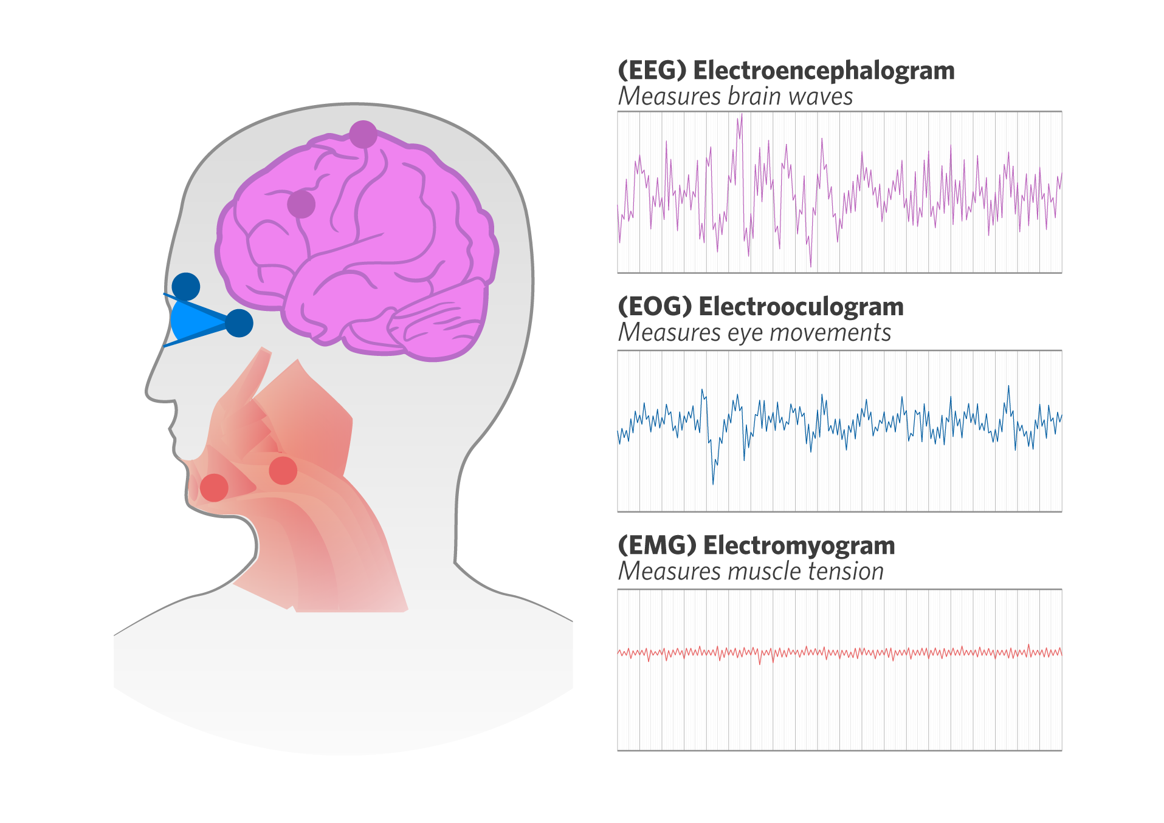
Important devices for measuring sleep
(EEG) Electroencephalograph
Detects, amplifies and records electrical activity of the brain (in the form of brainwaves)
https://www.youtube.com/watch?v=I3j2VrhqTAA
(EOG) Electro-oculargraph
detects, amplifies and records electrical activity of the muscles surrounding the eyes
(EMG) Electromyograph
Detects, amplifies and records electrical activity of the muscles of the body.
https://www.youtube.com/watch?v=gHsZ0bwxMsg
Notes:
Can we please edit the definitions of these measurements:
Electroencephalograph (EEG) – detects, amplifies and records electrical activity of the brain (in the form of brainwaves)
Electro-oculargraph (EOG) – detects, amplifies and records electrical activity of the muscles surrounding the eyes.
Electromyograph (EMG) – detects, amplifies and records electrical activity of the muscles of the body.

Slide 47
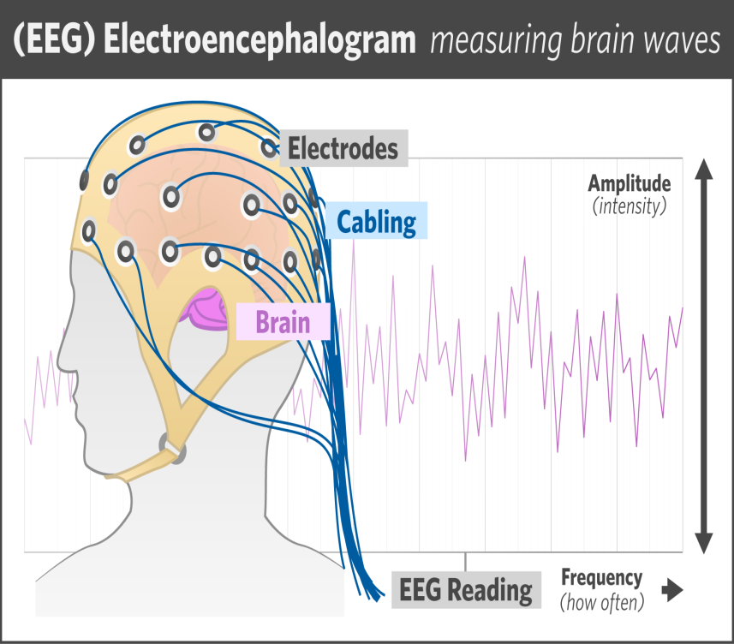
Electroencephalograph (EEG)
Electroencephalograph (EEG) – detects, amplifies and records electrical activity of the brain (in the form of brainwaves)

Slide 48
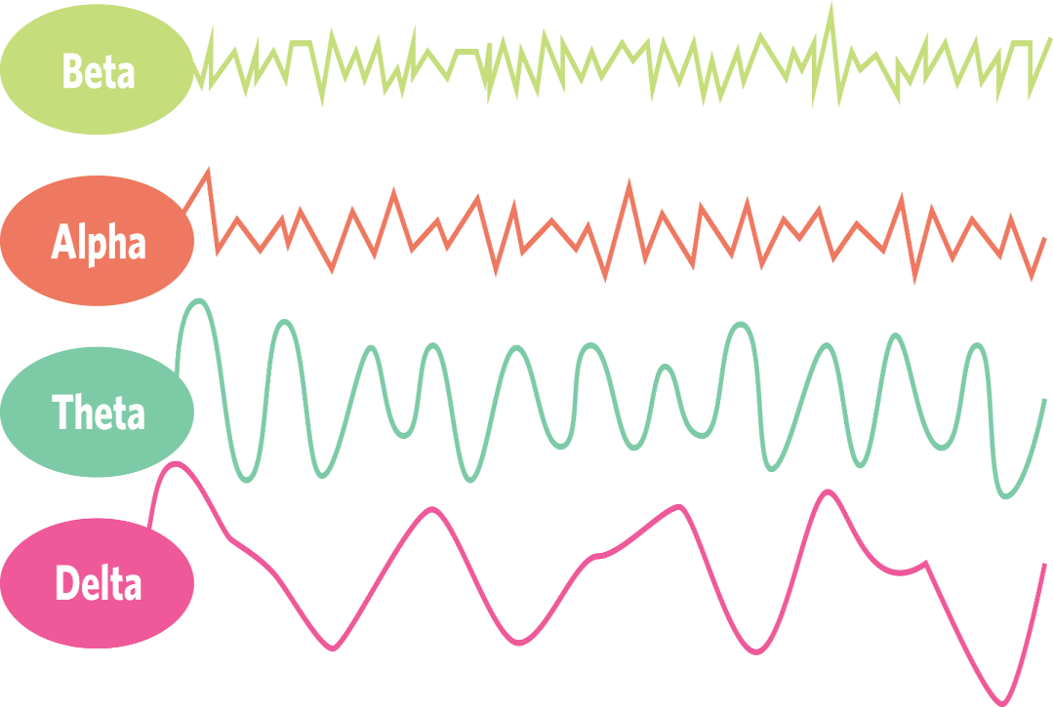
Brainwaves
Brainwave | Frequency | Amplitude
Beta | High | Low
Alpha | Medium | Low
Theta | Low | High
Delta | Lower | Higher

Slide 49
Brain wave activity
When do we see each type of brainwave?
How does sleep effect brainwaves?

Slide 50
Other techniques to investigate consciousness
cognitive tasks
subjective reporting (sleep diaries and video monitoring)

Slide 51
Cognitive Tasks
Cognitive tasks: tasks that require mental processes and that have an easily specified correct outcome.
The speed and accuracy of responding are two measurements that are commonly used with cognitive tasks.
Measurement of speed: involves response or reaction time to a stimulus, usually measured in milliseconds.
For example: recording the time it takes to identify a hazard in a driving simulator and respond accordingly (hit the brakes or course correct).
Measurement of accuracy: the number of correct responses and incorrect responses (errors) made by the individual.
For example: the number of road stimuli correctly attended to in a driving simulator.

Slide 52
Subjective reporting
Subjective reporting involves using self-reporting methods to obtain data. This data is considered subjective as it is based on a person’s opinion, interpretation, point or view or judgement. This type of data can be biased and inaccurate.
One type of subjective report to measure consciousness is a sleep diary.
Sleep diary: a self-reported record of an individual’s sleep and waking time activities, usually over the course of several weeks.
Sleep diaries are used to record information such as:
-Time of going to bed
-Time sleep began
-Number and length of time when waking during a night’s sleep
-Time of waking up in the morning
-How rested the person feels
-How tired they feel during the day
-Medications, stimulants or depressants taken
-Diet

Slide 53
Subjective reporting
Video monitoring: most commonly used in the study of sleep and sleep disturbances or disorders.
Sleep labs or sleep centres will have a room with a camera installed. A person is then recorded as they sleep as normal.
Physiological changes are recorded on video to be examined by professionals.
Responses commonly observed include:
-Changes in posture or body position
-Amount of ‘tossing and turning’
-Sleep-related breathing problems
-What happens when waking from a nightmare or night terror
-Behaviours associated with sleepwalking

Slide 54
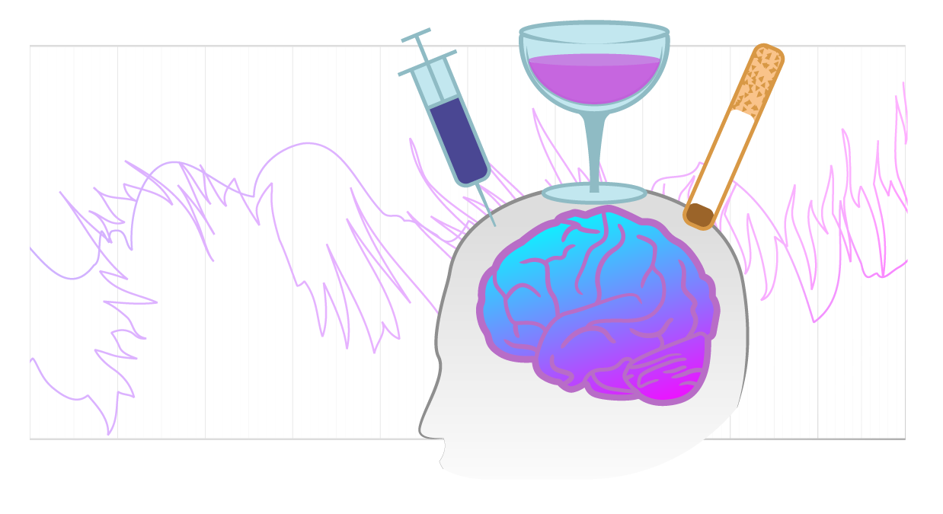
Drug use and brainwaves
How does drug use, both prescribed and unprescribed, effect brainwaves?
ADHD
Stimulants vs depressants
Notes:
https://www.pexels.com/photo/gray-blister-pack-140123/

