Slide 1
VCE PSYCHOLOGY
Research into social learning
Presented by Kristy Kendall
Study design dot point
Observational learning as a method of social learning, particularly in children, involving attention, retention, reproduction, motivation and reinforcement
© Kristy Kendall & Edrolo 2017

Slide 2
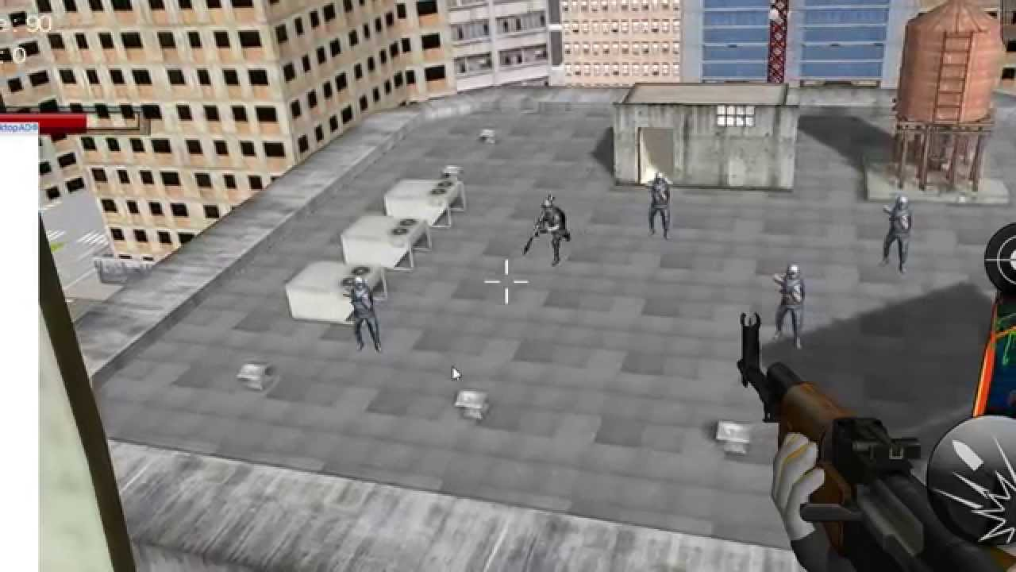
https://i.ytimg.com/vi/Wd3lyCl2wH8/maxresdefault.jpg
© Kristy Kendall & Edrolo 2017

Slide 3
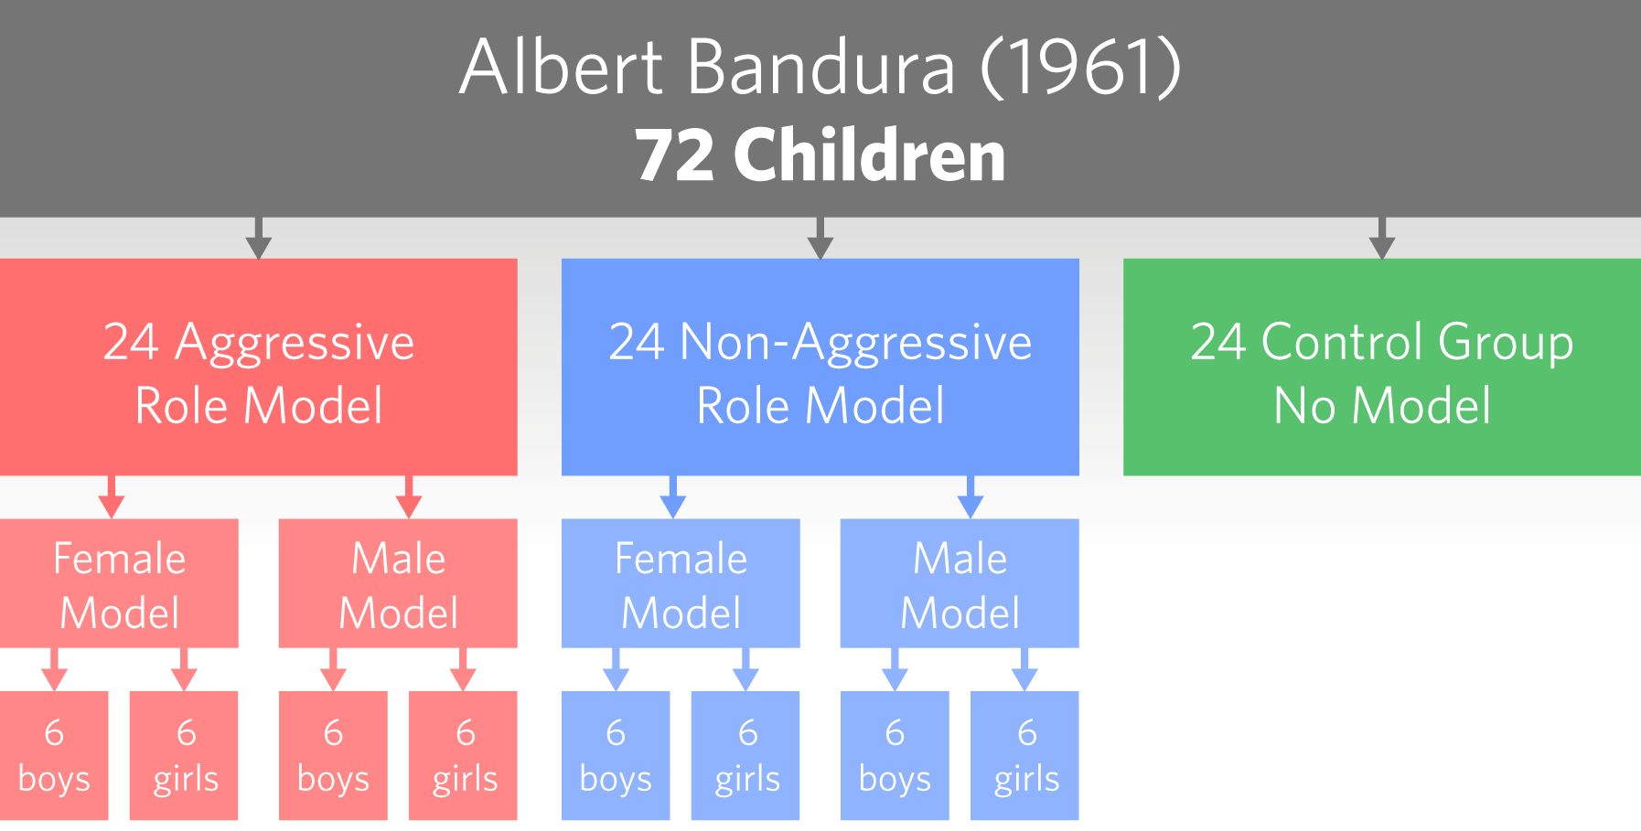
© Kristy Kendall & Edrolo 2017

Slide 4
Bobo Doll Experiments
Children watched an adult model show aggressive behavior toward a Bobo doll. Three experimental conditions:
Condition 1: The aggressive model was rewarded with lollies, soft drink and praise by another adult.
Condition 2: The aggressive model was punished with a spanking and verbal criticisms such as ‘Hey there, you big bully! Quit picking on that clown.’
Condition 3: There were no consequences whatsoever for the aggressor’s behaviour — the model was neither rewarded nor punished.

Slide 5
Results
Following exposure to the model in the movie, each child was placed individually in a room that had many toys and a BoBo doll. The child’s behaviour was then observed through a one-way mirror to see whether they imitated the aggressive model’s behaviour in any way. Some children were offered rewards such as fruit juice, stickers and praise for imitating the model’s behaviour, while others were not.
The results indicated that the consequences (or lack of them) for the adult model in the movie made a difference to the subsequent behaviour displayed by the children who saw them. This finding supports Bandura’s argument that observational learning is not totally separate from conditioning. Children who watched the aggressive model either being reinforced or experiencing no consequences for their aggressive behaviour imitated aggressive behaviour more than the children who watched the aggressive model being punished. When children were offered a reward (positive reinforcer) for imitating the model’s aggressive behaviour, even children who had seen the model punished tended to imitate the model’s behaviour by behaving more aggressively.

Slide 6
Although the boys were more aggressive than the girls in all three conditions, the girls were nearly as aggressive as the boys if they were offered a reward.
Importantly, the results also indicate that observational learning can sometimes occur by simply viewing a model even if the model is neither reinforced nor punished.

Slide 7
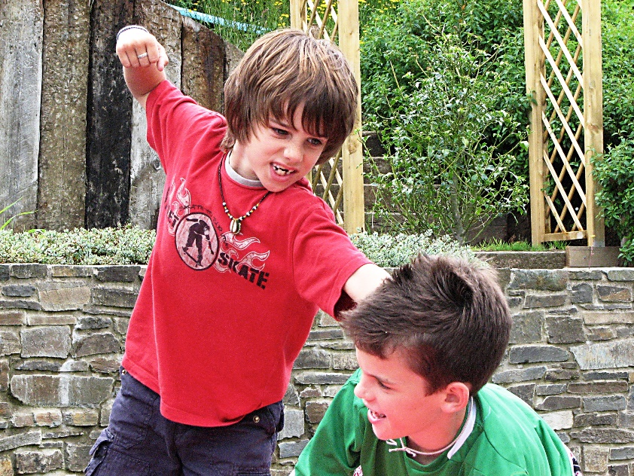
YouTube video - Albert Bandura (1961)
Boys more aggressive than girls
More aggressive when watching aggressive model
Non-aggressive model led to least aggression
Watch the original experiment here:
https://www.youtube.com/watch?v=NjTxQy_U3ac
https://upload.wikimedia.org/wikipedia/commons/3/3b/Sibling_Conflict.jpg
© Kristy Kendall & Edrolo 2017

Slide 8
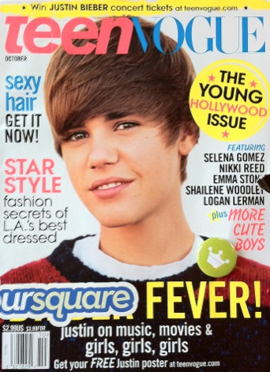
Characteristics of a model
According to Bandura (1977a), we pay closer attention and are more likely to
imitate models who have the following characteristics:
the model is perceived positively, is liked and has a high status
there are perceived similarities between features and traits of the model and the
observer, such as age and sex
the model is familiar to the observer and is known through previous observation
the model’s behaviour is visible and stands out clearly against other ‘competing’
models
5. the model is demonstrating behaviour that the observer perceives themselves as
being able to imitate.
In general, the greater the similarity between model and observer, and the more
attractive or successful the model, the more likely we are to follow their example.
Research studies also indicate that the higher the status of the model, the more the
observer will imitate the behaviour — which is why many advertisements feature celebrities.

Slide 9
Success of Social learning
Social learning is a powerful form of learning
Parents and friends are the most powerful models
Modelled consequences are a powerful learning tool
According to social learning theory the following elements are important for observational learning to be successful or not:
For the behaviour to be copied, the model must be seen to be rewarded for the appropriate or inappropriate social behaviour. Models who are seen to be rewarded for their behaviour are more likely to be copied than models who are seen to be punished, or where there is no follow-up.
The model must be appropriate for the learner (appropriate models for a child might be parents, siblings or peers).
The learning can occur in real life, or through behaviour modelled in film or on television.
This is why, for society, it is important to be aware of the potential influence of role models, especially on children. It is also important that role models who behave in anti-social ways are seen to receive negative consequences.

Slide 10
Fast five – Question 1
What was the name of the research best known for his work in social learning?
© Kristy Kendall & Edrolo 2017

Slide 11
Fast five – Question 1 (Answer)
What was the name of the research best known for his work in social learning?
Answer:
Bandura
© Kristy Kendall & Edrolo 2017

Slide 12
Fast five – Question 2
What did children who saw an aggressive model do when they saw the Bobo doll?
© Kristy Kendall & Edrolo 2017

Slide 13
Fast five – Question 2 (Answer)
What did children who saw an aggressive model do when they saw the Bobo doll?
Answer:
Acted aggressively
© Kristy Kendall & Edrolo 2017

Slide 14
Fast five – Question 3
Which gender was more aggressive in Bandura’s research?
© Kristy Kendall & Edrolo 2017

Slide 15
Fast five – Question 3 (Answer)
Which gender was more aggressive in Bandura’s research?
Answer:
Boys
© Kristy Kendall & Edrolo 2017

Slide 16
Fast five – Question 4
True or false: Live models produced greater number of aggressive acts in children than cartoon models.
© Kristy Kendall & Edrolo 2017

Slide 17
Fast five – Question 4 (Answer)
True or false: Live models produced greater number of aggressive acts in children than cartoon models.
Answer:
True
© Kristy Kendall & Edrolo 2017

Slide 18
Fast five – Question 5
True or false: Children who viewed aggressive acts punished still acted as aggressively as those who saw them rewarded.
© Kristy Kendall & Edrolo 2017

Slide 19
Fast five – Question 5 (Answer)
True or false: Children who viewed aggressive acts punished still acted as aggressively as those who saw them rewarded.
Answer:
False
© Kristy Kendall & Edrolo 2017

Slide 20
Multiple choice activity
With reference to Bandura’s research in which children watched an adult model interact aggressively with a Bobo doll, which statement is most correct?
Children never imitated the adult model’s behaviour.
Boys and girls were equally aggressive to the Bobo doll in all conditions.
Children who watched the adult model being punished were less likely to imitate aggressive behaviour.
Girls always imitated the adult model’s behaviour, whereas boys did not imitate the adult model’s behaviour.
(VCAA 2012 Exam 2 Section A Q17)
© Kristy Kendall & Edrolo 2017

Slide 21
Multiple choice (Response)
With reference to Bandura’s research in which children watched an adult model interact aggressively with a Bobo doll, which statement is most correct?
Children never imitated the adult model’s behaviour.
Boys and girls were equally aggressive to the Bobo doll in all conditions.
Children who watched the adult model being punished were less likely to imitate aggressive behaviour.
Girls always imitated the adult model’s behaviour, whereas boys did not imitate the adult model’s behaviour.
(VCAA 2012 Exam 2 Section A Q17)
© Kristy Kendall & Edrolo 2017

Slide 22
Short Answer Activity – Write a response
Describe two factors that could influence the likelihood of you imitating a model’s behaviour.
(2 marks)
(VCAA Unit 4 - 2005 Q4)
© Kristy Kendall & Edrolo 2016

Slide 23
Short Answer - Response
Describe two factors that could influence the likelihood of you imitating a model’s behaviour.
(2 marks)
(VCAA Unit 4 - 2005 Q4)
© Kristy Kendall & Edrolo 2016

Slide 24
Short Answer Activity – Mark your response
Describe two factors that could influence the likelihood of you imitating a model’s behaviour.
(2 marks)
Marking Criteria | Mark allocation
Describe one factor that would influence a person to imitate a model | 1 mark
Describe one factor that would influence a person to imitate a model | 1 mark
(VCAA Unit 4 - 2005 Q4)
© Kristy Kendall & Edrolo 2016

Slide 25
Bringing it together
Research into social learning
Study design dot point
Observational learning as a method of social learning, particularly in children, involving attention, retention, reproduction, motivation and reinforcement
© Kristy Kendall & Edrolo 2017

